Slide 1
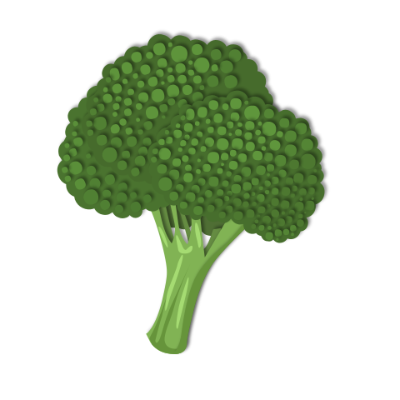


Relationship
Bistro
A MENU of options to build connections with your students throughout the year

Slide 2

My students don’t need me to learn. They need me to care.
-Liz Galarza
Tip Purposefully plan for relationship development in the first few weeks of school. Continue to build relationships with and amongst students throughout the year with weekly or monthly activities.

Slide 3

Starters
Name Pronunciation
What’s in a name?
Useless Facts
Ask students to record their names using padlet or as an audio message to ensure that you and their classmates are pronouncing their name correctly.
Ask students to write or tell about the story of their name. They may need some advance warning so they can ask at home if they don’t already know.
Students share a mundane fact about themselves with the class. “I hate mustard.” is less scary to share than revealing you didn’t do anything fun on vacation.
Name Posters
Find Someone Who
Help Me, Help You
Invite students to design and decorate their names on large paper. Hang them up as classroom decorations.
A traditional icebreaker that has students move throughout the room, looking for classmates that meet the criteria on the page.
On an index card, students share information with their teacher about how to best support them this year (or in this subject)

Slide 4
Bigger Bites
Learn Something New
Morning Meeting
Vision Boards
Commit to time throughout the year (or term) for students to acquire a new skill or greater knowledge around an area of interest.
Done daily or weekly, morning meetings are chance to check in and share how things are going.
Using collage of images or words, students highlight goals for the upcoming year or well into the future.
You’ve Got Mail
Commit to sending each of your students a postcard (in the mail) at some point in the school year, highlighting their strengths or recent achievements

Slide 5
Bigger Bites
This Is Me
Show and Tell
One Word
Students build webs, one-pager, or infographics, sharing facts and details about what makes them unique.
Invite students to share an object of significance with the class or in small groups. It could be a talent or area of interest.
Students complete an identity exercise to arrive at one word. This word is displayed in the classroom throughout the year.
What I Bring
Students are invited to share what they bring with them into the classroom each day.

Slide 6
Just for Fun
Exit Slips
Would you rather?
Puzzle in Progress
While usually used for formative assessment, ask students about weekend plans on an exit slip and then follow up with questions and/or conversations on Monday.
Students need to choose between two choices. Discuss choices as a class or in small groups.
Set aside space in your classroom to collaborate on a giant puzzle. Students can work on it when their work is done or if they need some quiet time to reset.
Be Inspirational
Say Hello
Classroom Hashtag
Offering sincere, inspirational messages to your students might be what you need to carry you through.
Greet your students by name at the door as they come in. Smile. Be welcoming. Learn how to say hello in the language(s) your students use at home.
Make a classroom twitter account and hashtag. Ask students to take on the role of social media content creator.

Slide 7
Take It Home
Good News
You’ve Got Homework
Survey Says
Plan to make good news phone calls (not texts or emails) home in the first few weeks of school. Parents will appreciate connecting with you.
Ask parents to tell you about their child(ren). In a million words or less, talk about strengths, challenges, interests, etc.
Send out a survey to parents (either electronically or paper copy) to learn more about their child(ren) and how to best connect with them throughout the year.
Celebrate Learning
Use time during parent-teacher conferences or schedule your own open-house night to highlight learning that students have selected to share.

Slide 8

Help Me, Help You
starter
Supplies
Index Cards Writing Tool Prompts (see below)
Instructions
Give each student an index card.
Ask students to complete the following sentences on the card. Feel free to add your own ideas to the list.
Name/ Preferred to be called.
I learn best when...
If you are proud of me please…
If I am angry please….
I hope we…
I hope we don’t…
If calling home, please talk to…
Success to me is...
BACK TO STARTERS

Slide 9
Name Pronunciation
starter
Supplies
Padlet or similar short video posting tool
Instructions
Provide students the code or link to upload/record a video or audio clip of themselves saying their name (first and last) several times.
Alternative Activity -- 60s Selfie Students are given a one minute video slot to record share their names, interesting facts, likes, dislikes, hopes for the class, etc.
BACK TO STARTERS

Slide 10
Find Someone Who
starter
Supplies
Copies of the scavenger hunt for each student Writing tools
Instructions
Give each student a copy of the “Find Someone Who” sheet. You can use this one, or make one yourself.
Set a timer and have students see which connections they can make.
BACK TO STARTERS

Slide 11
You’ve Got Mail
bigger bites
Supplies
Postcards* Student mailing addresses and postage
Instructions
Pre-label each postcard with your students’ addresses.
Throughout the year, write a postcard to each of your students that highlights their strengths or recent achievements.
*Consider asking students to design the postcards that you will mail out. You can also design your own with Canva or similar software. You can have them printed using a local printer, or an online service such as VistaPrint.
BACK TO BIGGER BITES

Slide 12
One Word*
bigger bites
Supplies
Identity Page Paper and coloring things for decorated word
Instructions
Hand out identity page (or simply have them create a five pronged web with their name in the middle). Model how you might complete this web personally, noting that there is no ‘right or wrong’ way to do this.
Support conversation and discussion as you and your students cross off a word from the list, one at a time. Be prepared for much fretting as you begin to narrow down their diverse identities.
Once they have arrived at their one word, ask them to decorate their word for display. Put up as a representation of the diversity in your learning space
*Idea from Tom Rademacher Before I Come Into Your Classroom, Let Me Show You Mine
BACK TO BIGGER BITES

Slide 13
This Is Me
bigger bites
Supplies
Samples of infographics, or one pagers Templates for infographics or one pagers
Instructions
Brainstorm as a class topics or categories that could be shared in their identity web, infographic, or one pager. These might include hobbies, fun facts, favorites, dislikes, quotes, images, etc.
Students explore samples of infographics or one-pagers for inspiration. They can make use of the the templates if they wish.
Hang up student work and invite classmates to do a gallery walk throughout the room. Ask them to share something they learned about a classmate or something they have in common with a classmate.
*More information on One Pagers
BACK TO BIGGER BITES

Slide 14
What I Bring*
bigger bites
Supplies
What I Bring Packet - make a copy and edit for your use
Instructions
This is done over a series of classes. Students are given time for brainstorming everything they bring into class with them, and developing the creation / representation they wish to share with the class. (See link below for more information and examples of student work.)
For sharing, put desks/chairs in a circle and invite students to share what they have created and why it is significant for them.
*Idea from Tom Rademacher Before I Come Into Your Classroom, Let Me Show You Mine
BACK TO BIGGER BITES

Slide 15
Learn Something New
bigger bites
Supplies
Journal (digital or paper) to record learning experience Time for learning and sharing
Instructions
Brainstorm as a class skills they would like to learn or topics they would like to explore deeper. It should be something that requires some struggle and perseverance (juggling, knitting, driving, etc.)
Students select a topic/skill that they will spend time on throughout the school year/term/semester. They will journal the experience of learning (using these questions if needed). You will offer class time for peer sharing of their experiences and new skills.
Inspired by Genius Hour, 20 Time
BACK TO BIGGER BITES

Slide 16
Vision Boards
bigger bites
Supplies
Large paper Old magazines, calendars, etc for images Scissors, markers, glue
Additional Resources
Vision Boards for Kids Vision Board Ideas Sample Vision Board Prompts
This can also be done digitally using Google Slides, Canva, or similar program.
Instructions
Share vision board samples and purpose with students. Brainstorm possible topics/goals or use the prompts above.
When students have completed the vision boards, display in the classroom or suggest they take them to put in their lockers or bedrooms to see daily.
BACK TO BIGGER BITES

Slide 17
Morning Meeting
bigger bites
Resources
The Power of the Morning Meeting What is a morning meeting? Sample Morning Meetings - Responsive Classrooms Sample Questions Morning Meetings in Upper Grades
Instructions
A morning meeting usually includes 4 parts Greeting, Sharing, Activity, Message from Teacher. Decide which elements will work best with your students.
Develop a routine and set expectations for the meeting time. Meetings should take 15-30 min.
BACK TO BIGGER BITES

Slide 18
Be Inspirational
just for fun
Resources
Inspiring Messages for Students
Instructions
Be genuine in your exchanges with students. These messages may be useful.
BACK TO JUST FOR FUN

Slide 19
Would You Rather...
just for fun
Resources
250 Would You Rather Questions 200 WYR Questions for Teens
Instructions
Use the last few minutes or the first few minutes, or even a middle few minutes as a break, and pose a ‘Would you rather…’ to your students. Give students a short amount of time to decide (15-20s). They can either physically move to the side of the room for their choice, hold up a paper with A or B written on it, etc. Optional: Give them time to discuss/debate choices as a class, in small groups, or with a partner.
BACK TO JUST FOR FUN

Slide 20
Celebrate Learning
take it home
Supplies
Celebration Tent Cards
Instructions
Discuss with students that the intent of selecting an artifact is to show off learning that they are proud of, not necessarily a ‘good mark’.
Give students time to reflect on the learning they have done so far this term/year/etc. Once they have selected an item (or an artefact to represent their achievement), students explain their choice on the tent card. For example, maybe it’s making the volleyball team (represented by a ball) or mastering a math concept (represented by the assignment).
Display the items for guests to view, much like a museum or art gallery.
BACK TO TAKE IT HOME

Slide 21
Survey Says
take it home
Supplies
Google Form survey or paper copy with questions like this or this.
Instructions
Send survey home for parents to complete.
BACK TO TAKE IT HOME

Slide 22
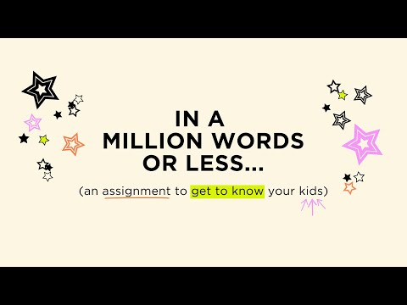
You’ve Got Homework
take it home
Resources
For more information check out this MiddleWeb post
BACK TO TAKE IT HOME

Slide 23
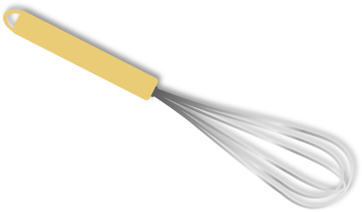


Credits and Resources
https://www.middleweb.com/40716/bonding-with-students-right-from-the-start/
https://www.edutopia.org/article/6-strategies-building-better-student-relationships
https://nowsparkcreativity.com/
https://www.cultofpedagogy.com/one-pagers/
https://www.understood.org/articles/en/questionnaires-for-connecting-with-students-and-families
Presentation Template: SlidesMania Images: Unsplash and Pexels Fonts used in this presentation: Lobster and Cairo

