Slide 1



Teaching New Science Curriculum
What’s new in the Science?
What resources will support us to design for learning?
How might we make connections with other subjects?
Part 1
Part 2
Active, Transdisciplinary and Fun!
Part 3
Link to slides: https://bit.ly/G2-3science
Notes:
Photo by Sharon Pittaway on Unsplash
Link to slides: https://bit.ly/K1science

Slide 2
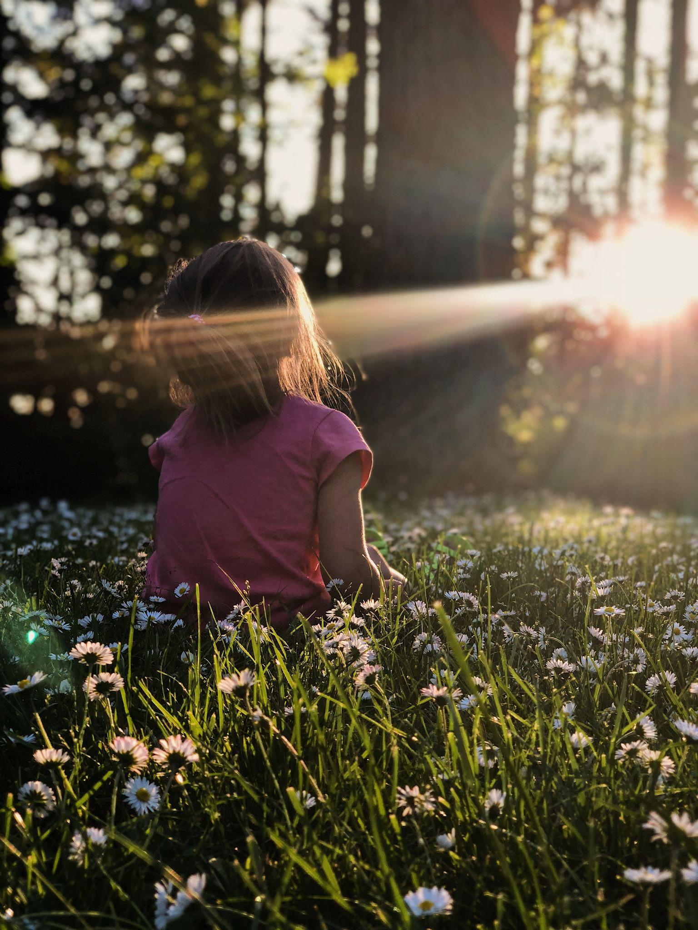

“If citizenship is a matter of shared beliefs, then I believe in the democracy of species.
If citizenship means an oath of loyalty to a leader,
then I choose the leader of the trees.
If good citizens agree to uphold the laws of the nation,
then I choose natural law,
the law of reciprocity,
of regeneration,
of mutual flourishing.”
Robin Wall Kimmerer
Author of Braiding Sweetgrass
Notes:
We acknowledge the many First Nations, Métis and Inuit who have lived in and cared for these lands for generations.
We are grateful for the traditional Knowledge Keepers and Elders who are still with us today and those who have gone before us.
Photo by Melissa Askew on Unsplash

Slide 3
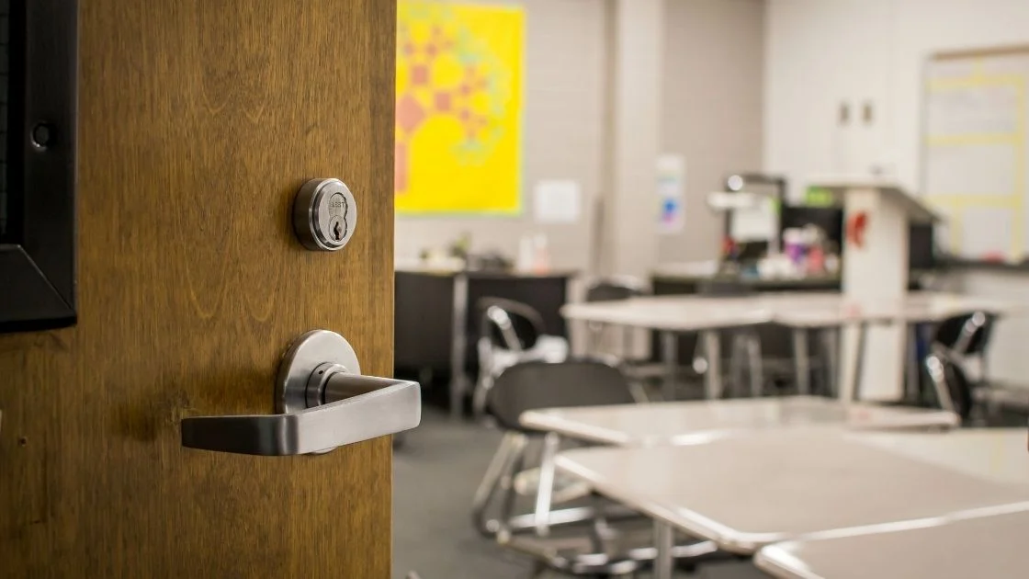
Imagine your students walking into your classroom, and they notice something new… something unusual.
They are curious.
They are questioning.
So, you smile.
You pass them a magnifying glass.
You listen… to their thoughts, murmurs, connections and questions.
And then you pose your own questions in return.

Slide 4
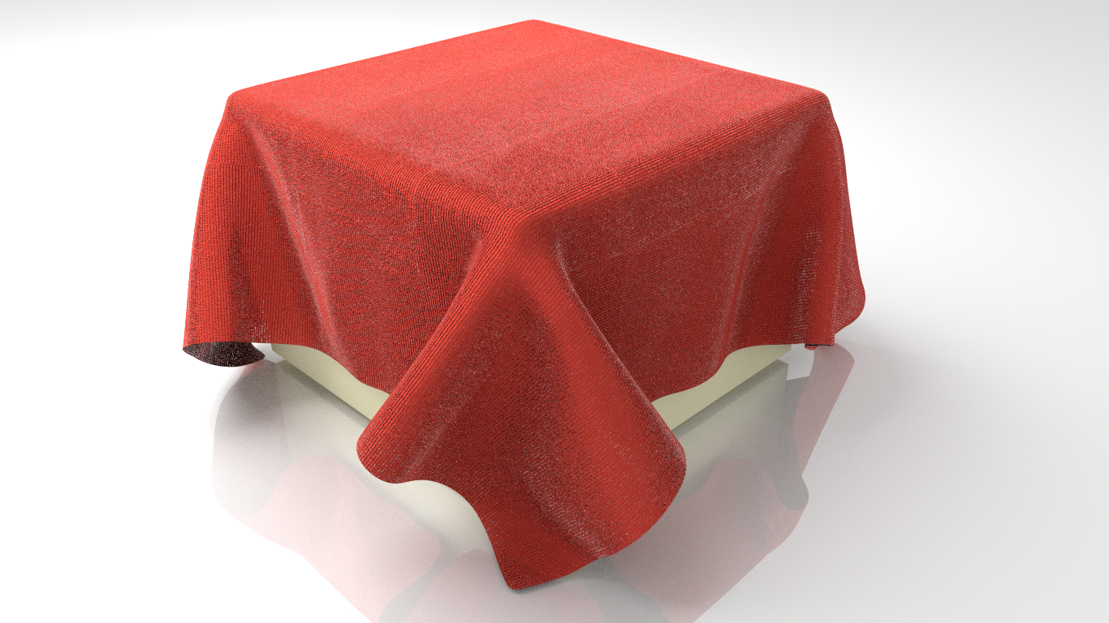

Slide 5
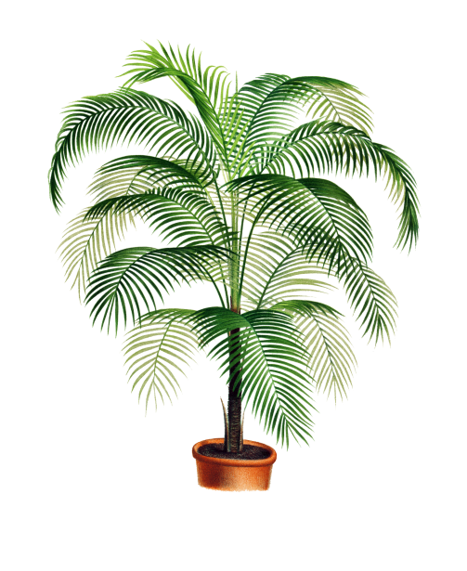
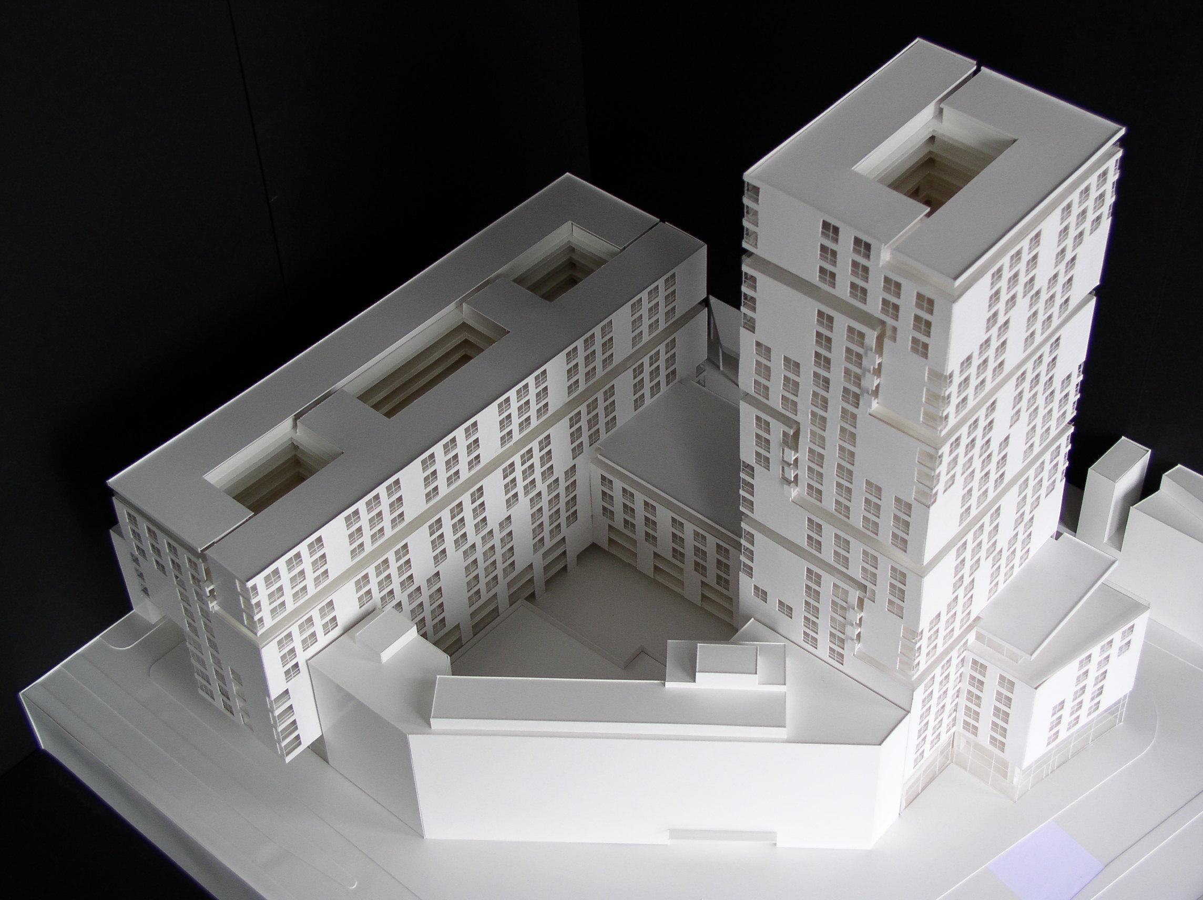
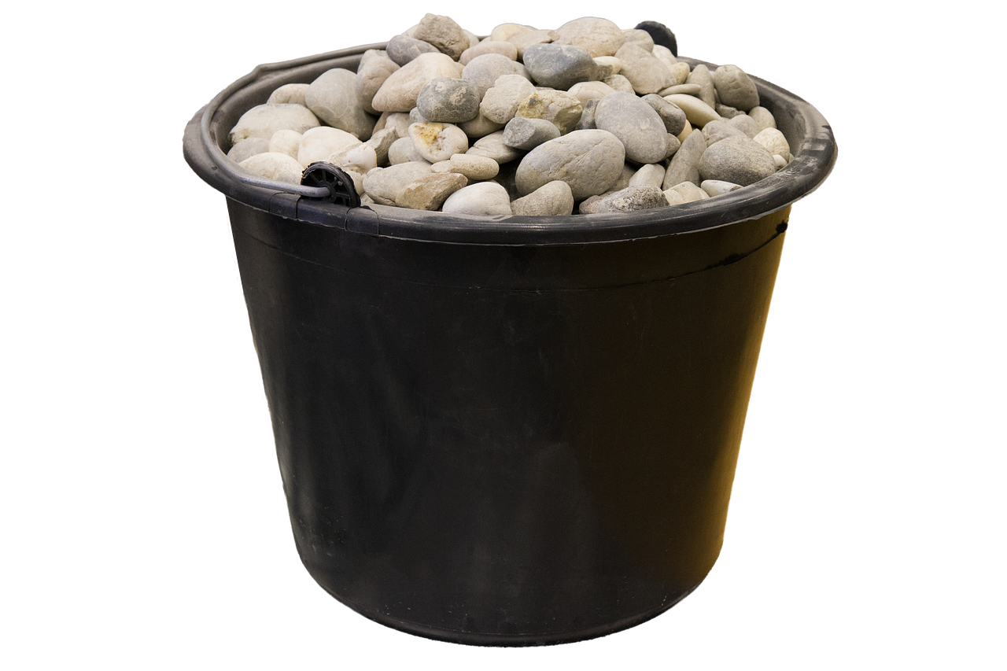

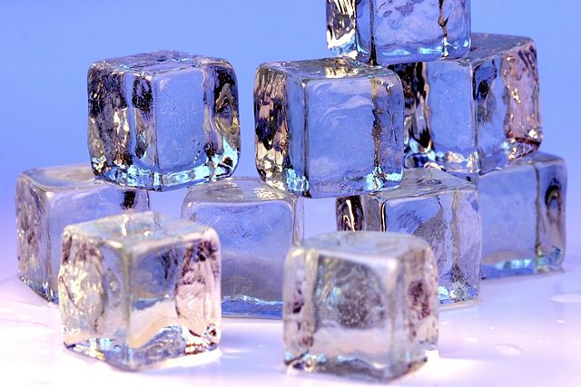


Slide 6
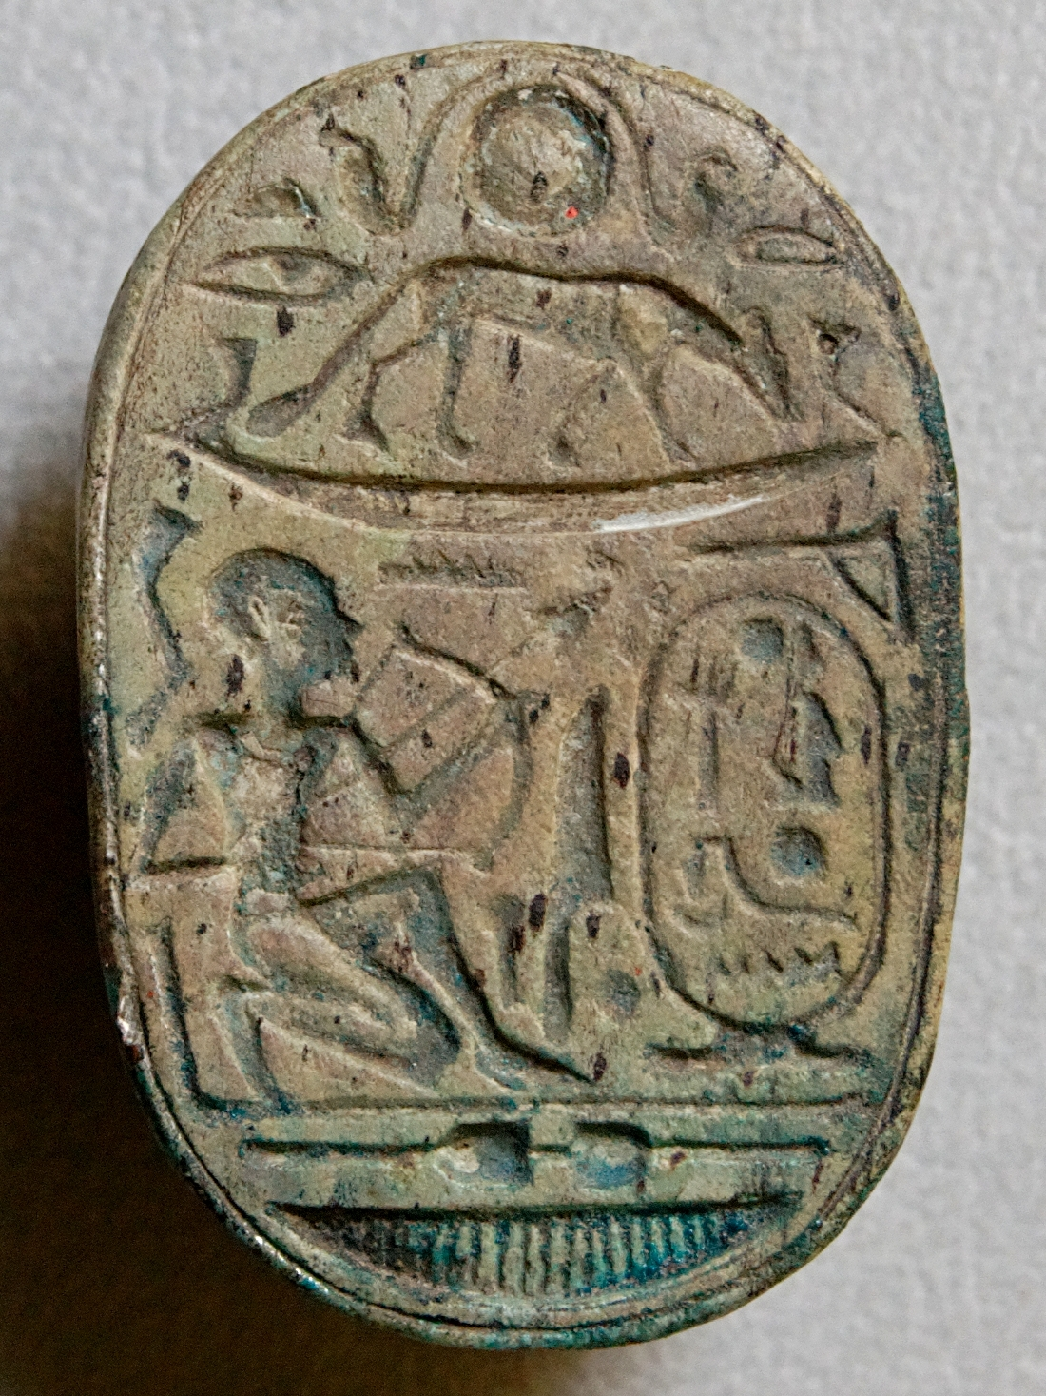
Describe the object’s PHYSICAL FEATURES
What colour is it? What is it made of? Is it a natural or manufactured material? Is the object complete? Has it been mended or changed? Is it worn? Might it have a smell? Would it make a sound?
How was it made or CONSTRUCTED?
Was it handmade or machine made? Is it made from several pieces? If so, how was it fixed together?
Think about the DESIGN
Does it do the job it was intended to do well? Were the best materials used? Is it decorated? If so, how was it decorated? Do you like the way it looks? Would other people like it?
What is it worth? What is its VALUE?
To the people who made it? To the people who used it?
To the people who keep it? To you? To a museum?
*Answer the question: Is this a valuable object? Explain and provide evidence.
The Art of Looking Closely
Looking at
Objects or Artifacts
Notes:
Cheryl - looking at art, objects, etc.

Slide 7
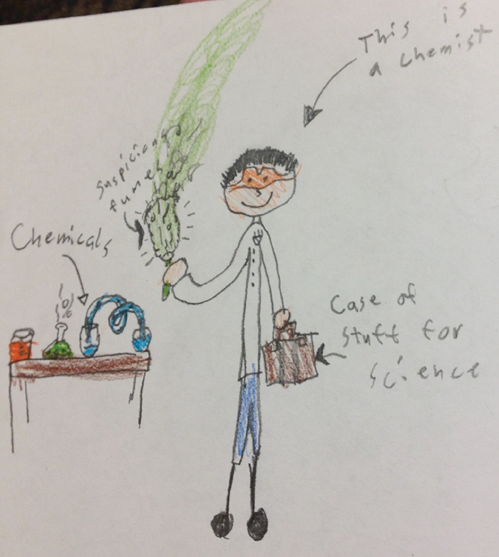
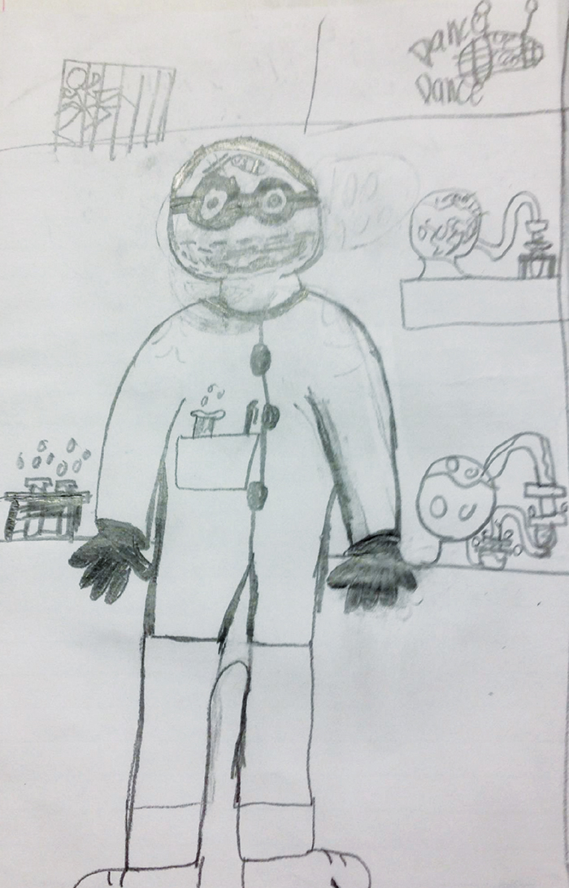
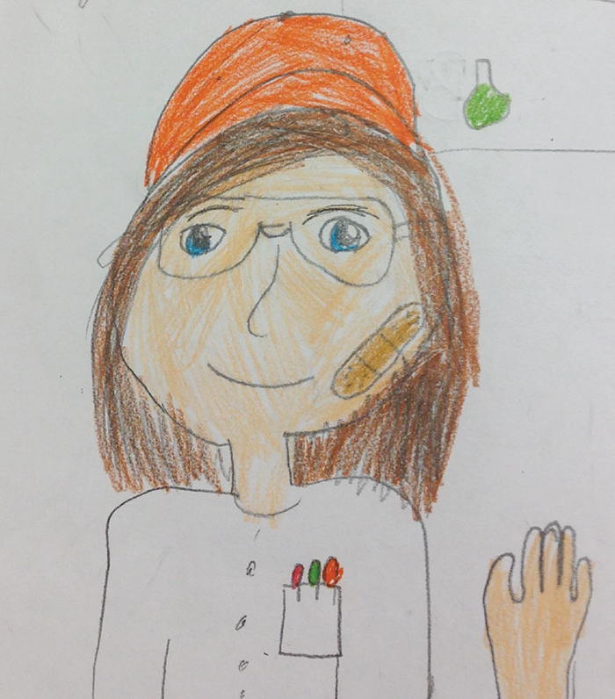
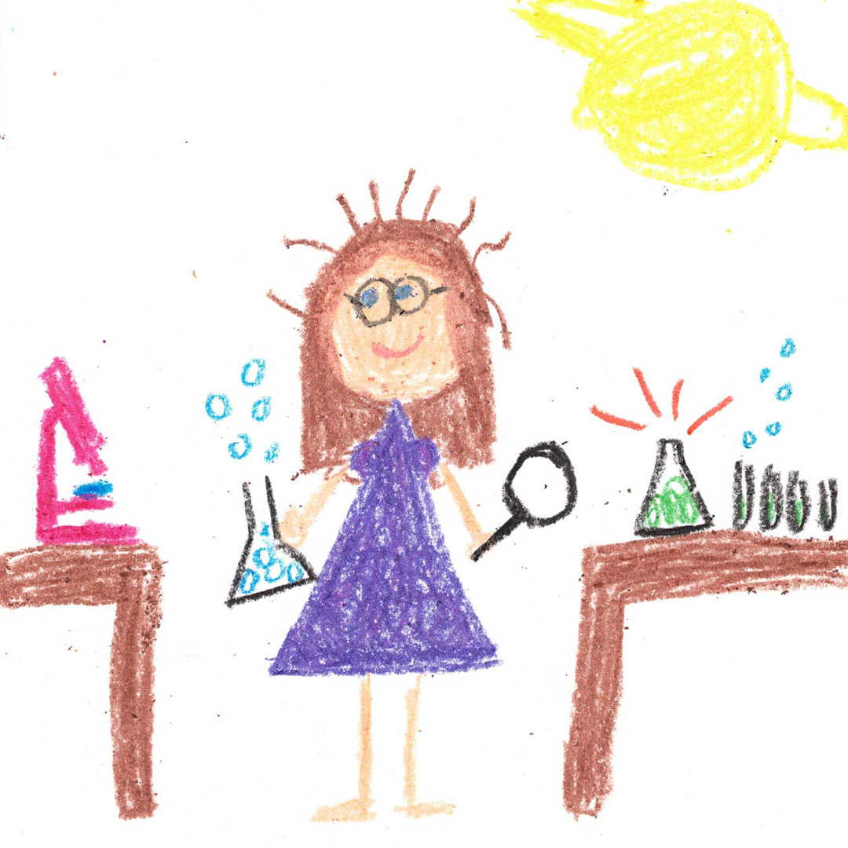
https://www.nsta.org/draw-scientist
Notes:
https://twitter.com/qldmuseum/status/1310021355686031360

Slide 8
Science is the study of many interconnected disciplines, including physics, chemistry, biology, Earth science, astronomy, and computer science. Science is creative, collaborative, and dynamic; is based on experience and evidence; and employs objective methods for observing, collecting, and analyzing data. Scientific knowledge is developed, refined, and extended as new evidence is uncovered. The study of science allows students to nurture curiosity, ask and answer questions, explore scientific and technological concepts, and acquire knowledge and understanding of the world. Science provides a reliable basis for decision making and is essential in developing innovative ideas and solutions. It includes the critical-thinking skills, scientific knowledge, and civic literacy required to respond to relevant personal, societal, and environmental issues. Students develop critical reasoning and scientific literacy through exploring science concepts and applying scientific methods. Scientific knowledge is enriched through the shared contributions of people from diverse cultures and perspectives. Science and technology are deeply interwoven in our daily lives. Together, they enable society to build and share knowledge, innovate, improve quality of life, and predict future events.
Notes:
What is science? https://curriculum.learnalberta.ca/curriculum/en/s/sci

Slide 9
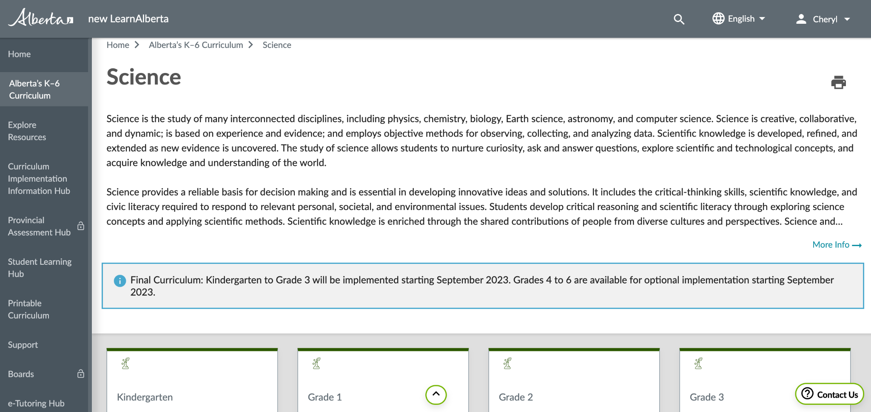
Heading Here

Slide 10
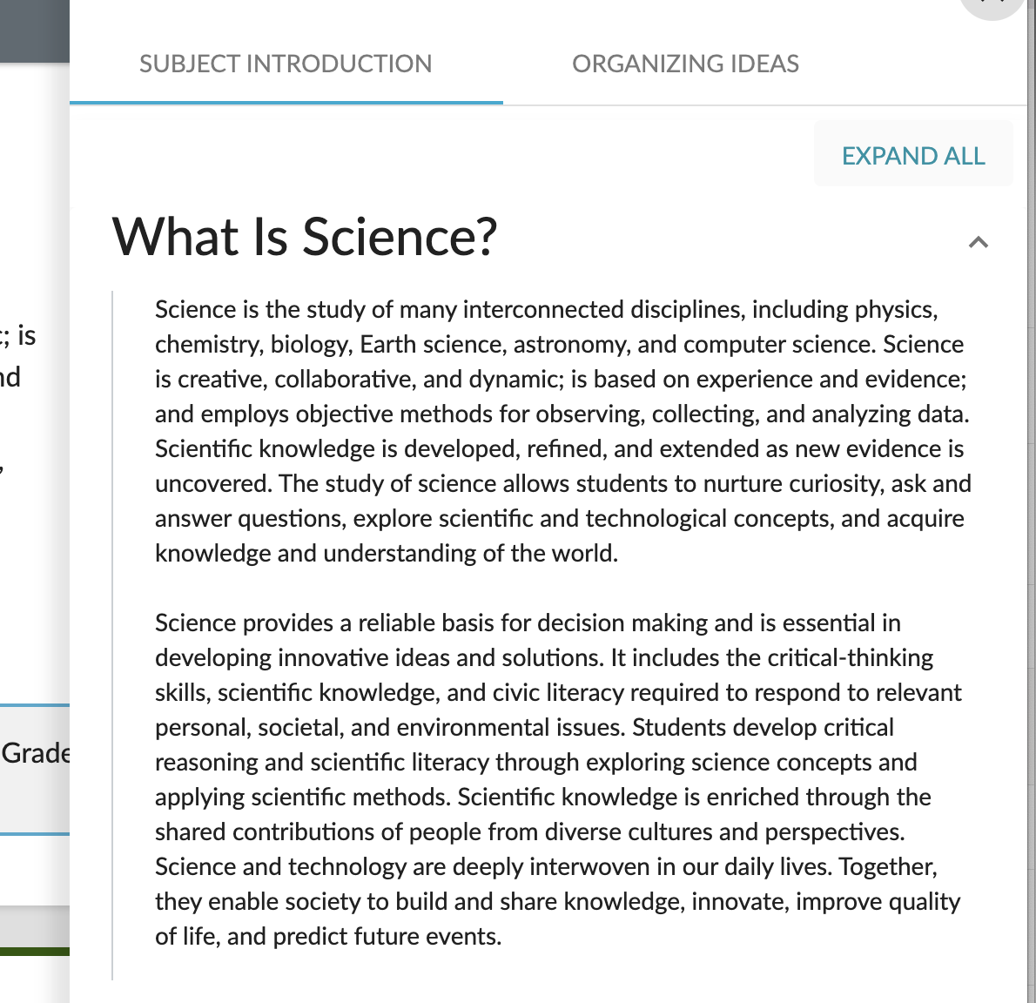
Heading Here
Notes:
https://curriculum.learnalberta.ca/curriculum/en/s/sci

Slide 11
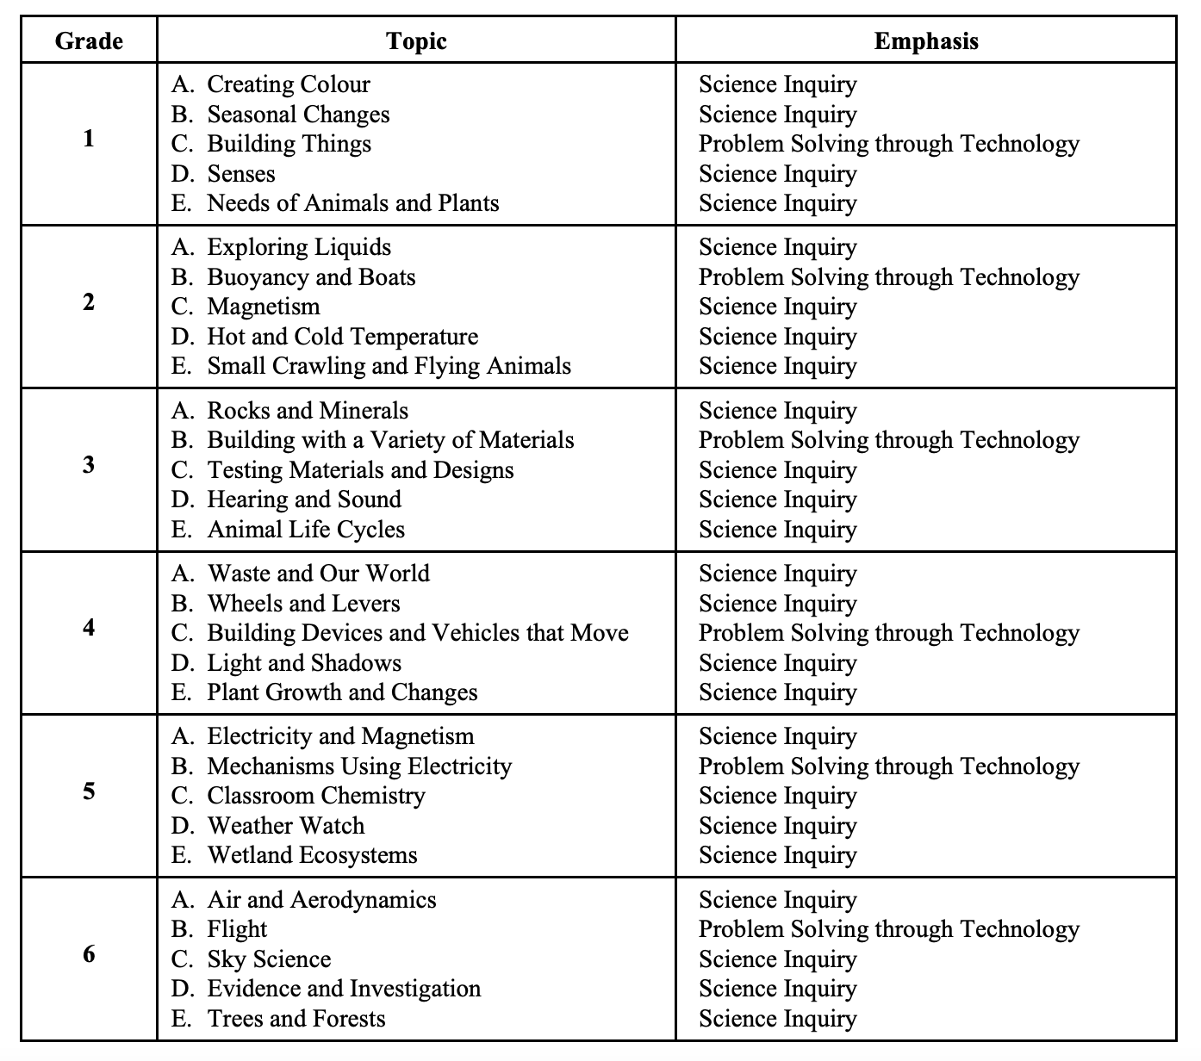
Previous curriculum was organized by TOPICS within grades 1 through 6.

Slide 12
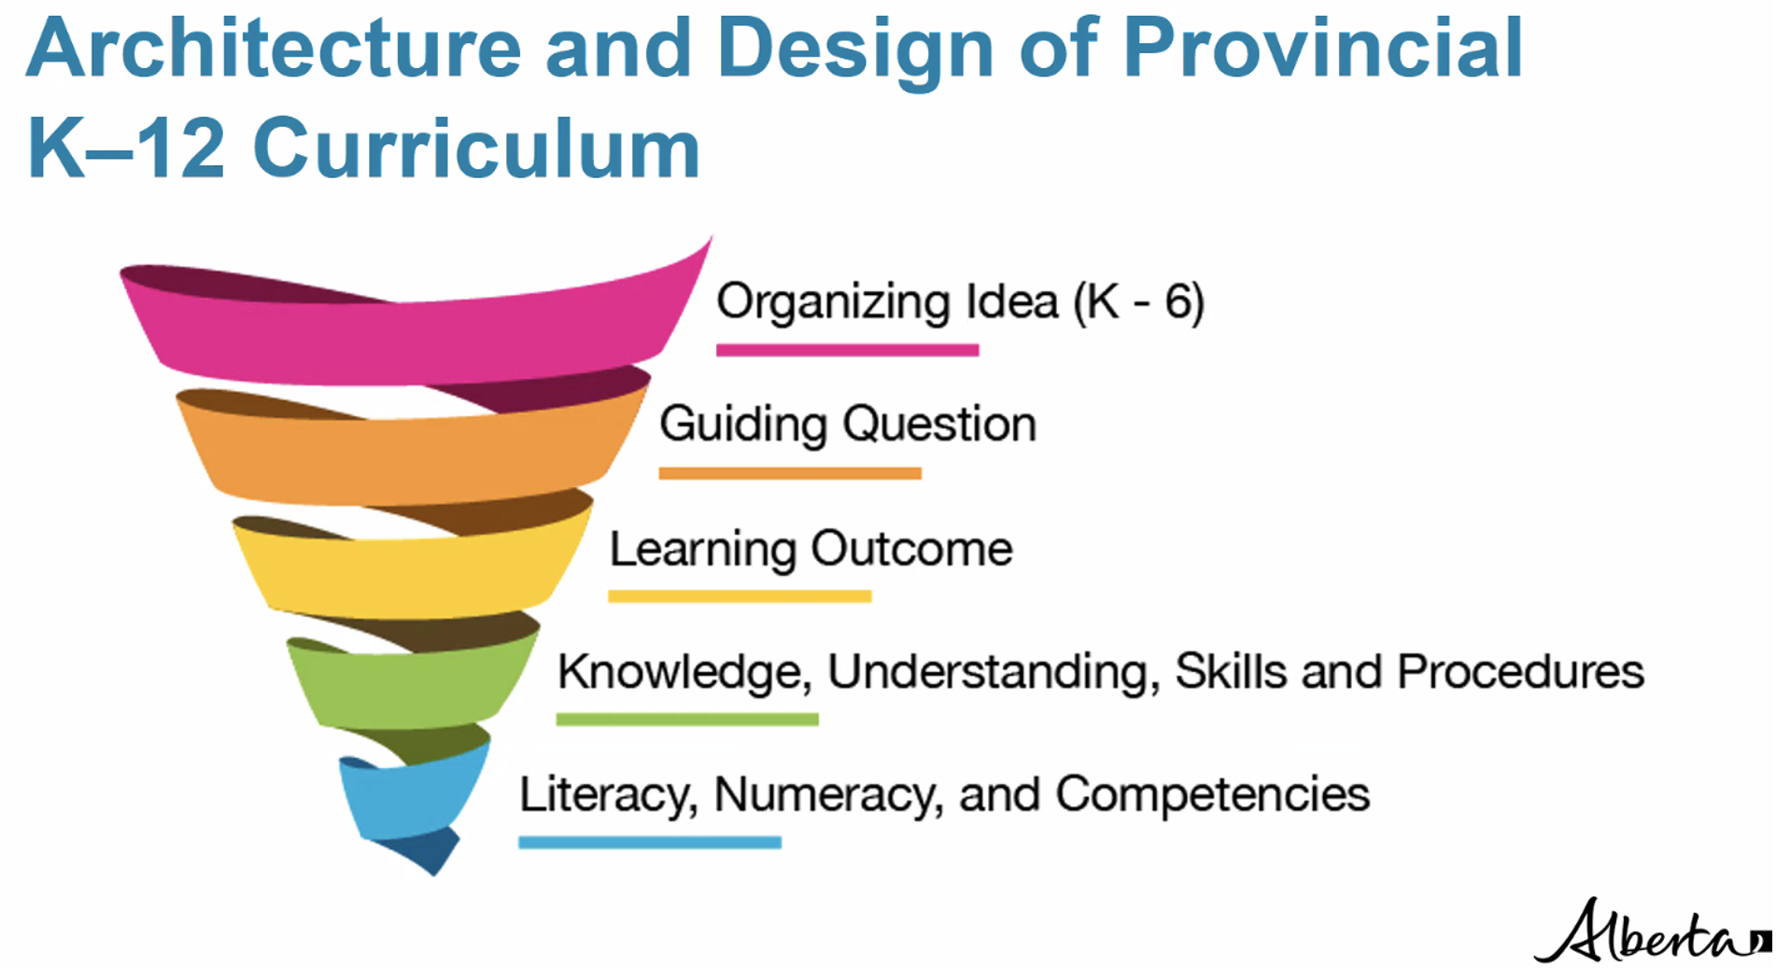
ALL new curriculum uses the same architecture.
This is good news for teaching young scientists!
Source: Alberta Education, 2022

Slide 13
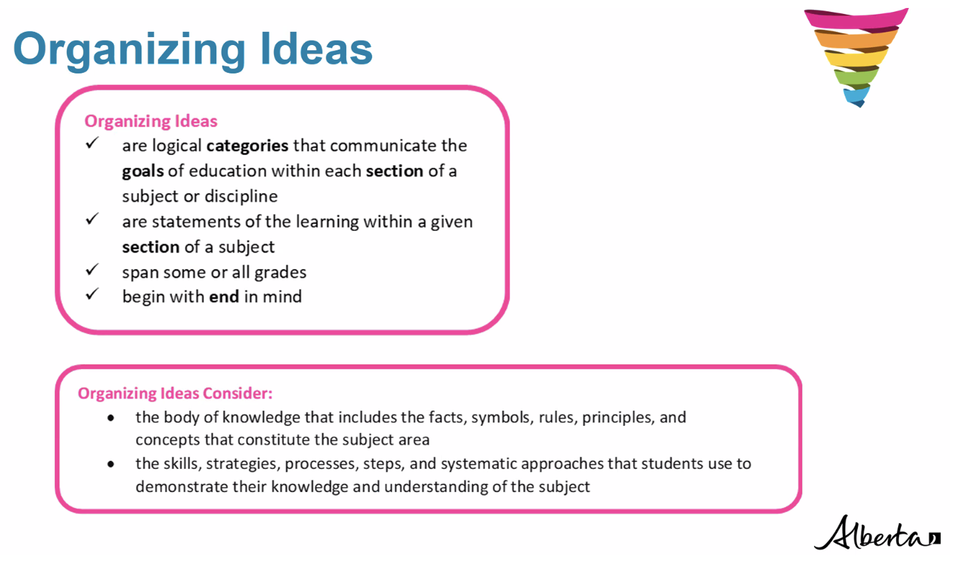
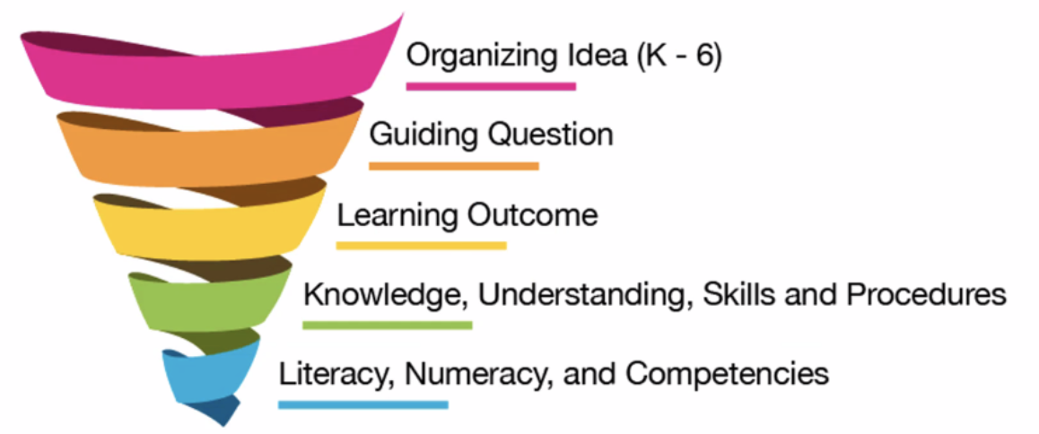
Source: Alberta Education, 2022
Notes:
Organizing ideas are like the chapter titles of a book.

Slide 14
K | 1 | 2 | 3 | 4 | 5 | 6
Matter: Understandings of the physical world are deepened by investigating matter and energy.
Energy: Understandings of the physical world are deepened by investigating matter and energy.
Earth Systems: understandings of the living world, Earth, and space are deepened by investigating natural systems and their interactions.
Living Systems: Understandings of the living world, Earth, and space are deepened by investigating natural systems and their interactions.
Space: Understandings of the living world, Earth, and space are deepened by investigating natural systems and their interactions.
Computer Science: Problem solving and scientific inquiry are developed through the knowledgeable application of creativity, design, and computational thinking.
Scientific Methods: Investigation of the physical world is enhanced through the use of scientific methods that attempt to remove human biases and increase objectivity.

Slide 15
K | 1 | 2 | 3 | 4 | 5 | 6
Matter: Understandings of the physical world are deepened by investigating matter and energy.
Energy: Understandings of the physical world are deepened by investigating matter and energy.
Earth Systems: understandings of the living world, Earth, and space are deepened by investigating natural systems and their interactions.
Living Systems: Understandings of the living world, Earth, and space are deepened by investigating natural systems and their interactions.
Space: Understandings of the living world, Earth, and space are deepened by investigating natural systems and their interactions.
Computer Science: Problem solving and scientific inquiry are developed through the knowledgeable application of creativity, design, and computational thinking.
Scientific Methods: Investigation of the physical world is enhanced through the use of scientific methods that attempt to remove human biases and increase objectivity.
Now, each grade will uncover concepts, knowledge and skills that derive from the same organizing ideas.

Slide 16
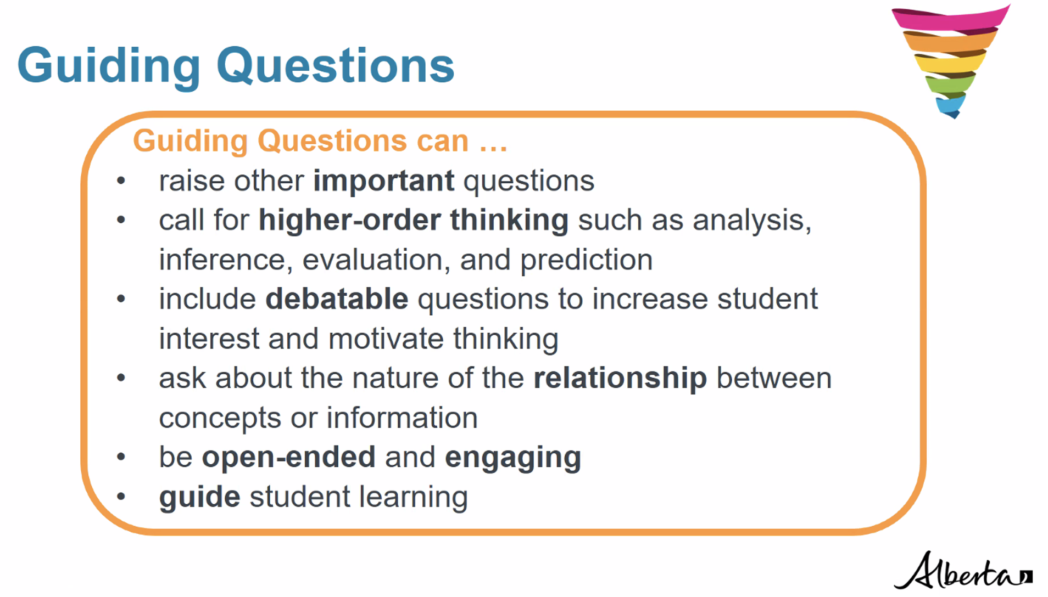
Source: Alberta Education, 2022
Notes:
GQ’s set the direction for the learning that follows and focuses learning.

Slide 17
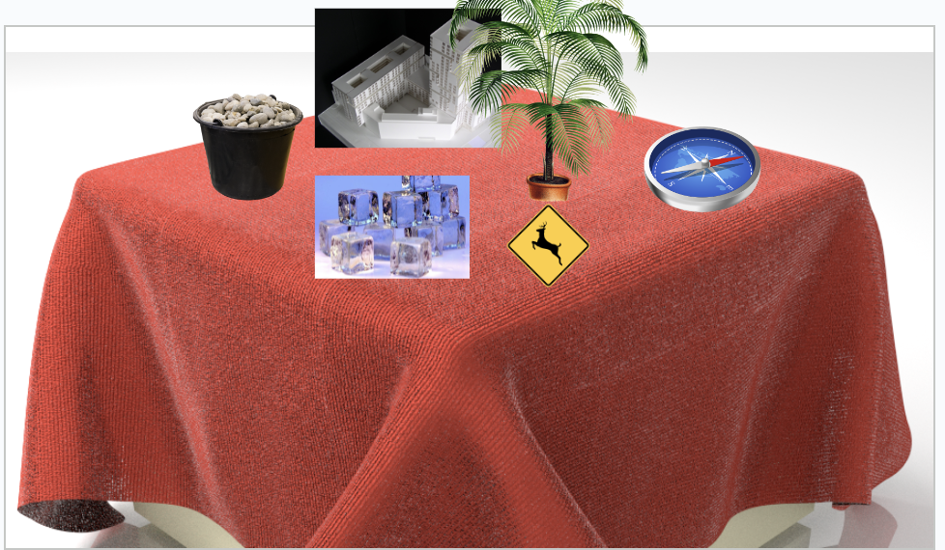
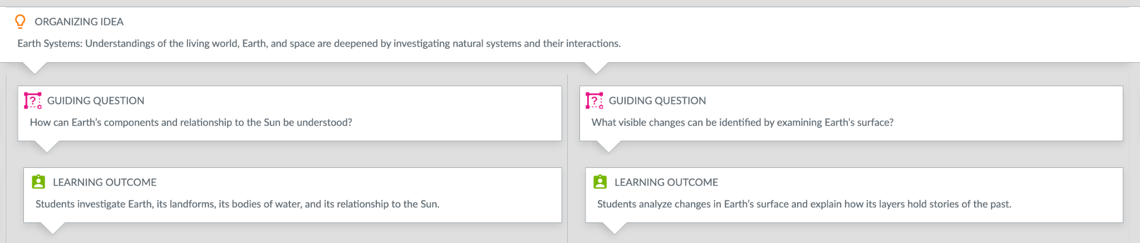

Slide 18
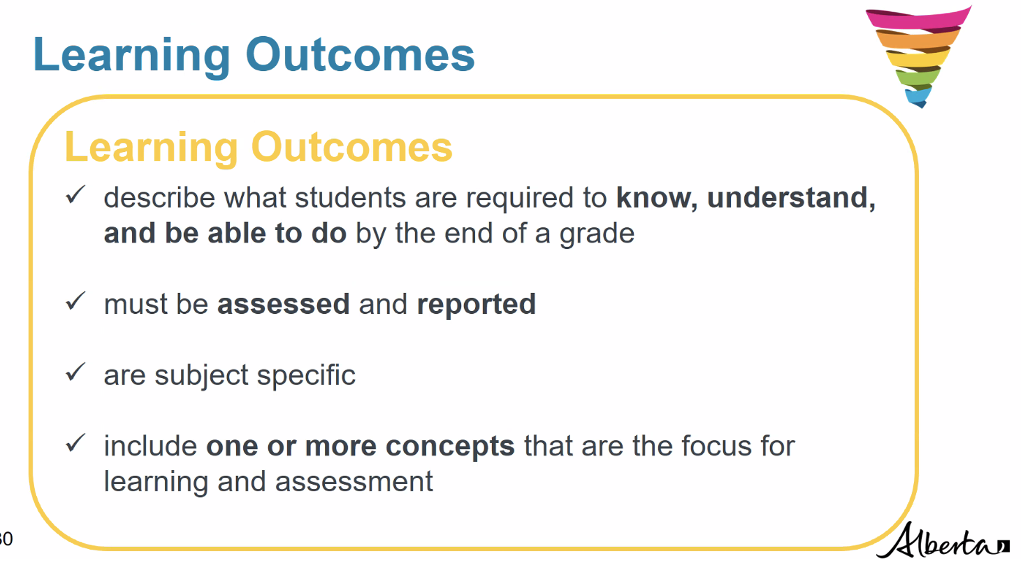
Would you like to access a copy of the curriculum where the outcomes are numbered? Click here.
Source: Alberta Education, 2022
Notes:
LO’s are assessed using the KUSPs. Content in the KUSPs define the LO and describes what students should know and be able to do. Teachers define the HOW of covering the content.

Slide 19
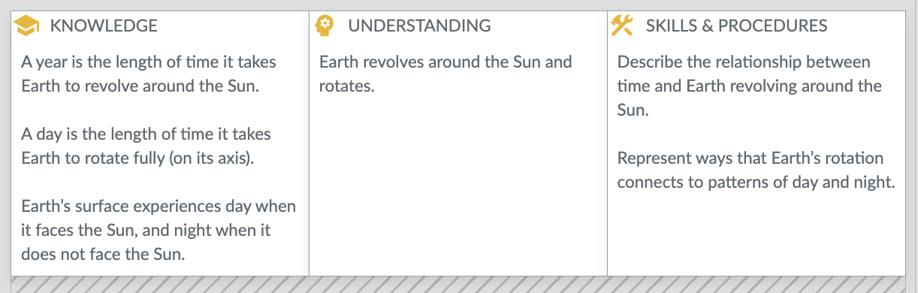
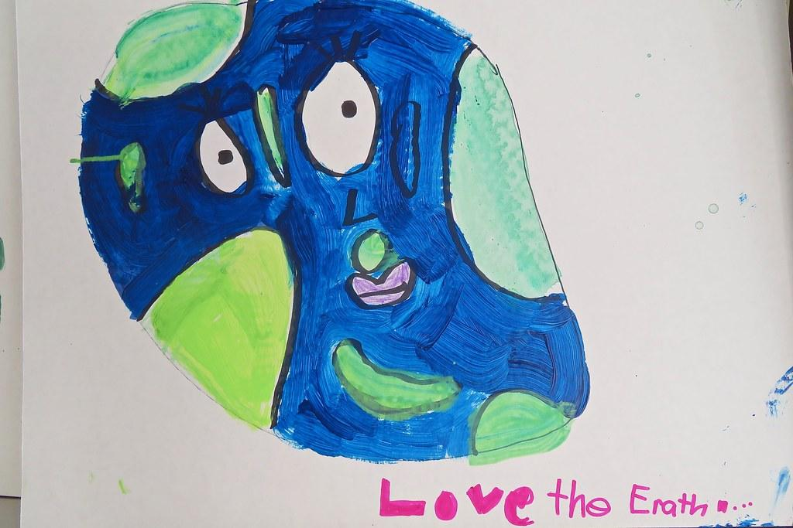
Organizing Idea GRADE 2 | Earth Systems: Understandings of the living world, Earth and space are deepened through investigating natural systems and their interactions.
Guiding Question | How can Earth’s components and relationship to the Sun be understood?
Learning Outcome | Students investigate Earth, its landforms, its bodies of water, and its relationship to the Sun.

Slide 20

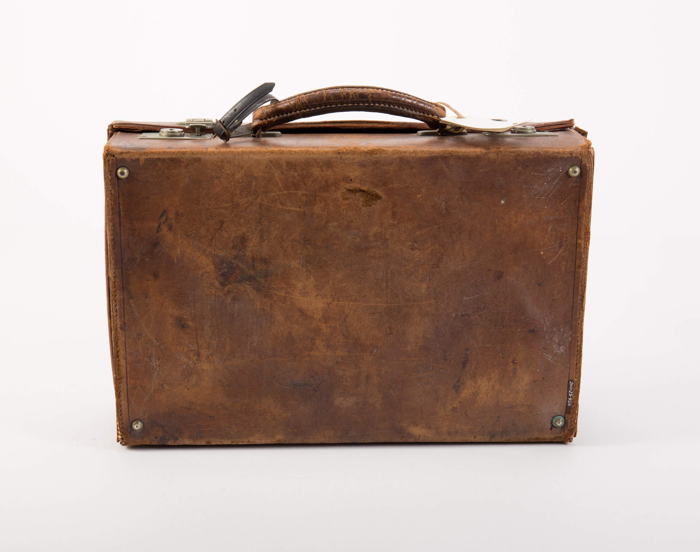

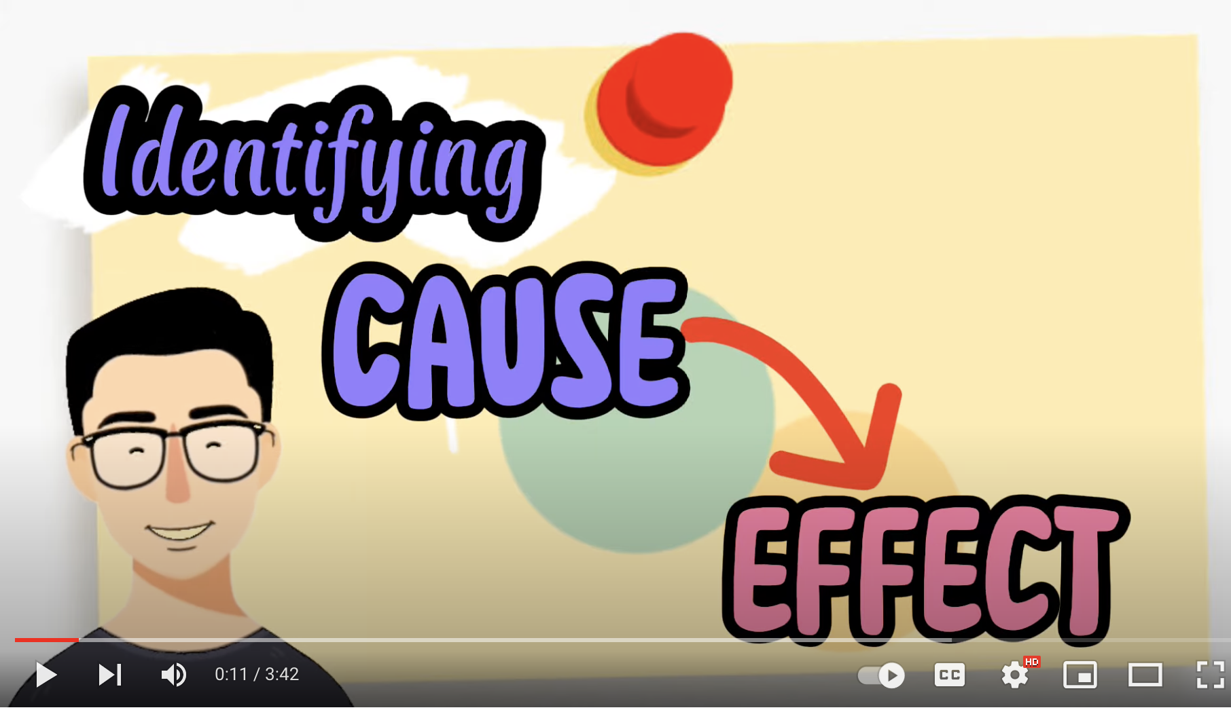
What makes a good relationship? What makes it not-so-good?
Things or people that are connected to each other.
Things or people that impact each other.
Impact is affect (feelings) or effect (consequence), or change.
relationship

Slide 21
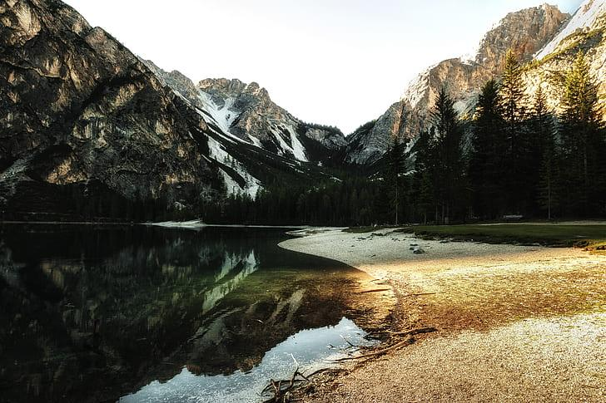
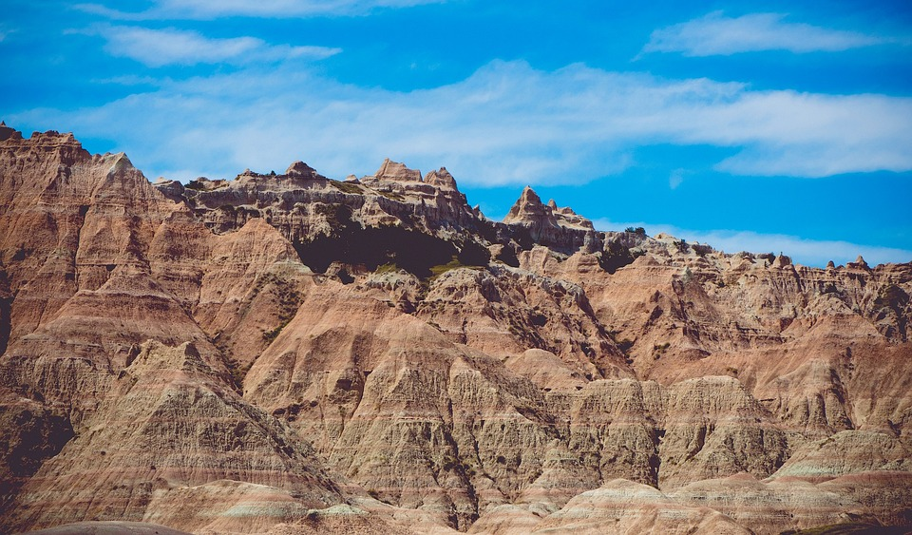
What makes a good relationship? What makes it not-so-good?
a set of things working together as parts of a mechanism or an interconnecting network.
a set of ways or procedures that describe how something is done;
an organized framework or method.
systems
A system is not “random”, chaotic, or “things are everywhere”
landforms
Bodies of water

Slide 22
Science Curriculum through Concepts
This document takes a look at the learning outcomes and has identified many of the topic specific concepts that teachers need to help students unpack. Sometimes called micro-concepts, these concepts are KEY to demonstrating understanding of the learning outcomes.
Teaching Science through Concepts: New AB Curriculum
Knowledge is essential to make sense of concepts.
Skills and procedures activate the knowledge.
Understanding of CONCEPTS helps to TRANSFER the learning to new and authentic situations.

Slide 23
change

Slide 24
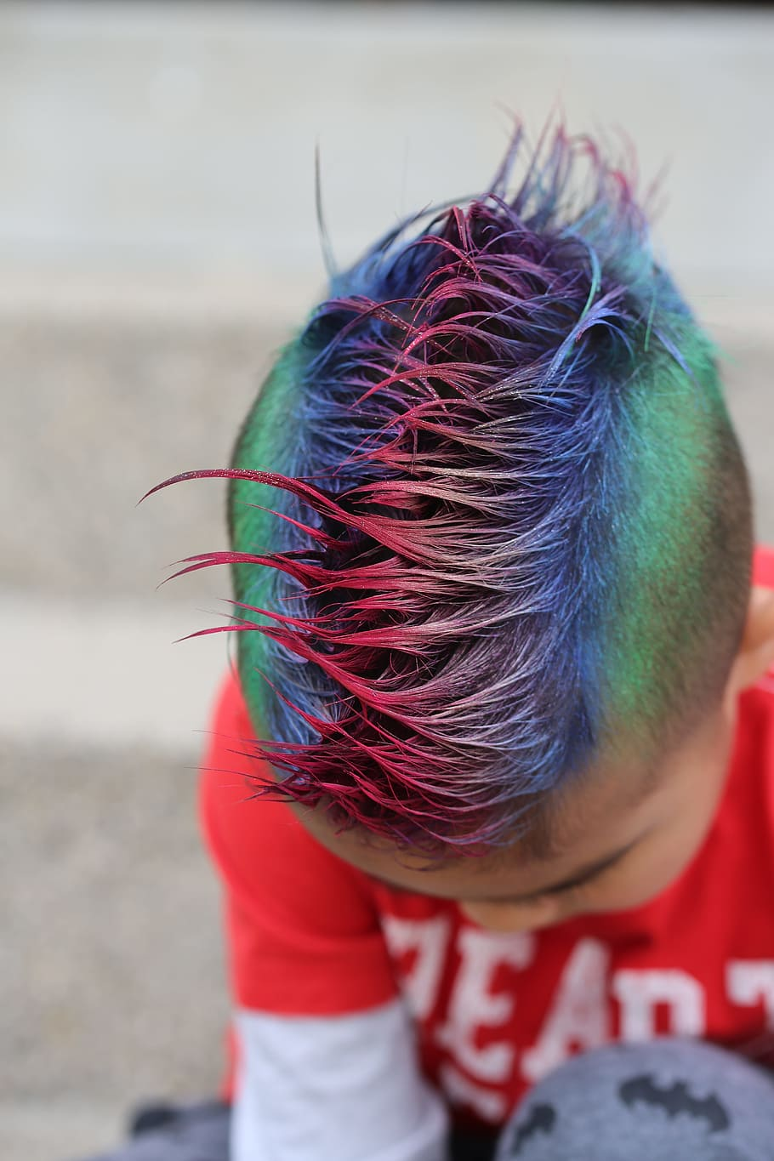
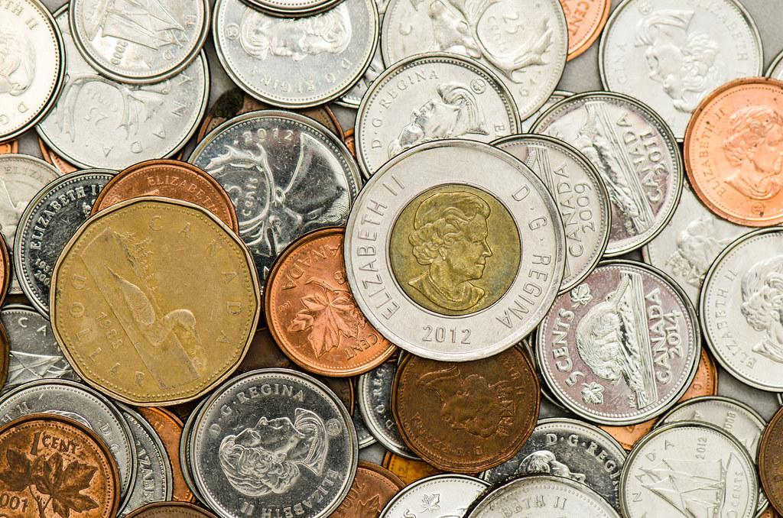
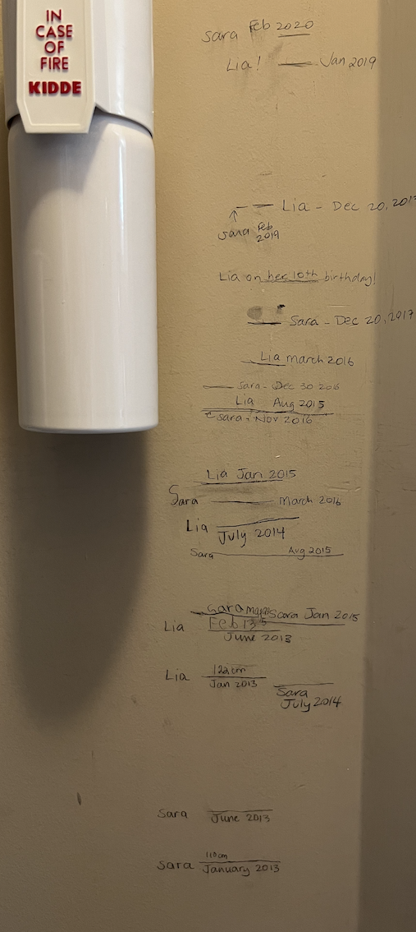
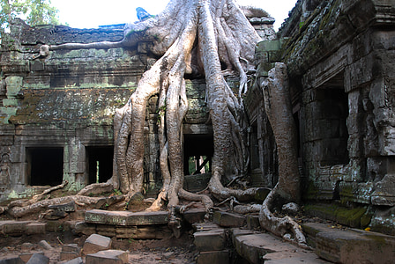
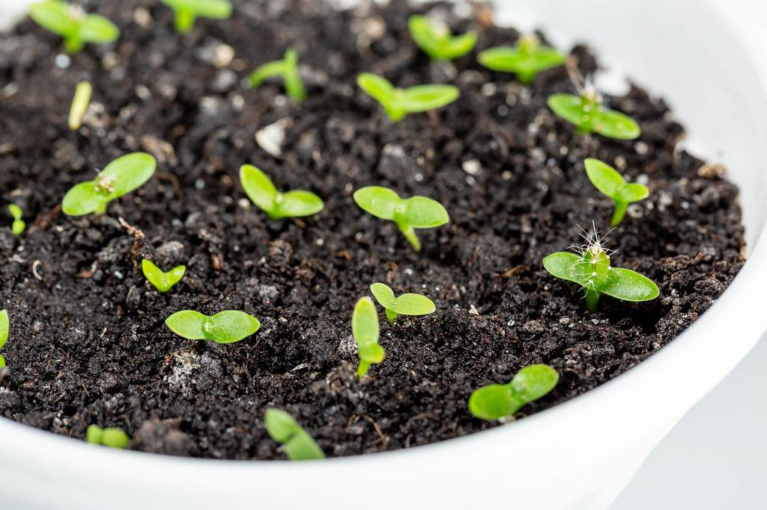
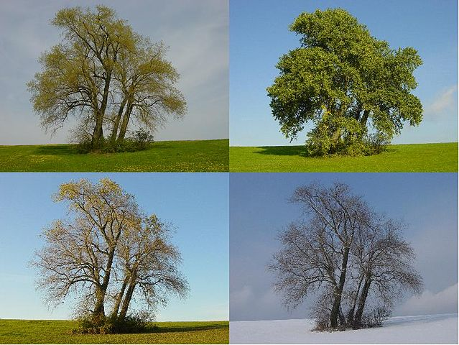
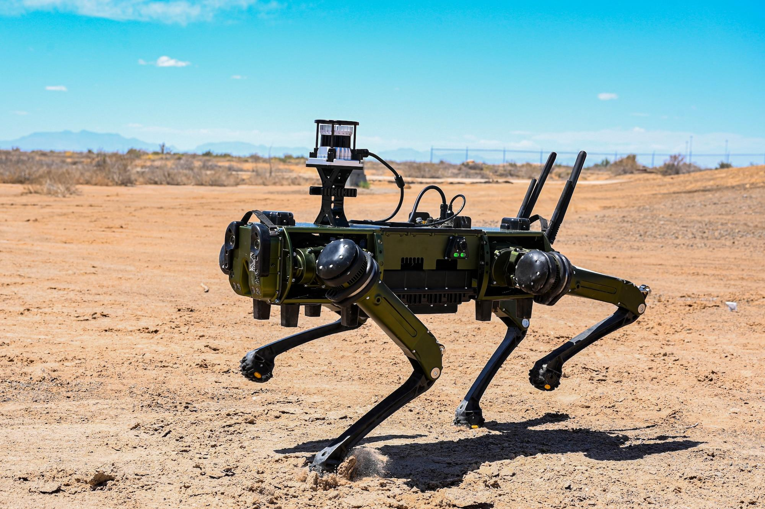
change
Notes:
Angkor wat, Cambodia

Slide 25
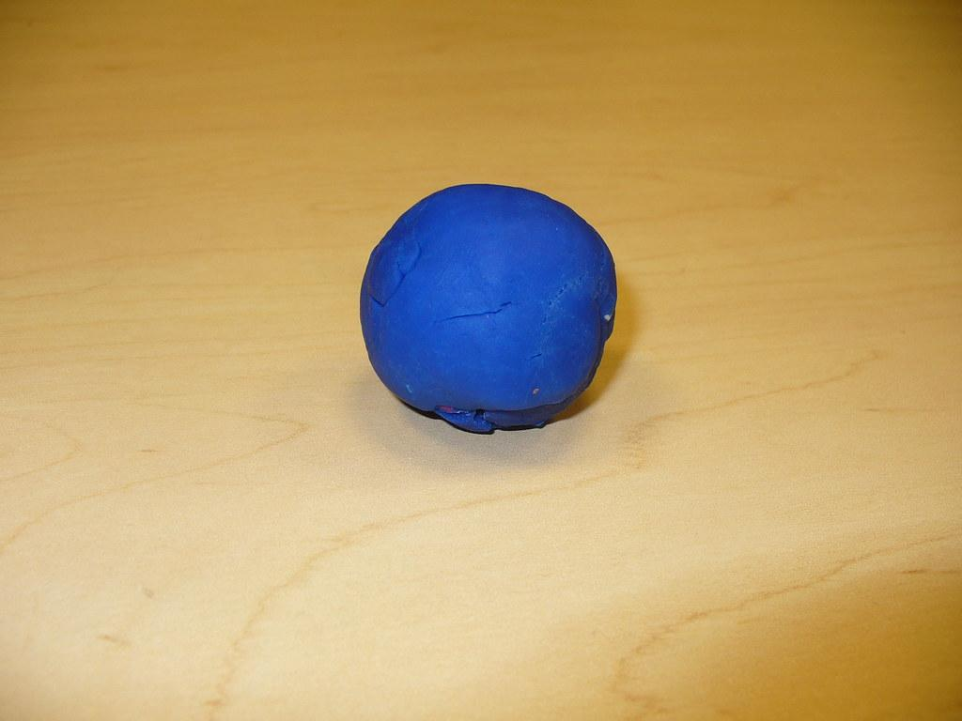
Can you share a story of change with this material?

Slide 26
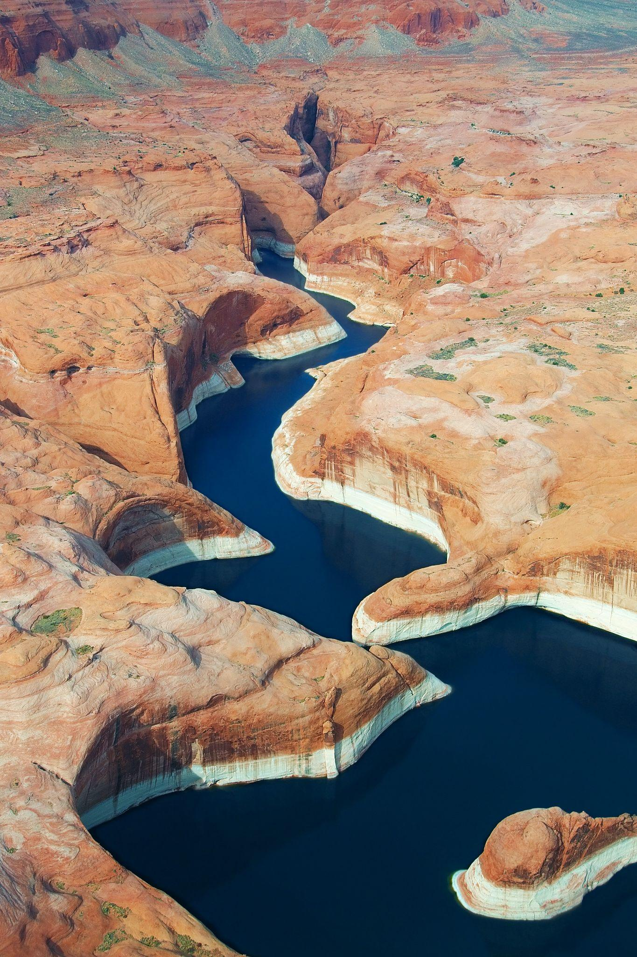
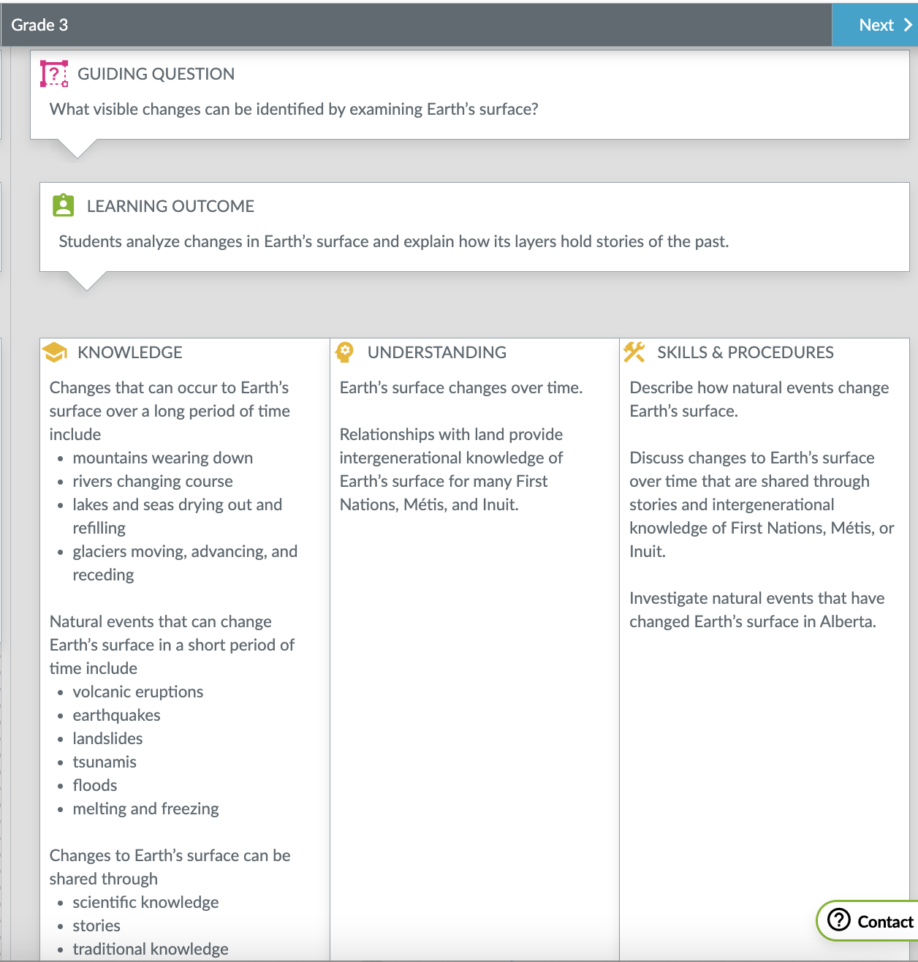
I see…
I think…
I wonder…
Earth’s surface changes over time.
Notes:
Photo by Rainer Krienke on Unsplash

Slide 27
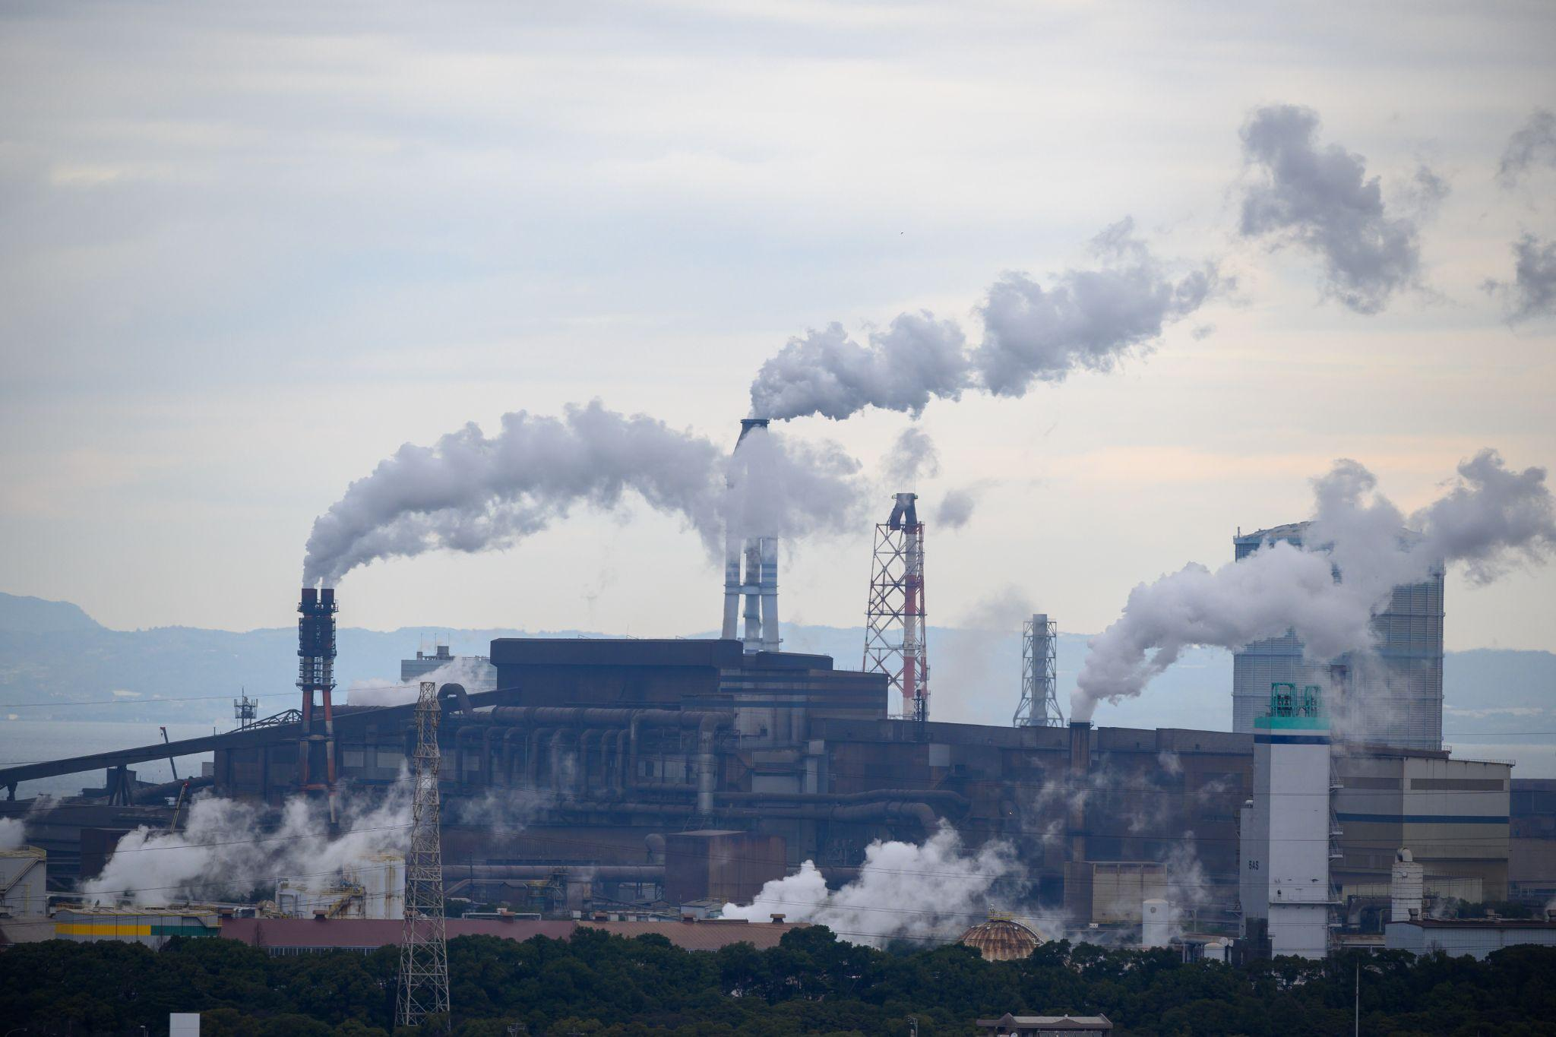
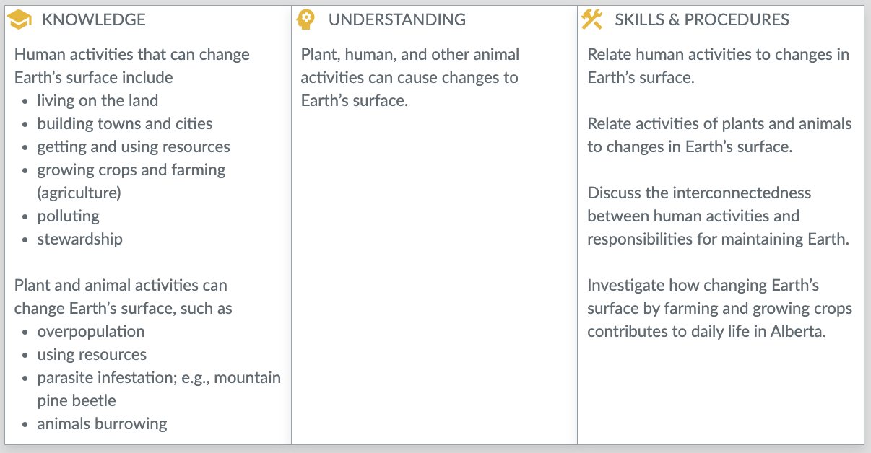
Do humans cause too much change to the Earth?
Observe.
Think.
Question.
Notes:
Photo by Kouji Tsuru on Unsplash

Slide 28

Question: Do humans cause too much change to the Earth?
Draw an arrow to represent your thoughts.
Give evidence (sound reasoning) for your opinion.
No.
Yes.
Notes:
Add your arrow, labels and then justify!

Slide 29
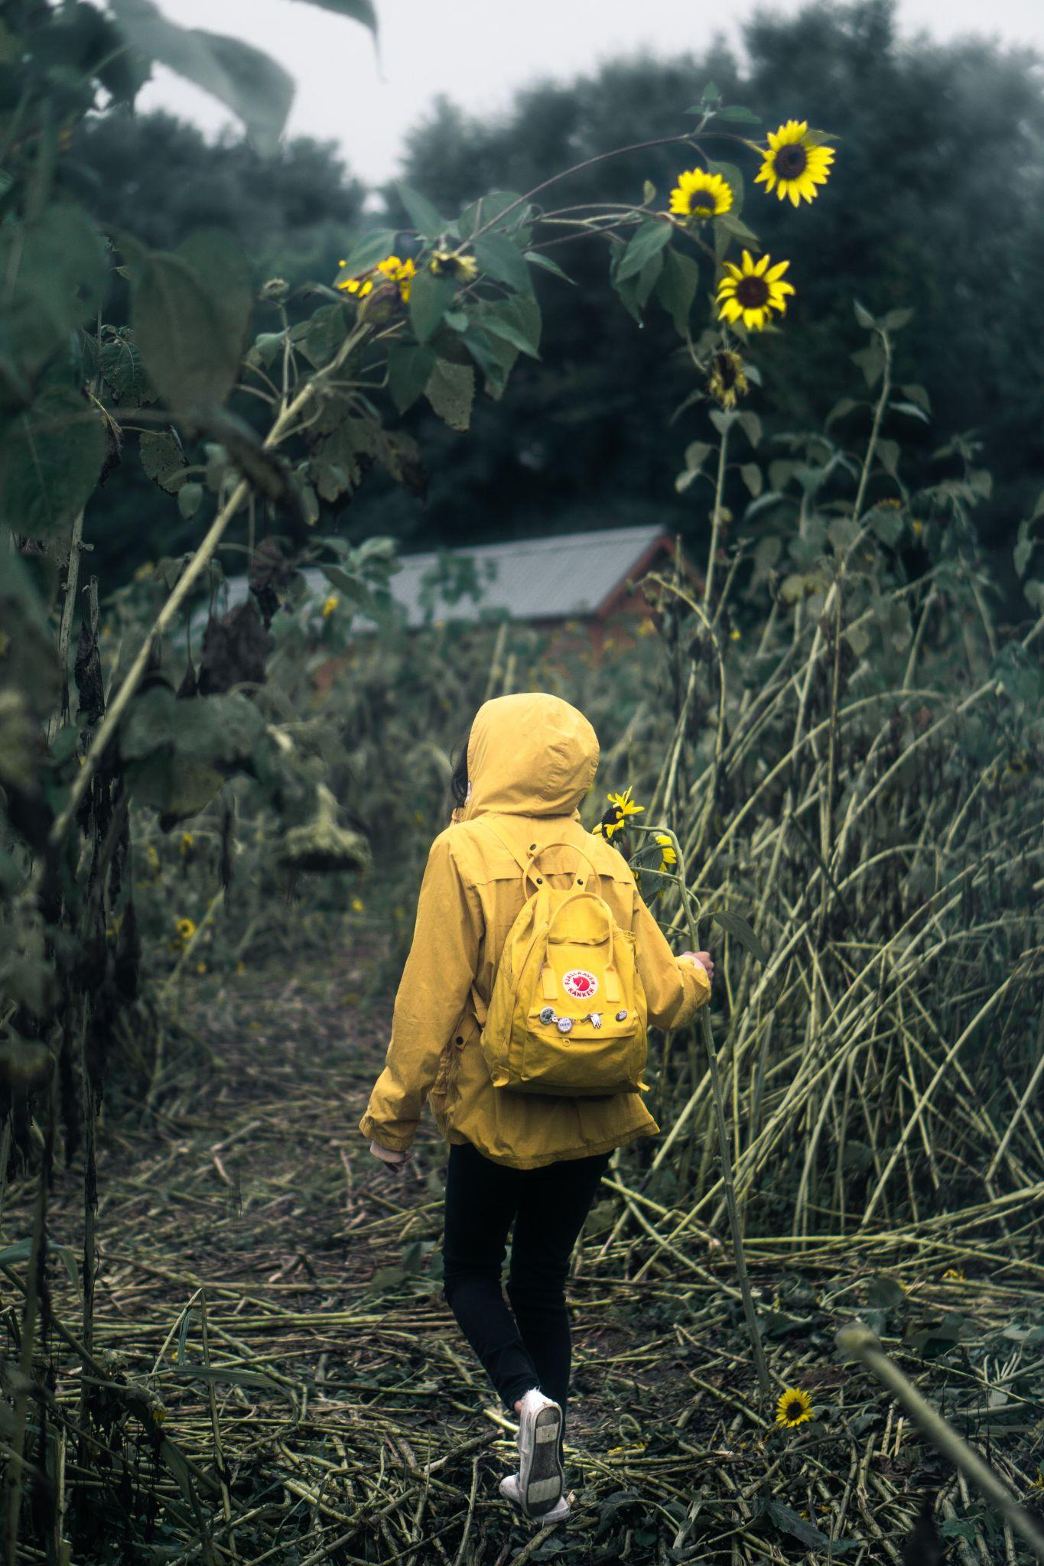
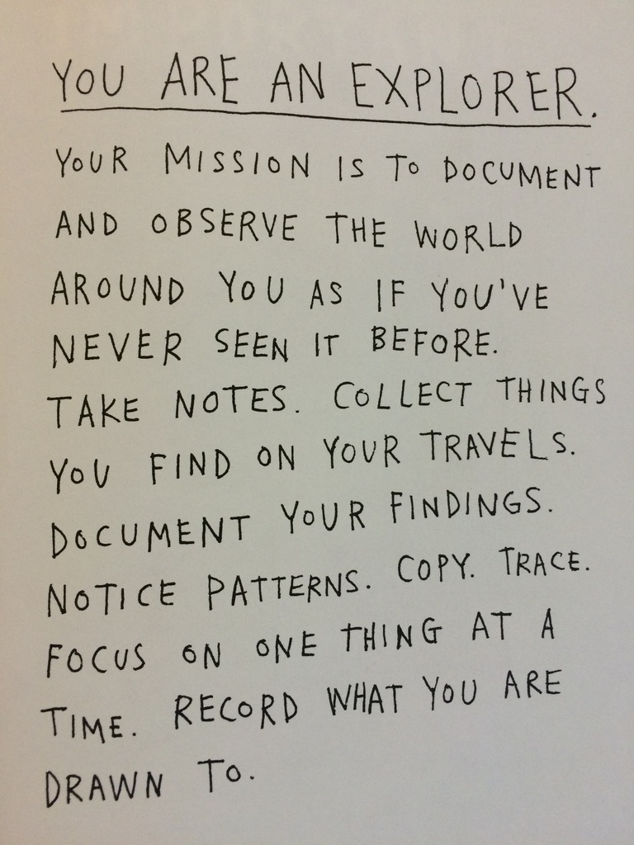
Notes:
You are an explorer source: How to be an explorer of the world: Portable Life Museum by Keri Smith
Photo by Brennan Martinez on Unsplash

Slide 30
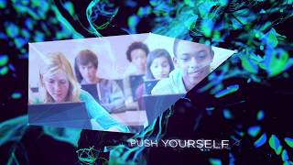
Notes:
Link to video: https://www.youtube.com/watch?v=ukXhbIYh4OY&t=6s

Slide 31
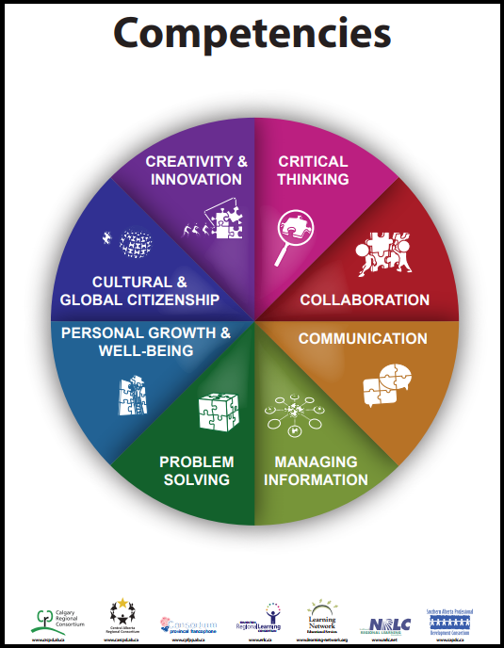
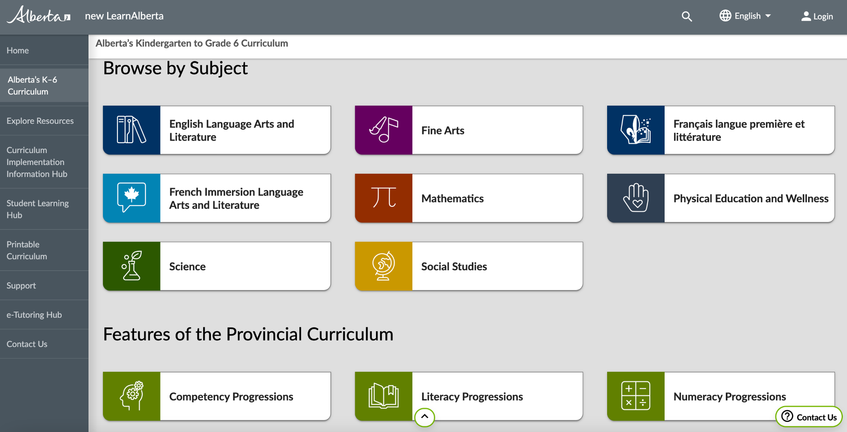
How might the competency progressions help lead the design of the learning?

Slide 32
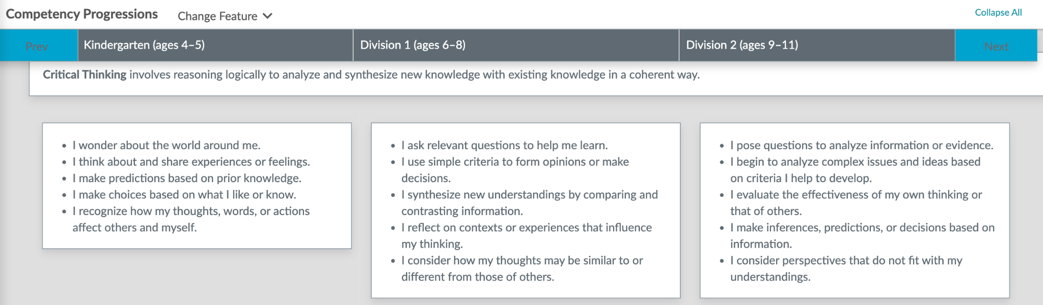
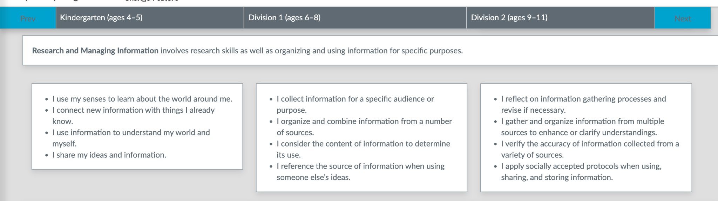

Slide 33
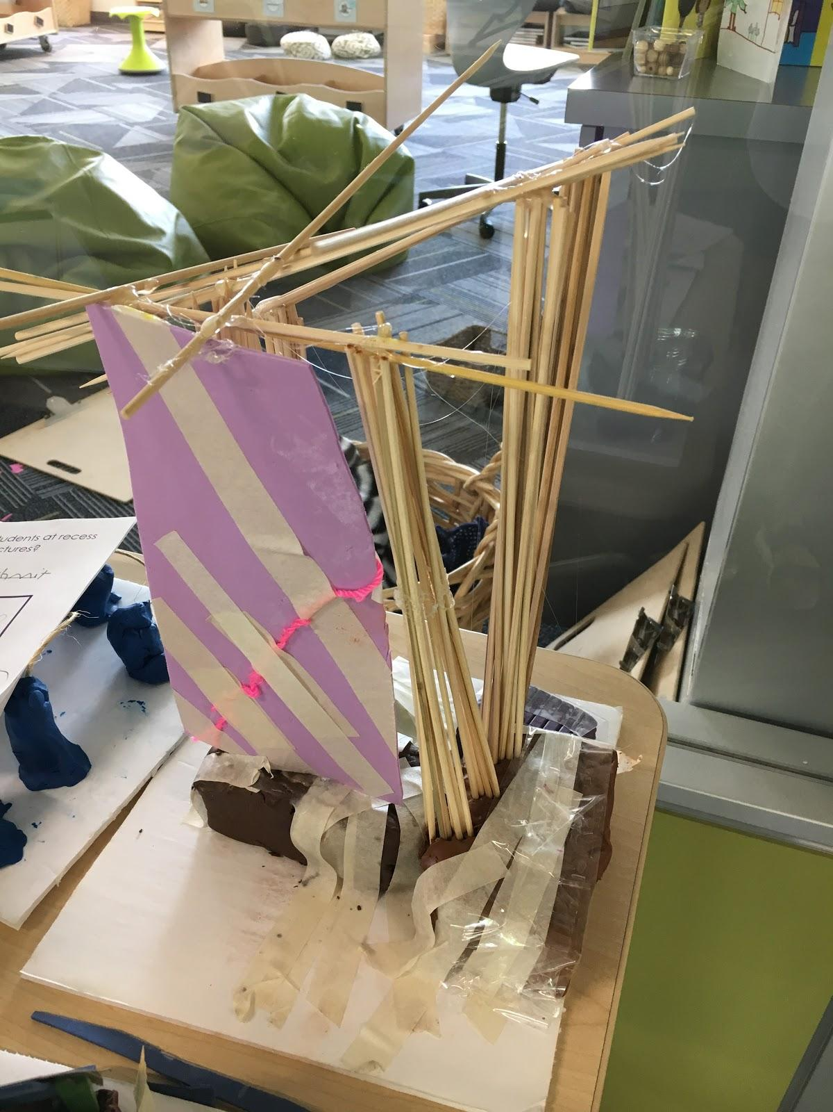
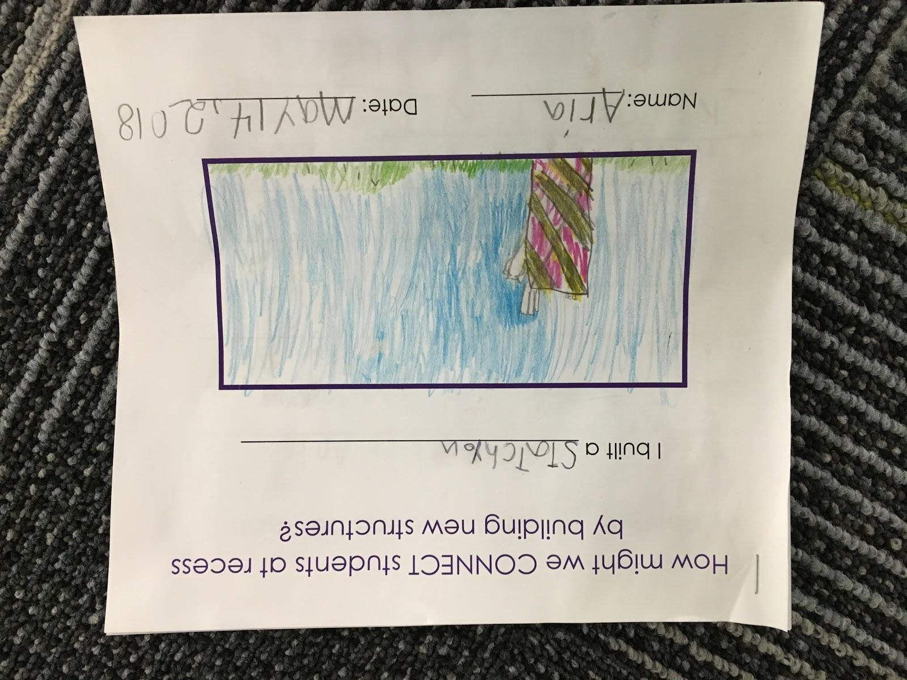
Structures are created to connect people and communities.
**Example from current curriculum, but what can we take from this learning?

Slide 34
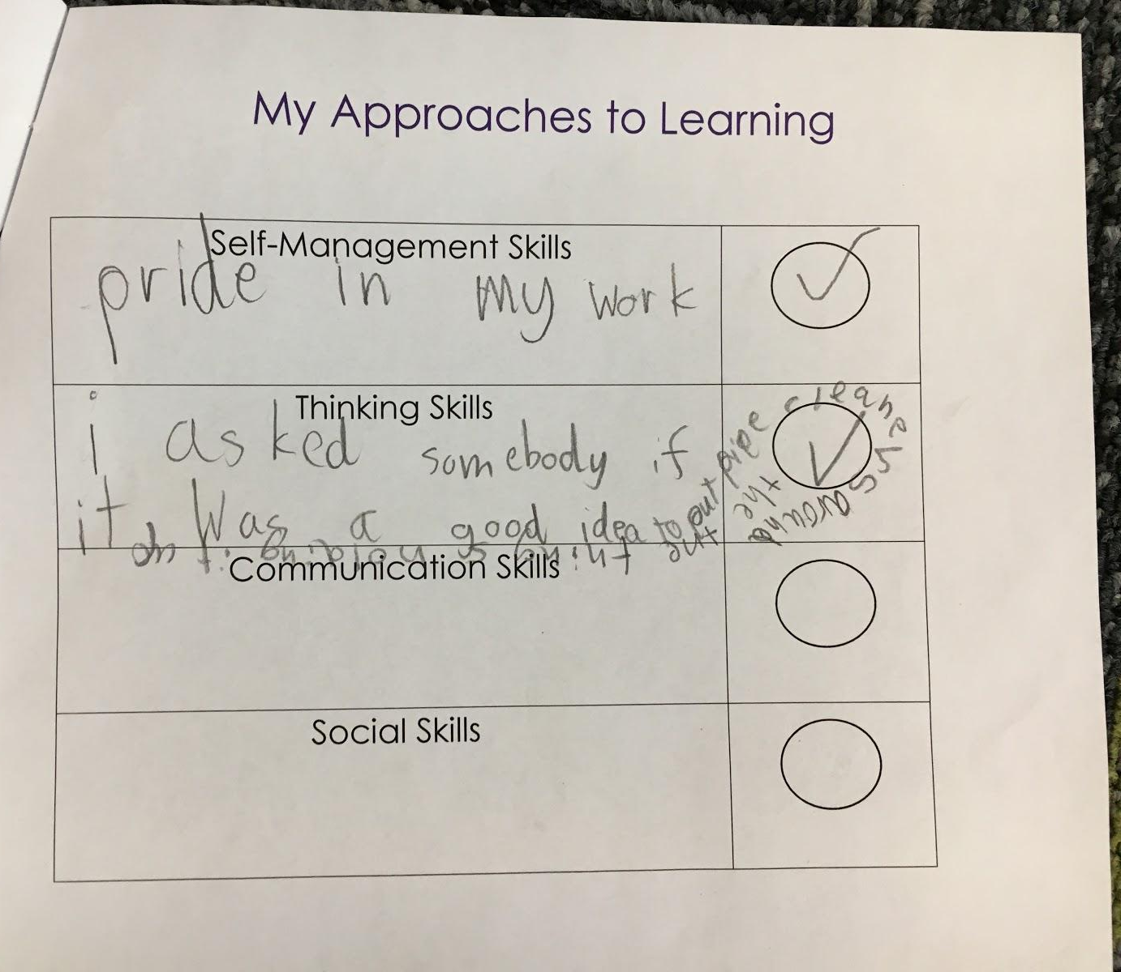


Slide 35

What’s new with Science? Click here for a link to Curriculum Comparison Documents
This link brings you to the ARPDC website with new curriculum resources. You’ll find K - 6 curriculum comparison documents here.

Slide 36

Download a copy!

Slide 37

Please use the chat to let me know what you need!
All the beautiful ways you stretch yourself as a teacher.
The resources we will uncover next week during our session.
Notes:
Photo by Neil Thomas on Unsplash

Slide 38






Summary of Annual Plan
CRC Designers of Professional Learning
Please reach out to us to discuss professional development for your school!
Wanda Dechant
Math
Kim Tackaberry
Literacy and Inclusive Ed
Cheryl
Babin
Curriculum, Pedagogy, Instructional Leadership
Jodi
Taylor
Inclusive Education and Literacy
Donna
Ross
Indigenous Education
Sign up for CRC eNews: https://crcpd.ab.ca/news

Slide 39


