Slide 1

Unpacking the New ELAL Curriculum
Grades 4 to 6

Slide 2

In the spirit of reconciliation, we want to acknowledge that this gathering is taking place on traditional Treaty lands across the province of Alberta - home to many diverse Indigenous, Métis and Inuit peoples.
Spanning generations, acknowledgement of the land is a traditional custom of Indigenous peoples and an important part of reconciliation. It gives voice to the authentic history of the land and its original people.
Honouring the land in this way acknowledges the story of the creation of this country in a way that has historically been missing.
Treaty Acknowledgement
Notes:
Tammy - 1 min

Slide 3

The Journey to the New Curriculum

Slide 4
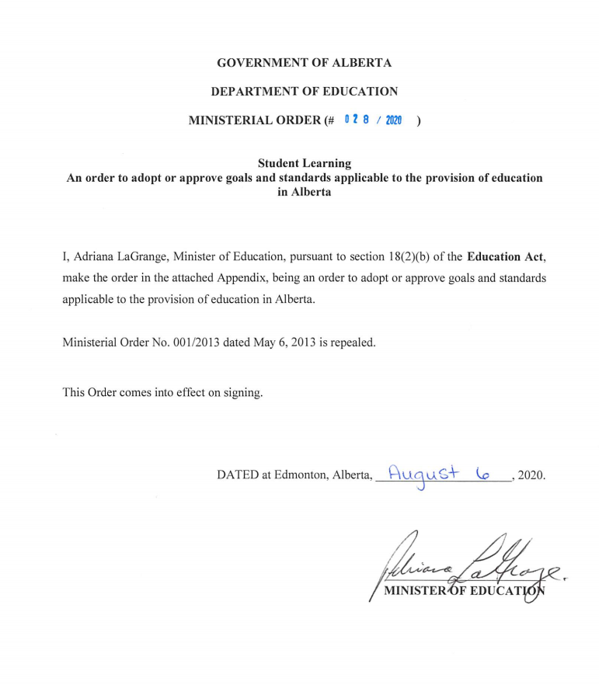
Direction for Curriculum
Ministerial Order on Student Learning
Vision for Student Learning
Foundations for Learning
Outcomes for Learning
“Education in Alberta will promote the acquisition of skills and the pursuit of knowledge with wisdom, while valuing equality of opportunity, parental responsibility, personal responsibility and excellence, and respect for difference and the inherent dignity of each individual.”
Notes:
The Ministerial Order on Student Learning (MO) is a policy document for k-12 education that was signed on August 6th 2020.
It sets the vision for learning: “Students will gain the knowledge and skills to form the foundations for successful and fulfilling lives, and make meaningful contributions to their communities and the world.”
It sets a foundation for learning that focuses on the importance of literacy and numeracy as foundational for student learning.
And, it outlines the outcomes for learning including knowledge development, character development and community engagement.
The Ministerial Order was the foundational document that lead to the development of the Guiding Framework.

Slide 5
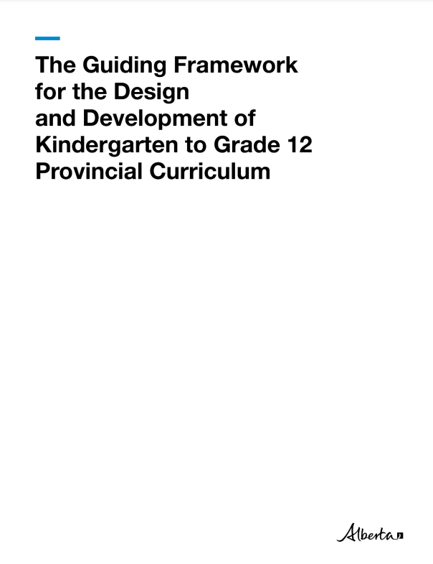
The Guiding Framework
provides transparent guidelines to help parents and educators understand curriculum development in Alberta.
guides curriculum development. Curriculum is the content—what students learn and why it is being taught in each subject from grade to grade.
2020
Notes:
Kelly - 2020…
The Guiding Framework provides transparent guidelines to help parents and educators understand curriculum development in Alberta.
It makes it easier for parents and teachers to understand what is being taught and why it is being taught in each subject and from grade to grade.
The Guiding Framework establishes a
Common design for curriculum in all subjects
Common structure of learning outcomes in all subjects and grades, and
Ensures clear and concise language
The Guiding Framework outlines overall guidelines, features and considerations for developing curriculum that are common to all subjects as well as subject specific guidelines. These informed (and continue to inform) curriculum development.
For example: research shows that when a child is coached to be able to write with clear grammar and logic, the skill of writing about substantive content reinforces long-term memory and clear thinking (Hochman, Wexler, & Lemov, 2017; Kirschner & Hendrick, 2020).

Slide 6
Language Arts and Literature Students will learn:
• to apply phonics, spell words correctly, expand vocabulary, and read with fluency
• to comprehend (summarize, recall, synthesize, draw inferences) and interpret types of text
• the difference between fact and opinion and to evaluate, use, and record information ethically from a variety of sources • to summarize, analyze, and discuss the arguments as presented by an author
• to view, appreciate, and analyze various texts and media
• to speak and present in various contexts through coaching for skillful public speaking
• to write in various genres for a variety of audiences
• the art of listening well and charitably (even to opposing views)
• to use socially and culturally appropriate verbal and non-verbal communication skills (e.g., respectful and inclusive dialogue, body language, tone, clarity of speech)
• to compose and revise their own texts with attention to correct spelling; vocabulary; punctuation; grammar; and sentence, paragraph, and essay or story structure for a variety of audiences
• to develop various techniques for adding elements of beauty and persuasion to their composition of texts with their audience in mind
• to appreciate a body of age-appropriate unabridged stories, fables, poetry, myths, oral traditions, plays, films, novels, and non-fiction texts that all children in Alberta will have in common, forming a foundation of cultural knowledge and a sense of historical continuity and change within the tradition of the language being studied
• to read a diversity of the greatest and most influential writers whose works show that we as humans have much in common that transcends differences and helps us find our own unique voice
• that texts from many traditions have shaped our society and the primary language being studied, including many texts brought in from other languages (e.g., The Odyssey, Beowulf, Aesop’s Fables, Indigenous legends)

Slide 7
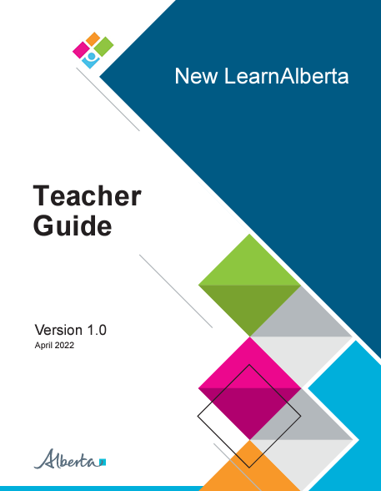
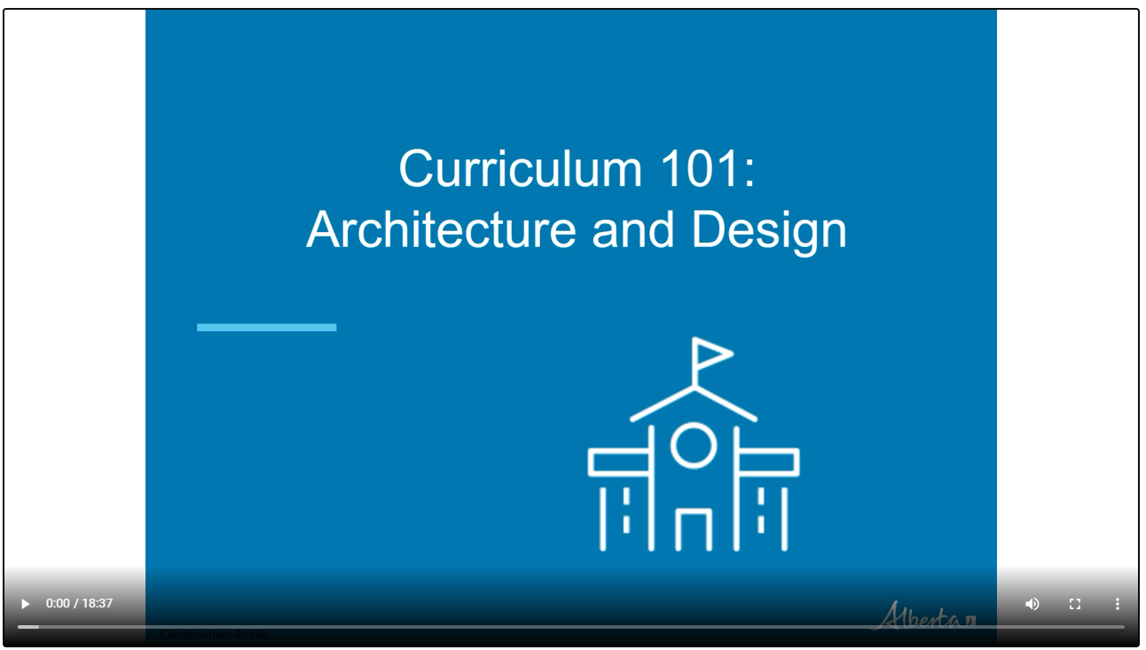
New LearnAlberta Video Overview
Notes:
15 minute video – we won’t play that today-know that it’s there

Slide 8

Navigating the New Curriculum
Notes:
Tammy - Structure

Slide 9

Go to New Learn Alberta
Go to NewLearnAlberta
Notes:
Kelly - There are added features if you have a log-in

Slide 10
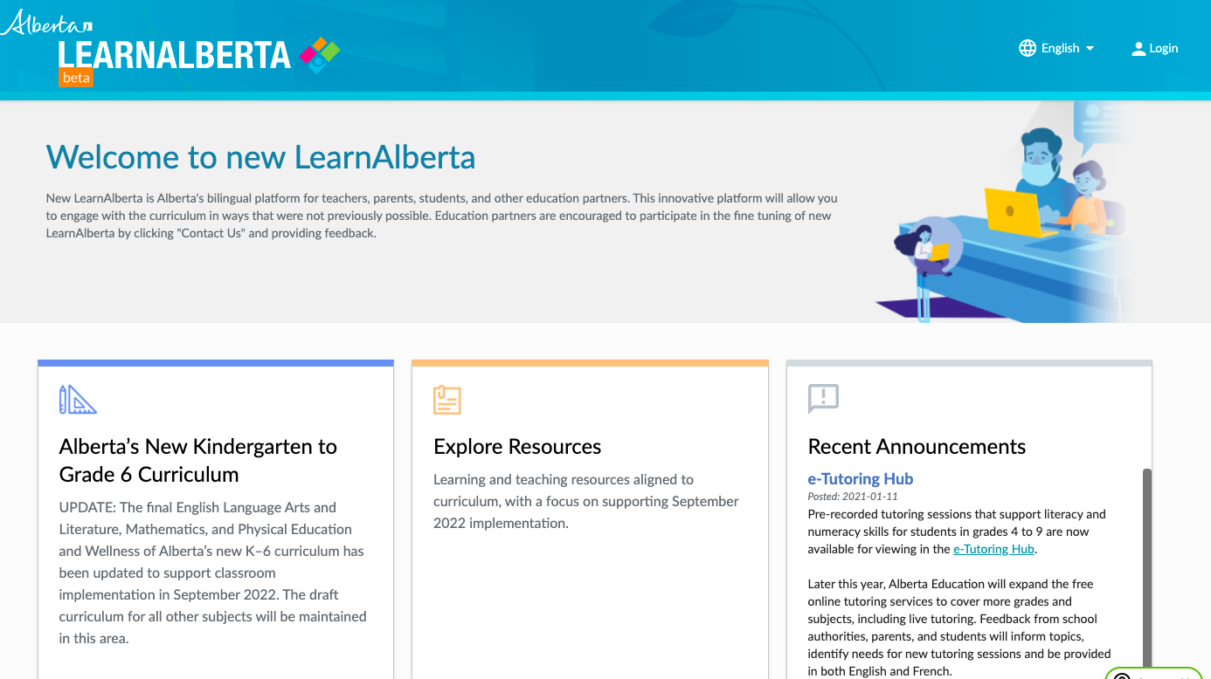
To Access: curriculum.learnalberta.ca
Notes:
Kelly

Slide 11
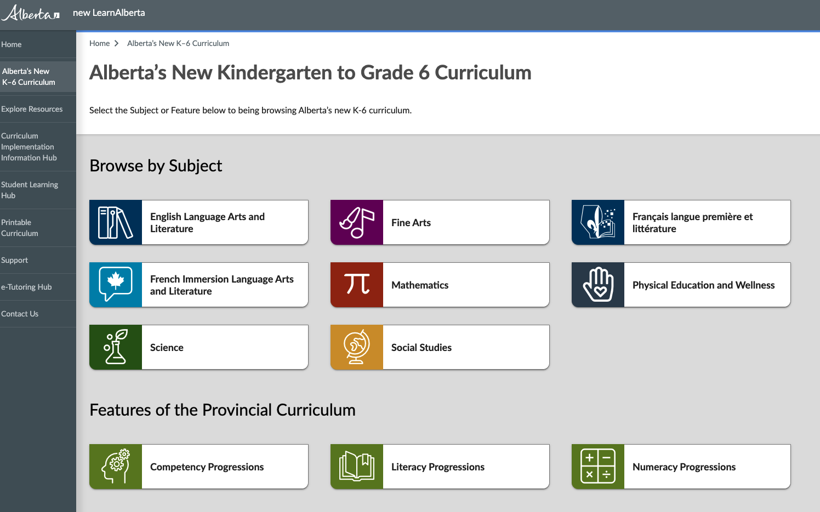
Notes:
Kelly - 2 versions
printable version - and digital
QR code for access as well

Slide 12
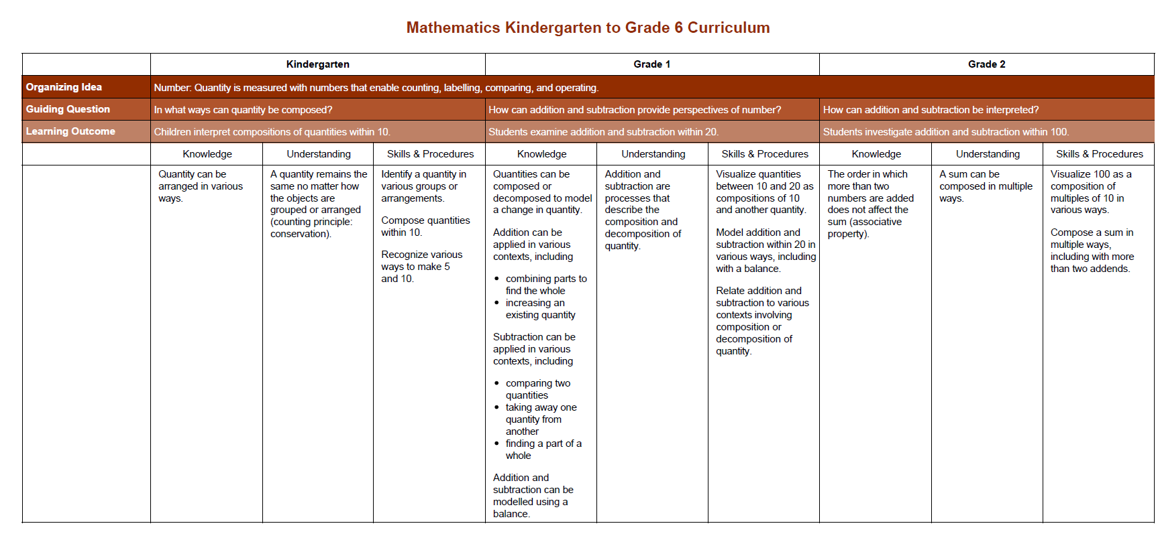
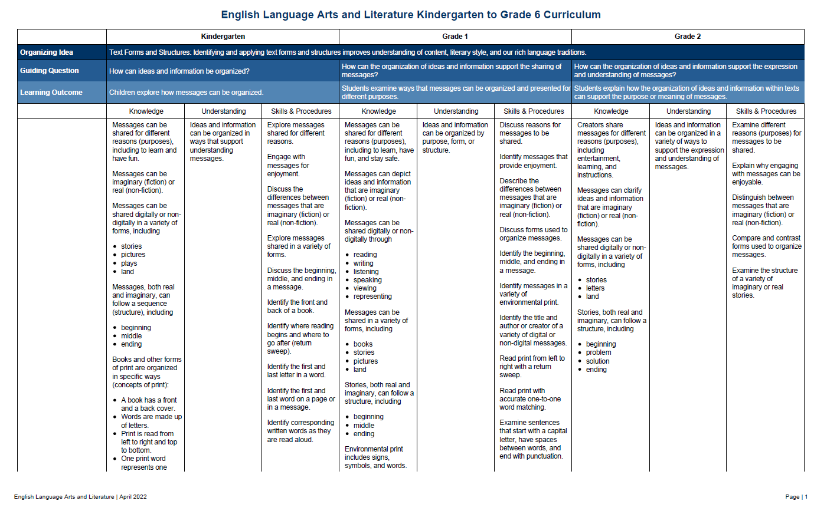
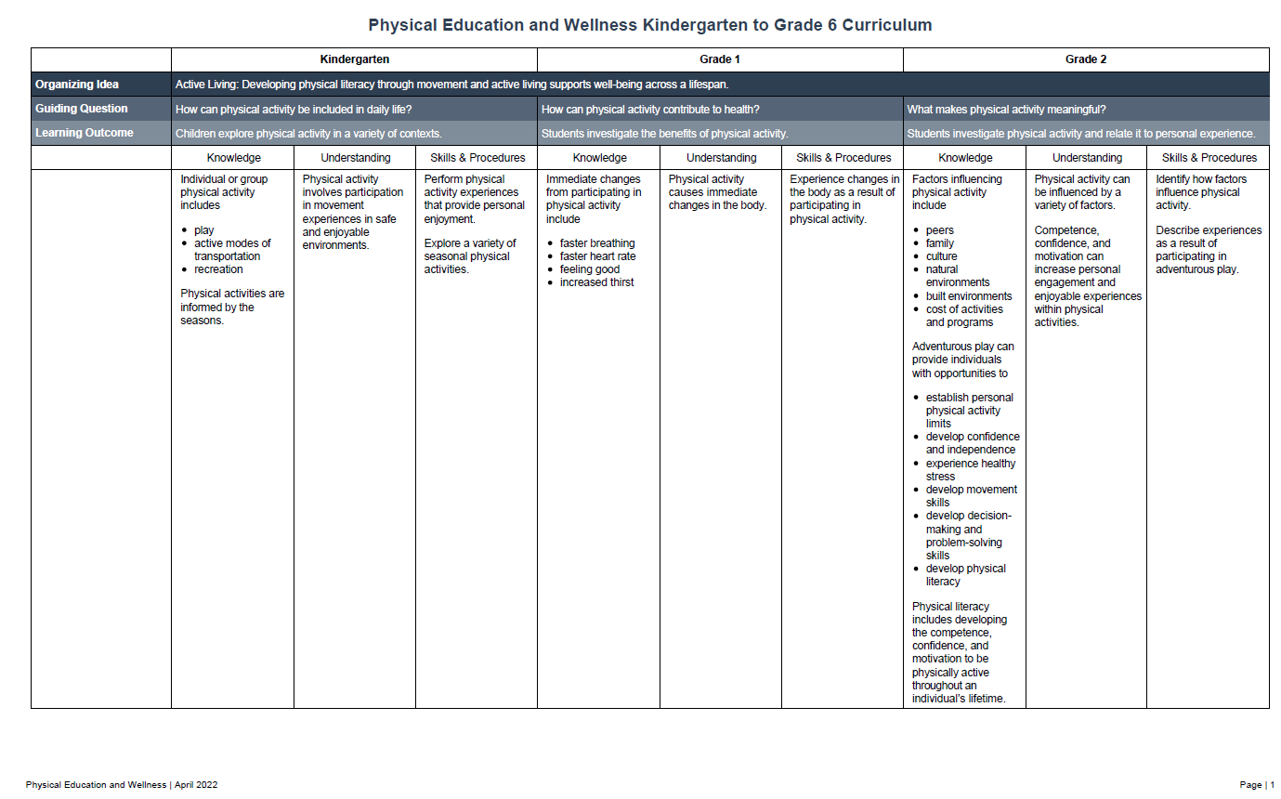
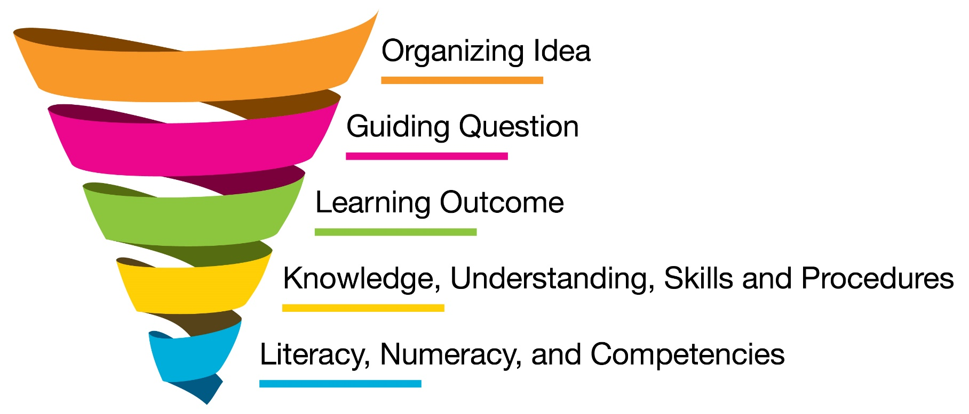
3 Common Features Across All Subjects
Architecture and Design
Learning Outcomes
Clear and Concise Language
Notes:
Tammy
Architecture and design: The architecture and design provides a systematic and logical arrangement that is consistent for all core subjects of the provincial curriculum.
Structure of learning outcomes: Each learning outcome includes one or more concepts that are the focus for students’ learning and assessment experiences.
Clear and concise language: This helps to give clear direction and accountability for teachers and helps enable parental oversight of their children’s education.

Slide 13
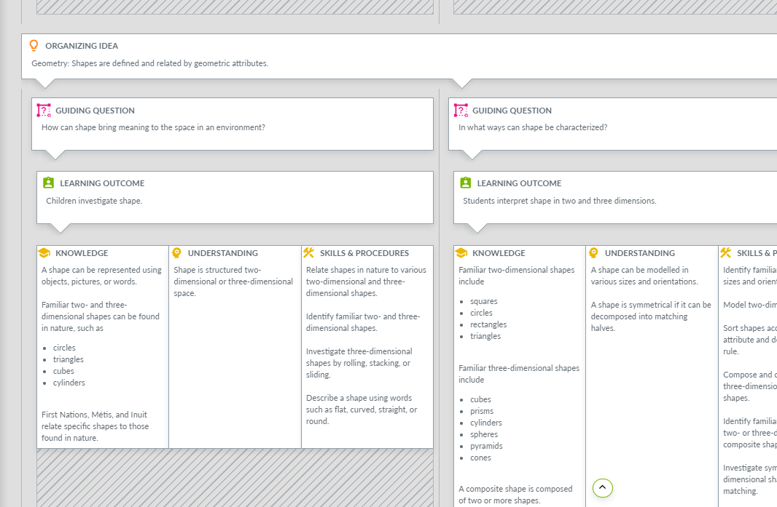


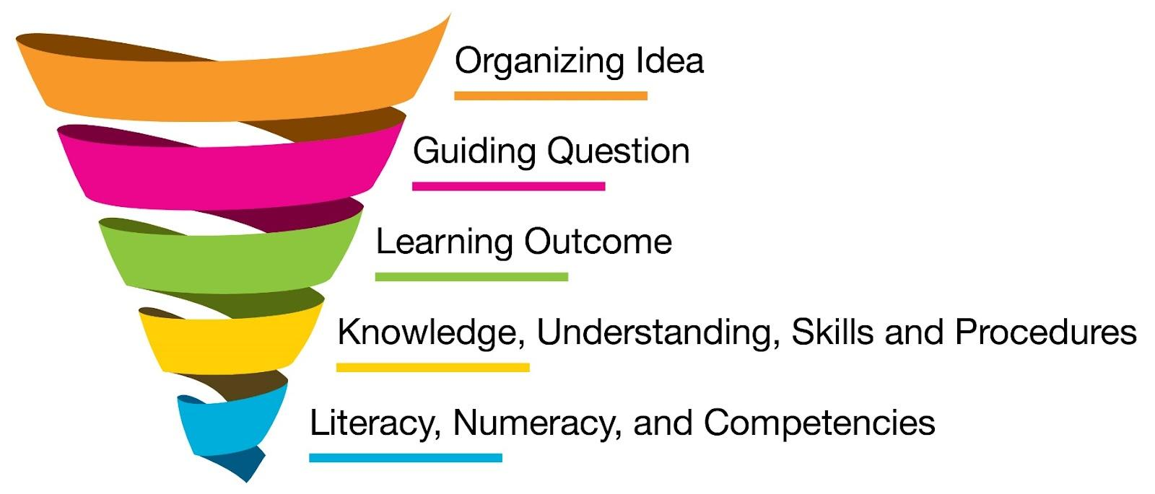
Notes:
Tammy
In the bottom right hand you will see the critical components or pieces that make up curriculum and are so important to teachers.. Notice that they are spiralled. You need to understand what each of them are and how they can be used to plan your learning experiences and assessments.
Big ideas and essential understandings are in there.

Slide 14
Unpacking the Curriculum
in
ELAL
Notes:
Tammy

Slide 15

REMEMBER: Curriculum and Pedagogy
Curriculum is the ‘what’ to teach and not the ‘how’ to teach.
Notes:
Tammy - Even though the curriculum outcomes are changing
Social-emotional and academic needs of students
Strong pedagogy
Assessment that reveals evidence of learning and informs differentiated response
Add in picture

Slide 16
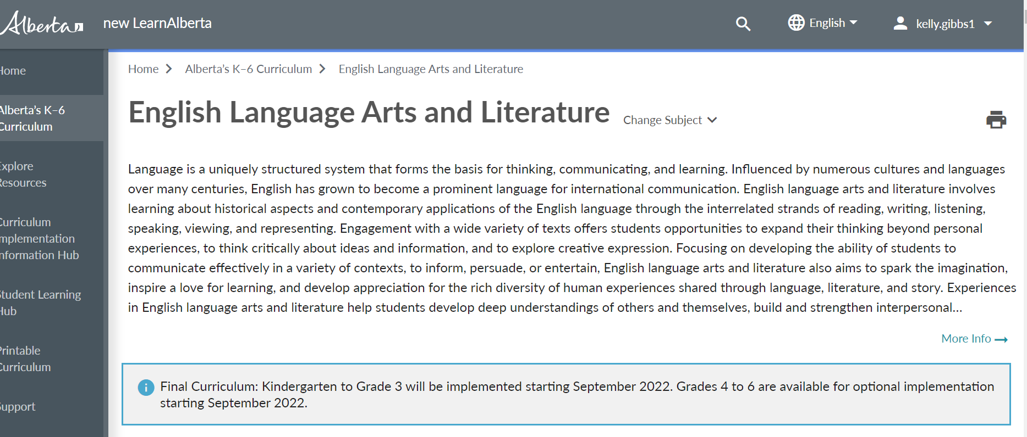
DIGITAL VERSION
Notes:
NO link here…on the next slide

Slide 17
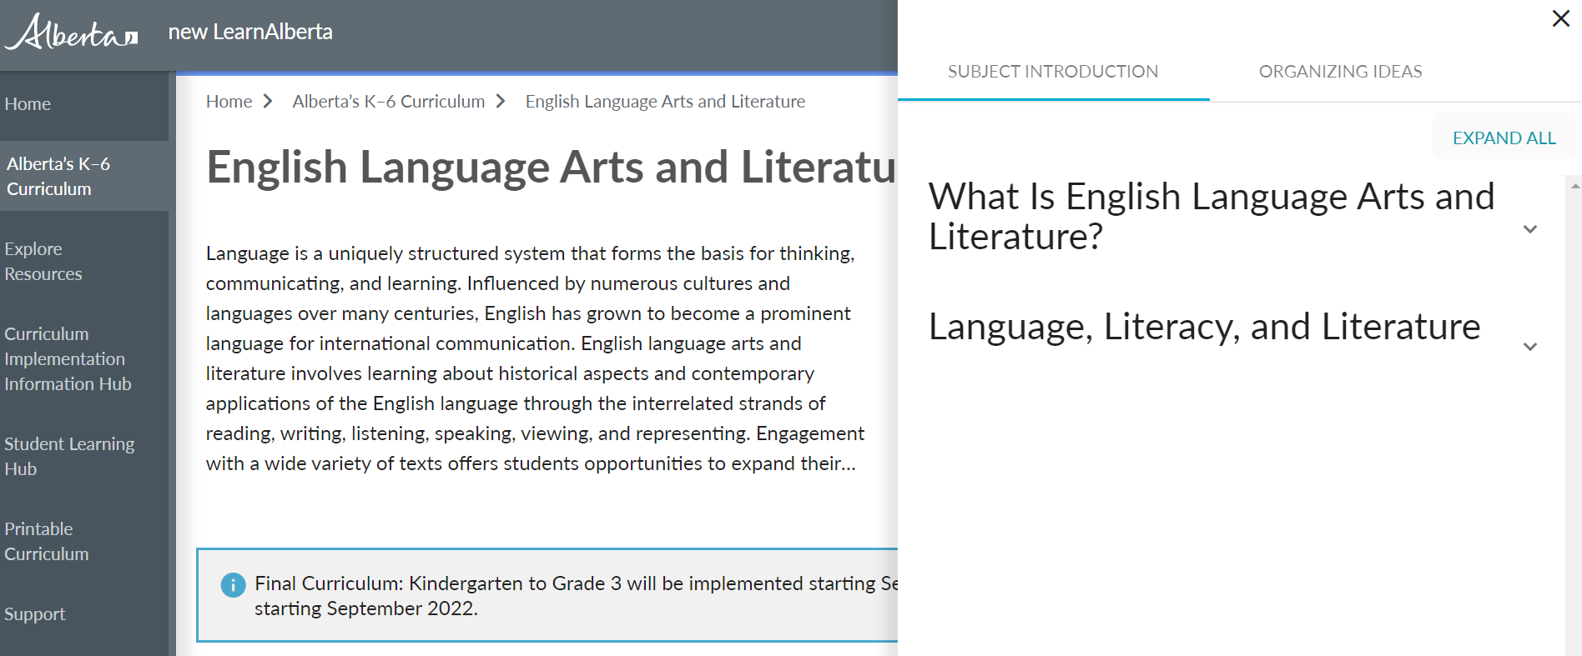
DIGITAL VERSION
Notes:
The front matter is important - summarized in the next slides

Slide 18
What is English Language Arts & Literature?
Alberta Education says…(adapted)
A structured system as the basis for thinking, communicating and learning
Engagement with a wide variety of texts offers opportunities to expand thinking beyond personal experiences and to think critically and explore creative expression
Help students develop deep understandings of others and themselves, build interpersonal relationships and engage in responsible citizenship
Provides a solid foundation in language, literacy and literature to support students in achieving personal and academic goals
Notes:
The Front matter

Slide 19

Literacy
involves acquiring and applying the understandings necessary to:
decode
evaluate
logically communicate ideas
build meaning
Image from joyinreading.org

Slide 20
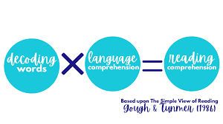
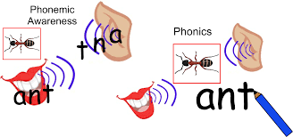
Foundational Literacy: Specific to Decoding
Phonological awareness
Phonics
Identify and manipulate sounds in ORAL language
Understand relationships between sounds and letters
Fluency in order to read a range of texts accurately, automatically, and with expression
Comprehension-students apply foundational
knowledge in order to demonstrate comprehension
of increasingly complex messages
Image from teachphonics.blog
Notes:
New

Slide 21

In Writing:
Apply comprehension of messages and expand verbal and written vocabulary through the study of word meaning, origins and structures
Explore ways to share ideas and respond to text
Students apply writing processes and language conventions to organize ideas and communicate effectively & form opinions based on research

Slide 22
Let’s remember… the 5 Pillars of Reading (National Reading Panel 2000) As we Discuss Structured Literacy
Phonemic Awareness
Phonics
Fluency
Vocabulary
Comprehension
Notes:
1. Phonemic awareness: The ability to distinguish, produce, remember, and manipulate the individual sounds (phonemes) in spoken words…phonemes are blended in spoken words and can be broken apart (segmented).
-a necessary underlying skill for mapping alphabetic symbols to spoken words and can be developed through instruction
2. Phonics: Knowledge of the predictable correspondences between phonemes and graphemes (the letters and letter combinations that represent phonemes).
-readers use phonics as they learn to decode unfamiliar words, to recognize familiar words accurately and automatically, and to spell.
-Explicit, systematic instruction in phonics helps average children learn to read and spell more accurately and fluently than those who don’t receive phonics instruction.
3. Fluency: Reading text with sufficient speed and accuracy to support comprehension. Fluency can be enhanced with various instructional techniques and with reading practice.
It is said that to comprehend well, students must achieve adequate oral reading fluency rates.
4. Vocabulary: Best achieved by reading itself, oral language practice, and instruction in a wide range of topics
-Reading comprehension depends heavily on knowledge of the individual word meanings in a text, and those meanings are learned by repeated exposure to a word’s use in context and by explicit, direct instruction in word meanings.
5. Comprehension: Requires comprehension skills and strategies, background knowledge, and verbal reasoning.
-Teachers can be instrumental in imparting to children the skills and strategies necessary to navigate narrative and expository texts
§ In a grapheme-phoneme level approach, children would learn to decode the word brick by learning the sounds for the letters (graphemes) b, r, i, and the letter pattern –ck, as well as how to blend the four sounds represented by those graphemes.
§ In an onset-rime approach, the emphasis would be on somewhat larger units within words; to decode brick, children would learn sounds for the letter patterns associated with the onset br- and the rime –ick, and how to blend those two parts.
§ In analogy phonics or a word families approach, the focus would be on whole words. Children would learn to read brick by comparison to a word they can already read, such as sick, or they would learn patterned words from a “family” such as sick, stick, trick, pick, and brick
The NRP (2000) found that many phonics approaches were more effective than not teaching phonics at all or than relying only on incidental, unsystematic phonics, but it did not find a difference between larger-unit and smaller-unit phonics approaches.
BUT…later NRP research suggests that phonics instruction with an initial focus on grapheme-phoneme level relationships, rather than larger-unit phonics approaches, can lead to better reading outcomes, especially on more advanced code skills.
-need to learn to decode more complex types of words, children must also be taught about larger units in words such as common orthographic patterns (e.g., igh, ea, ar), as well as about morphology (i.e., word parts that carry meaning such as roots, prefixes, and suffixes).

Slide 23
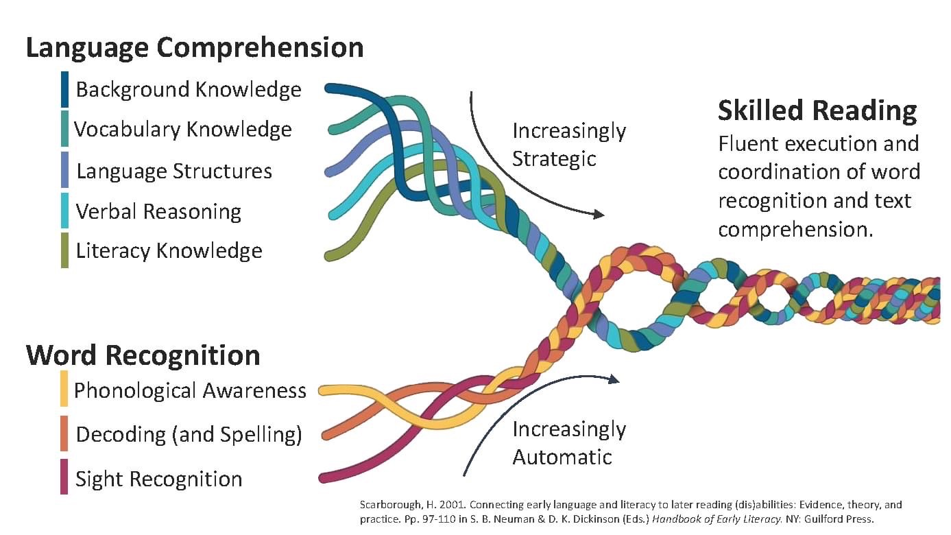
Scarborough’s Reading Rope
Notes:
The k-1 piece of the curriculum focuses on
THE BOTTOM OF THE ROPE,
& so let’s talk about THE TOP OF THE ROPE
that INCORPORATEs COMPREHENSION
TOGETHER….THIS BUILD THE READING ROPE TOWARDS BECOMING A SKILLED READER
Hollis Scarborough 2001

Slide 24

LANGUAGE COMPREHENSION STRAND:
Strand One: Background Knowledge
The knowledge and experience a child brings to reading
It is the knowledge of what has been gained in the world
Background knowledge will vary from person to person
Background knowledge strengthens our comprehension

Slide 25

LANGUAGE COMPREHENSION STRAND:
Strand Two: Vocabulary
Part of and works with Background Knowledge, Verbal Reasoning, Comprehension
We learn words through our Social and Academic experiences

Slide 26

LANGUAGE COMPREHENSION STRAND:
Strand Three: Language Structures
(Of Yoda from Star Wars you should think)
Syntax and Semantics (so, grammar/meaning!)
Understanding how words go together to convey meaning
Arrangement of words in a phrase or sentence
Lots of patterns and rules
Build comprehension
How language works

Slide 27
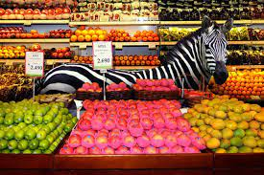
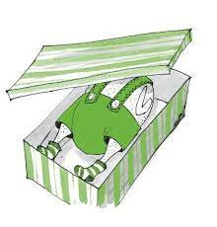
LANGUAGE COMPREHENSION STRAND:
Strand Four: Verbal Reasoning (connections)
The Grocery store was a zoo!
Think: Amelia Bedelia (‘dressing the turkey’ or ‘drawing the drapes’)
Combining knowledge and vocabulary
Express that knowledge and vocabulary through verbal reasoning
Make connections to move ideas, understanding and connections further
The means to problem-solve and deepen our knowledge

Slide 28

LANGUAGE COMPREHENSION STRAND:
Strand Five: Literacy Knowledge
A wide exposure to a variety of literary styles
Gives students a more developed framework on which they can rely as they read more and more for themselves
Exposure to a variety of stories, stories with different themes, from different cultures and for different purposes.
When a student is able to connect something they are reading to a story/text/theme/purpose they have already internalized, they will be better able to understand and stick with it through challenges.
Notes:
POSTERS ONTO STRANDS

Slide 29



The Work of Constructing Meaning
THE STRANDS ARE A METAPHOR FOR READING
WEAVING ALL THE STRANDS TOGETHER IS NECESSARY
ANY FRAYED STRAND CREATES A BREAKDOWN

Slide 30
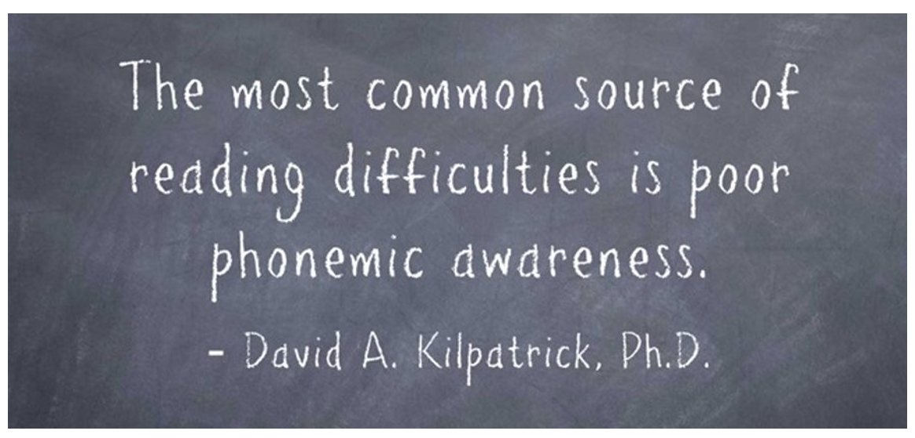
Notes:
And sometimes we need to go back to the curriculum to focus on support

Slide 31
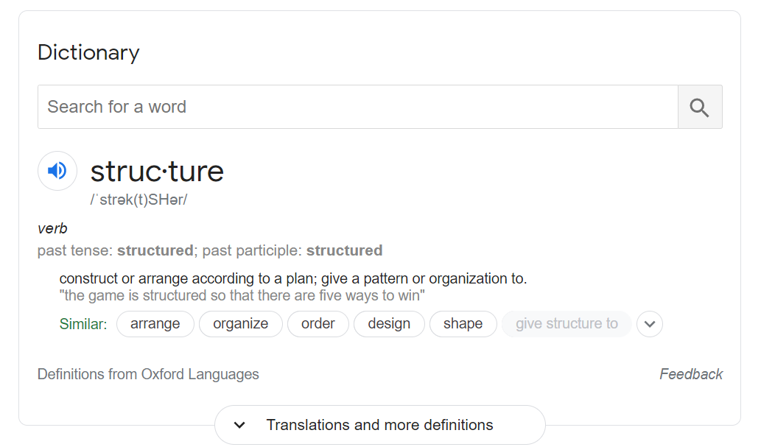
Structure(d)

Slide 32
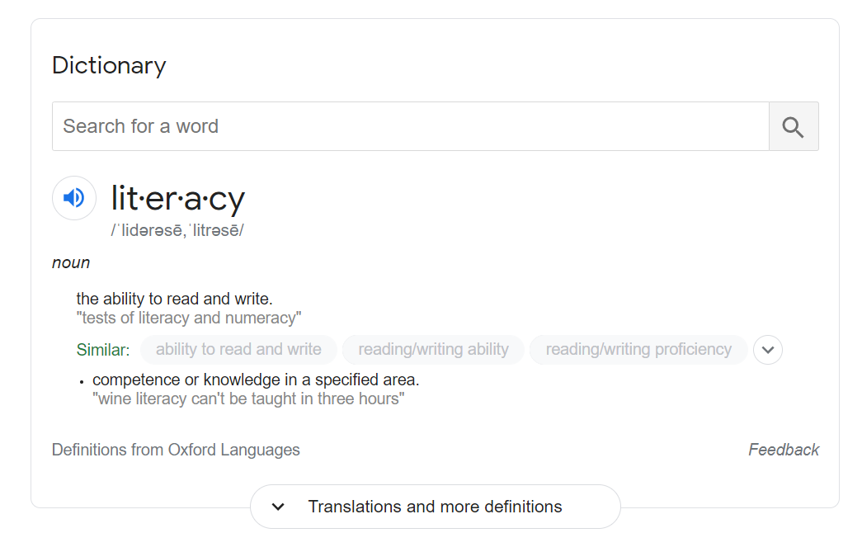
Literacy

Slide 33
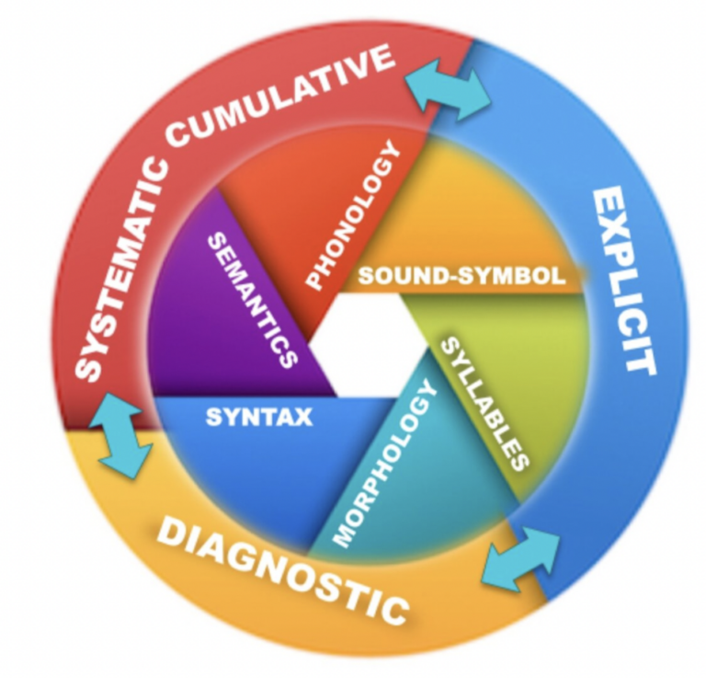
Details of the Structured Literacy Approach

Slide 34






Structured Literacy requires:
PHONOLOGICAL AWARENESS
PHONICS AND WORD RECOGNITION
FLUENCY
VOCABULARY
LISTENING AND READING COMPREHENSION
WRITTEN EXPRESSION
Notes:
Look at the needs that may not be being met in a sequential manner in traditional literacy programs
What is taught in Structured Literacy?
Phonological awareness
Research has shown that 'phonological awareness' is a key foundational skill for learning to read well. Phonological awareness is the ability to separate and manipulate the sounds in spoken language, including words in a sentence as well as syllables and individual sounds in a word.
Phonics & Word Recognition
Decoding and spelling skills are taught explicitly, including letter-sound associations (alphabetic principle), morphology, and strategies for reading phonetically irregular and multi-syllable words. Instruction is supported by the use of decodable texts. Spelling instruction also includes explicit instruction of spelling rules and guidelines.
Fluency
Reading fluency is the ability to read words quickly enough and with accurate phrasing to retain the meaning. Techniques such as repeated readings and fluency drills can help improve reading rate and prosody, and subsequently comprehension.
Vocabulary
Vocabulary knowledge is critical in reading comprehension. All instruction should be in a language rich environment. Specific vocabulary instruction activities include teaching morphology, classroom conversation, reading aloud, wide independent reading, word-learning strategies and word play.
Listening & Reading Comprehension
Instruction addresses many contributors to language comprehension including background knowledge, vocabulary, syntax, semantics, verbal reasoning, sentence processing, knowledge of literacy structures and conventions, and skills and strategies for close reading of text.
Written Expression
Written expression instruction includes the mechanics and conventions of writing, composition (handwriting, spelling, punctuation, syntax), semantics, as well as the phases of the writing process (composition, revision, and editing).

Slide 35

Curriculum Connections:

Slide 36
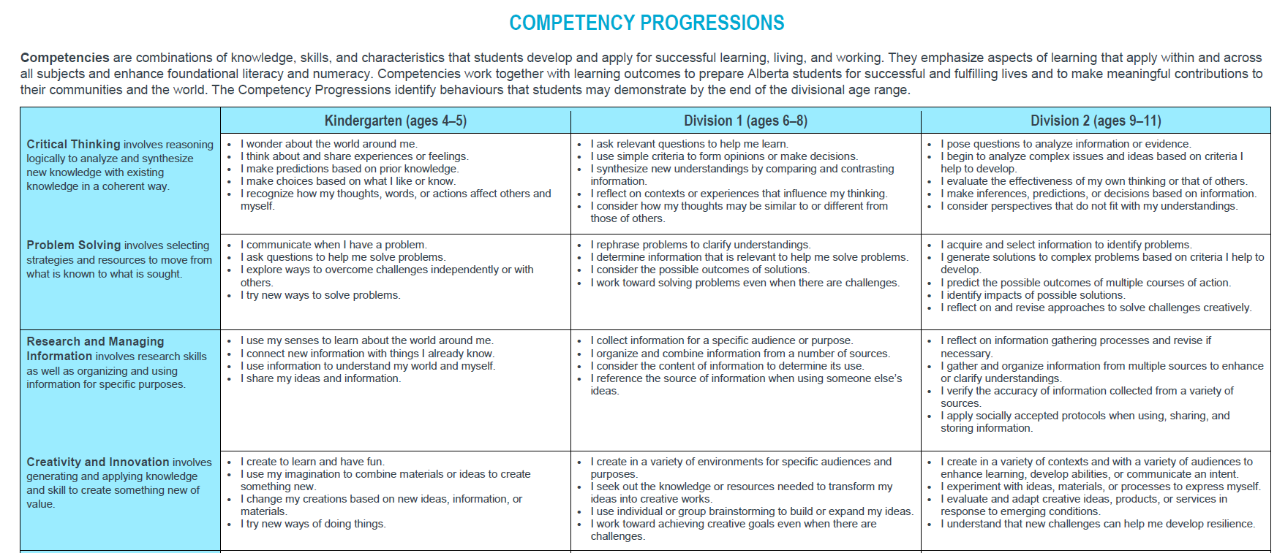
Competencies
Critical Thinking
Problem Solving
Research and Managing Information
Creativity and Innovation
Communication
Collaboration
Citizenship
Personal Growth and Well-being
Notes:
Tammy - The Competency, Literacy and Numeracy Progressions play an important role in planning for classroom learning experiences. When they experience repeated experiences with progressions which are embedded in daily learning experiences, their skills develop

Slide 37

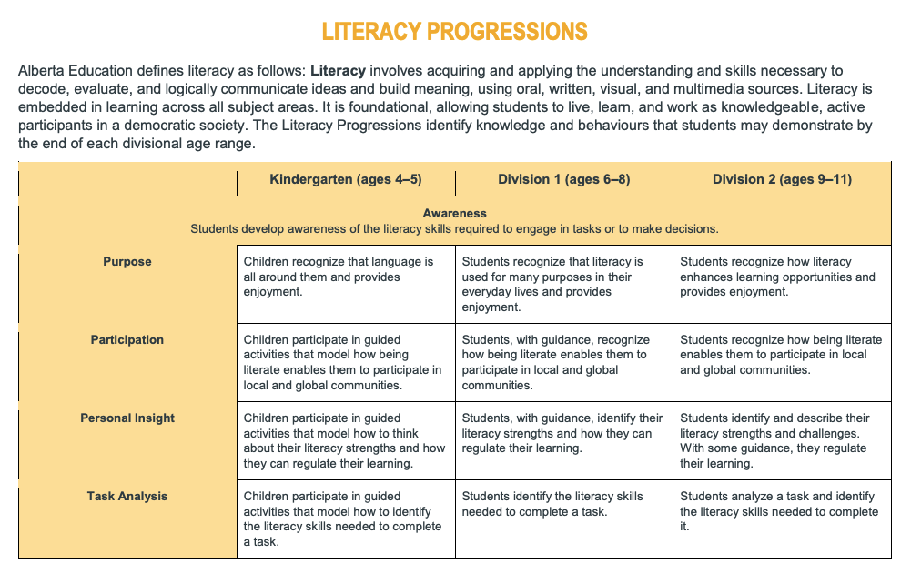
Literacy Progressions
Awareness
Rules of language
Acquire Information
Construct Meaning
Communicate Meaning
Notes:
Kelly - we looked at this briefly earlier - this is the depth! - DEMONSTRATED BY THE END OF THE DIVISIONAL AGE RANGE
-consistent across the DIVISIONS (K, Div 1, Div 2) - if you are familiar with the 5 pillars of reading (NRP 2000) then you can see how the new curriculum covers reading acquisition of decoding, spelling, fluency, vocabulary and comprehension and into writing
Awareness/Rules of Language/Acquire information (through reading) - 1st three pillars of reading phonemic awareness/phonics, fluency
Acquire information and construct meaning - last 2 pillars - Vocabulary and Comprehension through reading
AND we have a means to Communicate meaning (writing) through all-phonics and comprehension with vocabulary

Slide 38
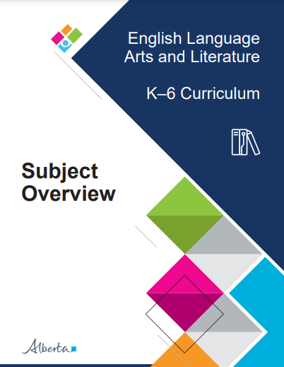
Subject Specific Overview

Slide 39

Bridging Documents for ELAL (found under “Curriculum Implementation” hub)

Slide 40
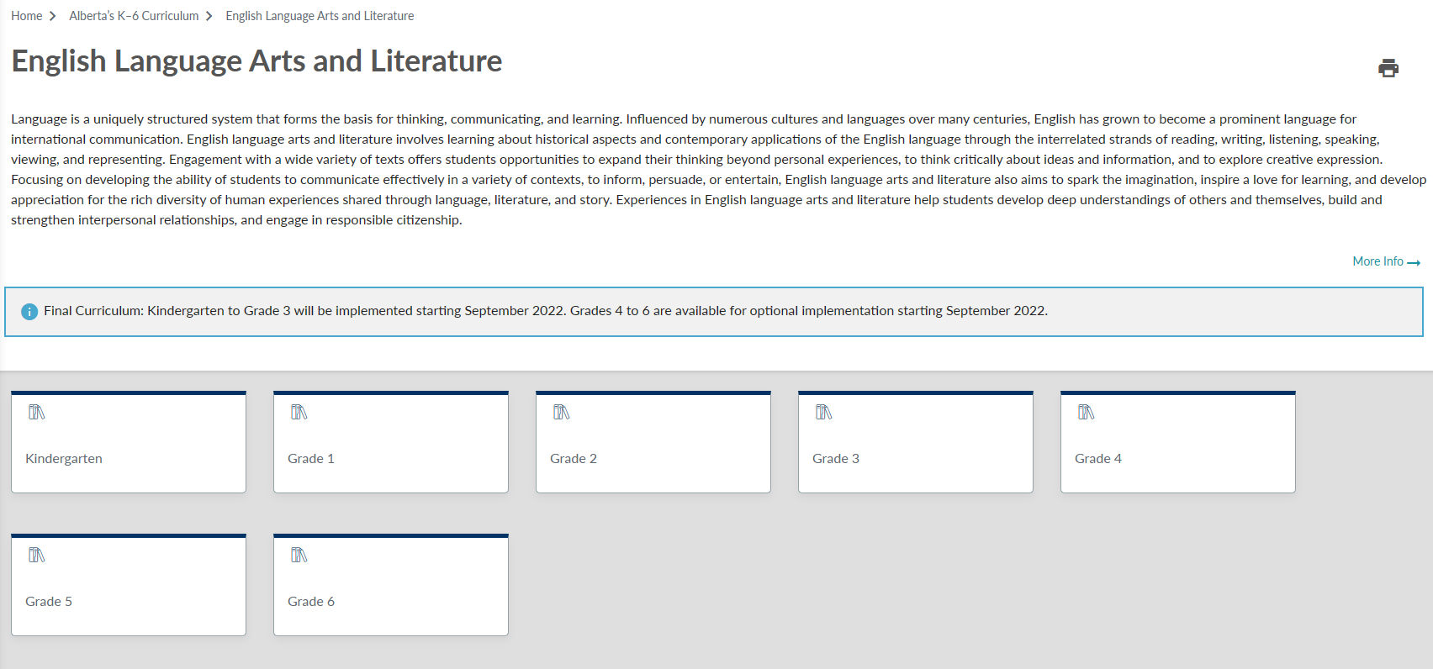
ELAL Curriculum Overview (“More info” icon)

Slide 41
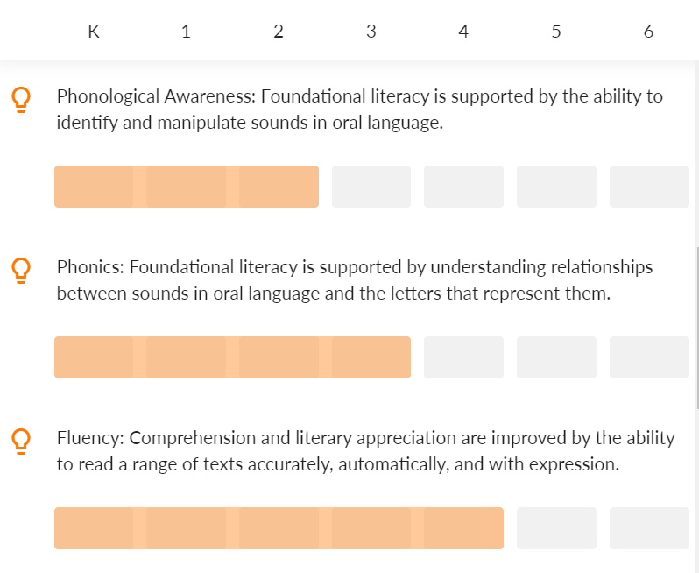
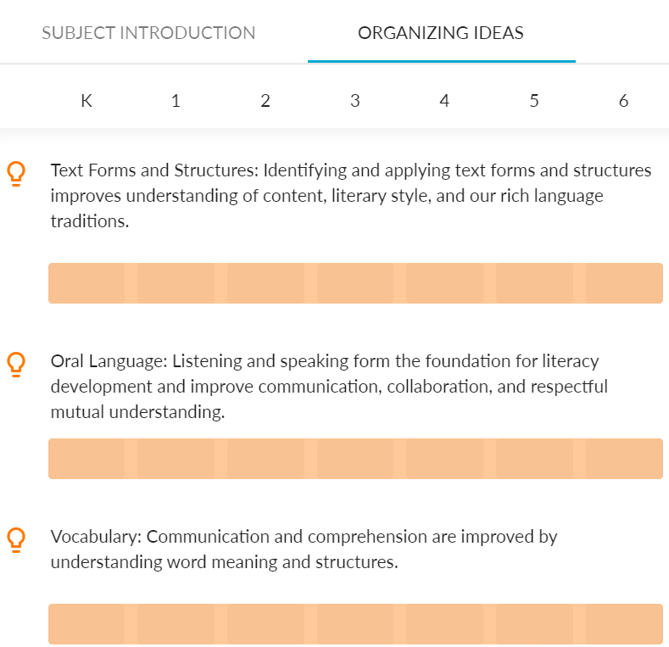
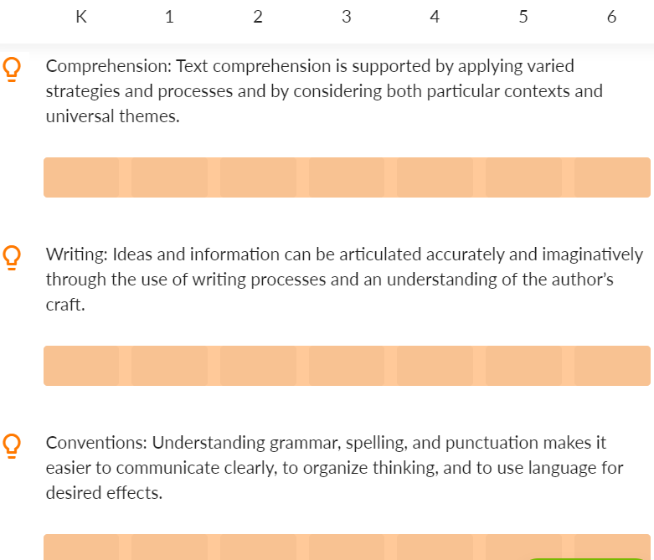
OI from K-6
Notes:
Can be found on the first page - to the right where the front matter of ELAL is

Slide 42
Current ELA STRANDS:
Students will listen, speak, read, write, view and represent to:
explore thoughts, ideas, feelings and experiences
comprehend and respond personally and critically to oral, print and other media texts
manage ideas and information
enhance the clarity and artistry of communication
respect, support and collaborate with others.
Current ELA STRANDS:
Students will listen, speak, read, write, view and represent to:
explore thoughts, ideas, feelings and experiences
comprehend and respond personally and critically to oral, print and other media texts
manage ideas and information
enhance the clarity and artistry of communication
respect, support and collaborate with others.
New: ELAL ORGANIZING IDEAS:
Text Forms and Structures
Oral Language
Vocabulary
Phonological Awareness
Phonics
Fluency
Comprehension
Writing
Conventions
New: ELAL ORGANIZING IDEAS:
Text Forms and Structures
Oral Language
Vocabulary
Phonological Awareness
Phonics
Fluency
Comprehension
Writing
Conventions
Notes:
Web link to the current curriculum

Slide 43

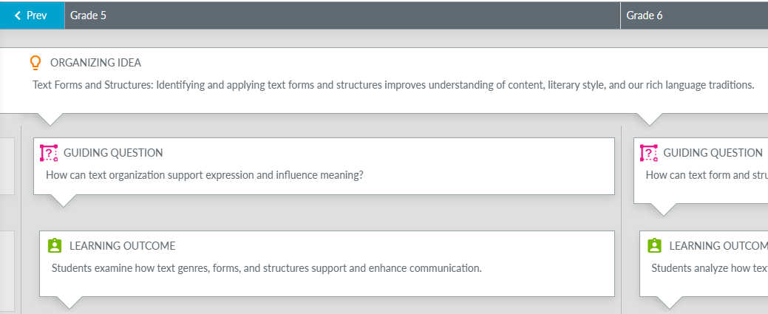

EXAMPLE:
Grade 5 ELAL Curriculum
Notes:
Click on the MORE INFO at the bottom of the front matter…goes to the

Slide 44
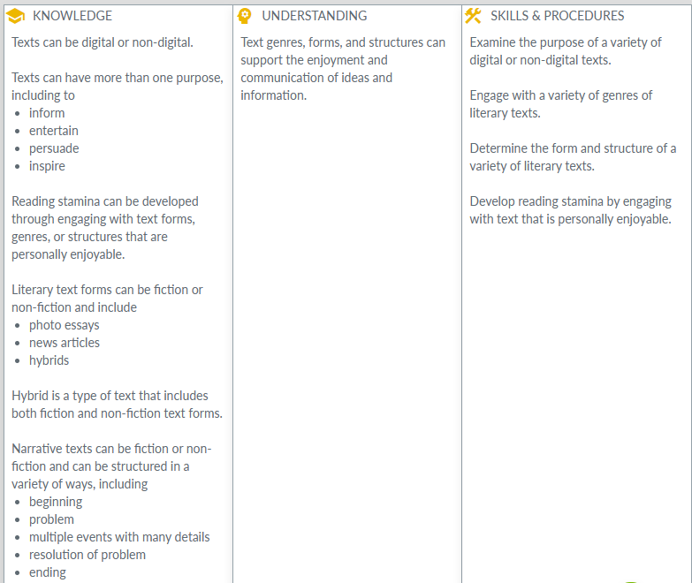
KUSPs (Grade 5 ELAL example continued)
Notes:
These are SOME of the curriculum KUSPs….there are more

Slide 45
Documents - New and Previous Curriculum (CARC)
Grade 4 Comparison
Grade 5 Comparison
Grade 6 Comparison

Slide 46
Curriculum Connections:

Slide 47
Subject Overview(s)

Slide 48

CURRICULUM MATCH! In your grade group, connect the OI & GQ to LO to KUSPs

Slide 49

Breaking Open Syllable Words

Slide 50
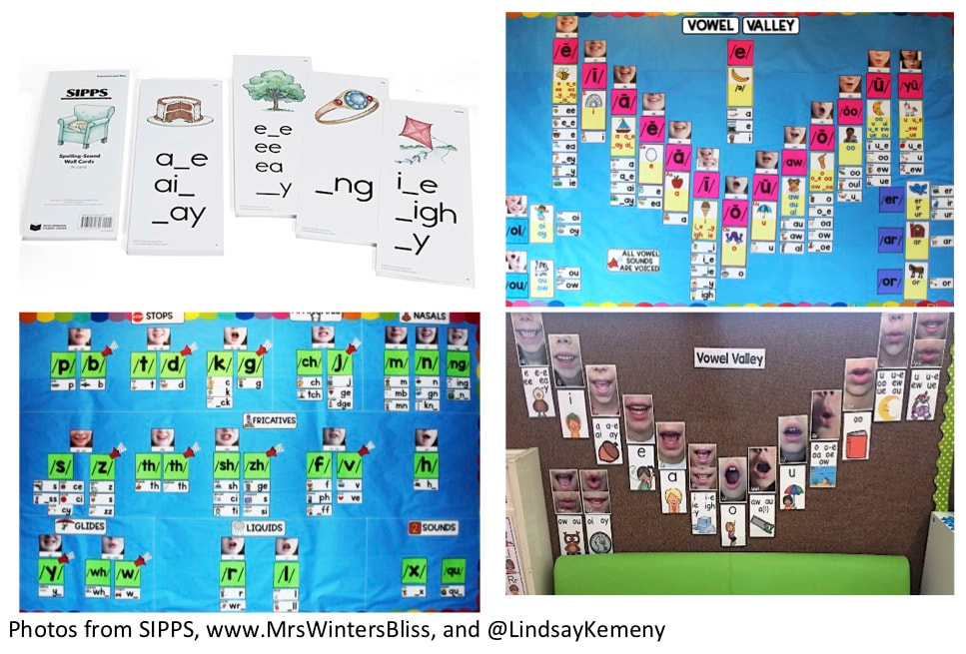
Sound Walls (2 part series; by Kelly Gibbs, ERLC)
What are they and how to implement them?

