Slide 1
Money Talks – Grade 6 Financial Literacy
JULY ‘22 CHANGE NOTICE: We’ve added a one-line style for titles to give you more space on each slide when you have short titles.
Junior Achievement of Southern Alberta
Notes:
Welcome to our Money Talks session today. My name is Chris Meaden. I am proud to be a long time educator, especially with the Calgary Board of Education, and now representing Junior Achievement of Southern Alberta as their Director of Teacher Development. My goal is to share a little bit of information about our organization and our programs especially those in financial literacy. I look forward as well to your feedback about how we can support your work in accomplishing the related outcomes in the new curriculum.
As we begin“I would like to take this opportunity to acknowledge the traditional territories of the peoples of the Treaty 7 region in Southern Alberta, which includes the Blackfoot First Nation tribes of Siksika, the Piikuni, the Kainai, the Stoney Nakoda First Nations tribes of Chiniki, Bearspaw, and Wesley and the Tsuut’ina First Nation. The city of Calgary is also homeland to the historic Northwest Métis and to Métis Nation of Alberta, Region 3.

Slide 2
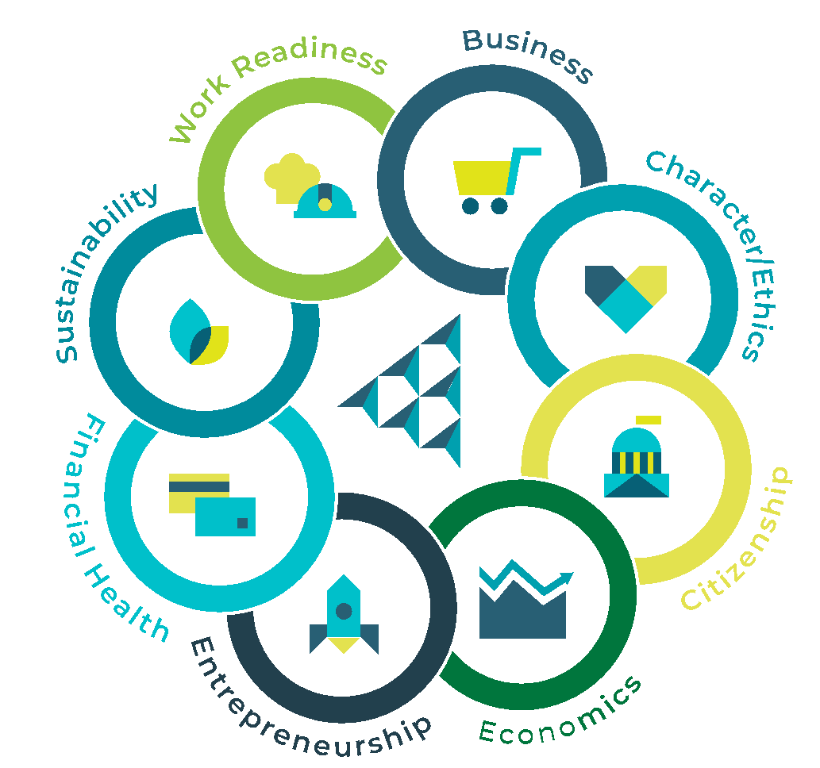
About JA
As a member of the world’s largest and most-impactful youth-serving NGOs Junior Achievement, JA Southern Alberta delivers hands-on, immersive learning in entrepreneurship, financial health, work readiness, sustainability, STEM, economics, citizenship, ethics, and more.
Reaching more than 12 million young people globally each year through nearly half a million teachers and business volunteers, JA Worldwide is one of few organizations with the scale, experience, and passion to build a brighter future for the next generation of innovators, entrepreneurs, and leaders.
Notes:
Junior Achievement Southern Alberta is proud to be part of JA Worldwide - a global Non-Governmental Organization that has been in existence for over 100 years and that includes over 120 local chapters.

Slide 3



Skills we focus on
Entrepreneurship training
Financial literacy
Career readiness
Notes:
As an organization, JA continues to build and grow opportunities to help our students build their skills in three key areas - financial literacy, career readiness and entrepreneurship training. Through the opportunities provided, it has been exciting to see evidence of student growth, not only in terms of their financial literacy but also their financial capability and even financial capacity. You will see the term financial capacity more and more in literature – that motivation and knowledge that individuals have to engage with and use financial information to make sound decisions. Some of our volunteers and professionals have even found the information useful in their own financial planning – linking to what the literature also calls financial health.
I am interested in our audience today. Please feel free to turn on your microphones or identify in the chat if you have worked with Junior Achievement in the past – as a student, a teacher, a parent or a volunteer!

Slide 4
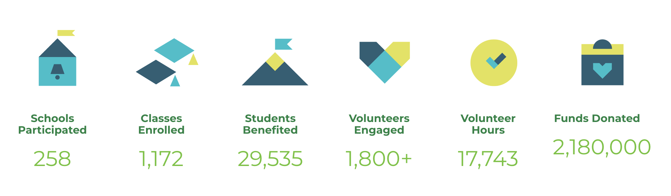
JA Southern Alberta - Our reach
Notes:
JA Southern Alberta is a regional office and one of the largest in Canada. We work with other regions including Junior Achievement of Northern Alberta and NWT to consider our provincial needs and develop new materials based on what is happening locally – in this case, our new provincial curricula.
Because of our reputation and our ability to respond, JA Southern Alberta is proud to report a substantial increase in our reach – as of December this year, almost 30, 000 students accessed our programs.

Slide 5

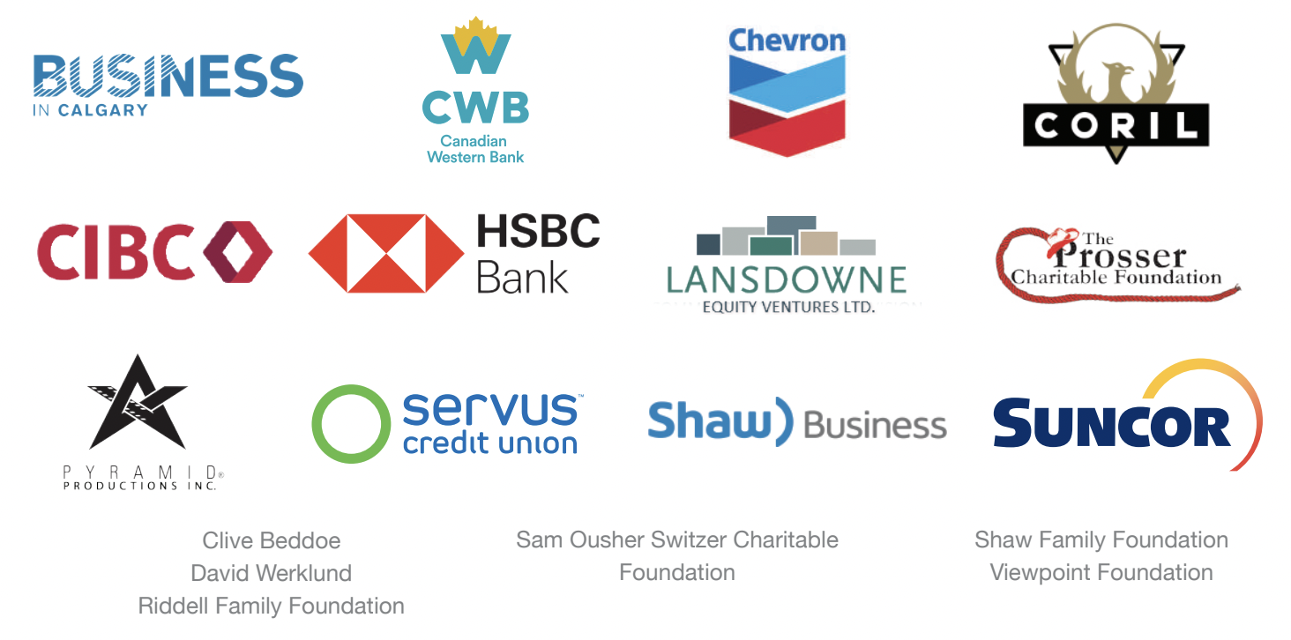
Recognizing our supporters
Notes:
Throughout the world, JA has huge support from the community. We appreciate our volunteers and the funds to provide our programs free of charge.
Here are some of our local funders.

Slide 6
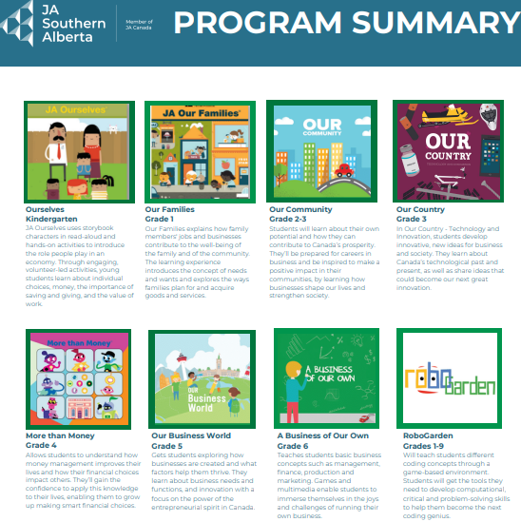
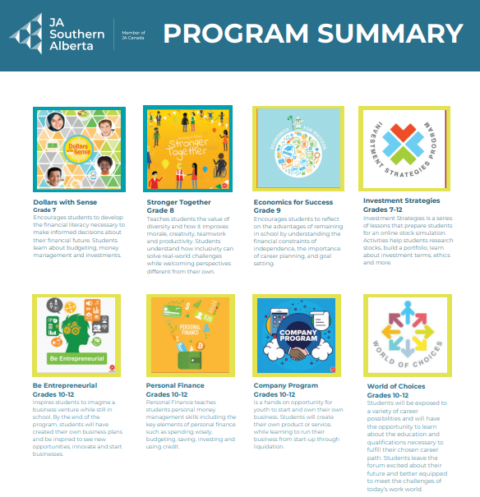
Our Program Summary Link
Notes:
You can find information about our many JA programs on our website and/or through the link/ QR code provided. You will note that the programs are currently attached to these K through 12 programs. You will note that most of the programs include both a student workbook as well as a program guide for facilitators. There are online options if you prefer less paper.
Today, as we adapt to the outcomes from the new curriculum though, we will highlight information from different across programs as it links to the new curricula.

Slide 7
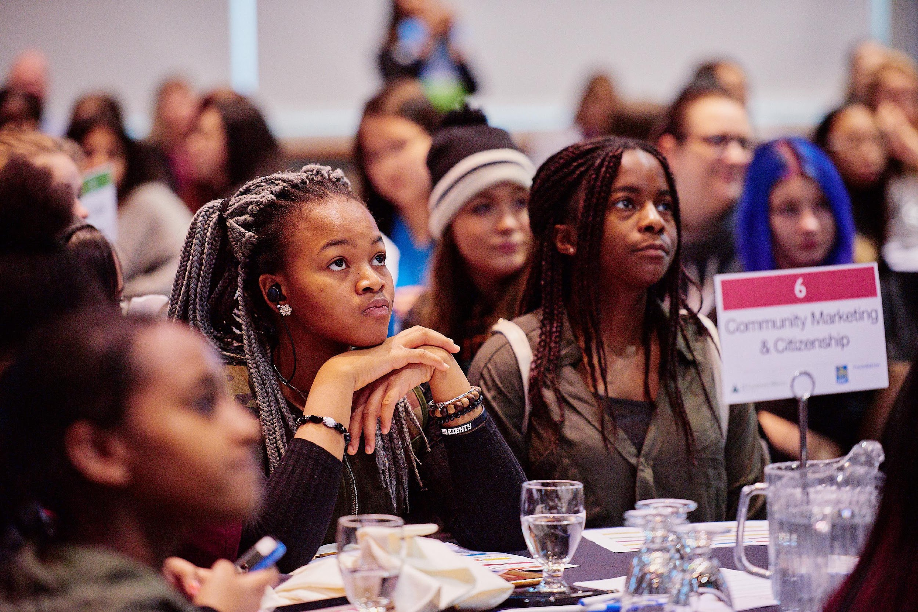
Sharing the Work – JA can help!
Notes:
Our goal is to help you as you consider your work related to financial literacy. We know that you make important decisions every day about the resources you choose as you consider the learning profiles of the students in your class, your lesson pacing,your assessment…
We’ve provided a visual journal template or graphic organizer to help you as you reflect today. As educators, we recognize journaling as an important tool for both us and our students. Like many of our learning processes, it has been adopted by others. Bullet journals or BuJos (developed by Ryder Carroll) are also used by many entrepreneurs as a combination to do list, goal tracker, diary of questions, observations, both job-related and personal – the design of each is unique to the individual and may include things to read, write, edit, watch, blog, quote, hear…

Slide 8
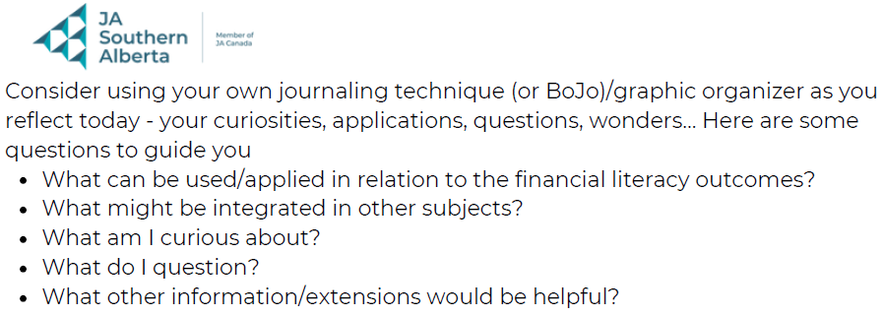
Visual Journal Link
Notes:
Consider using this journal/ learning tool as place to document today – what is interesting, important to take note of – imagine, wonder, question or be curious about. We’ll also appreciate your feedback as we continue to evolve our current programs and develop new ones.

Slide 9
Alberta’s K – 6 Curriculum and Financial Literacy
Physical Education and Wellness
Scope and sequence of Financial Literacy K to 6
Curriculum Integration - math
Practical Skills
Financial Literacy is identified as one of the practical skills.
Notes:
In terms of the Alberta Education new K to 6 curricula , a scope and sequence of financial literacy outcomes are now identified in our physical education and wellness curriculum. Students will learn in age- appropriate ways that money has value and allows them to purchase the things that they need and want.
Students will continue to work with money concepts in mathematics to support the financial literacy skills learned in physical education and wellness.
Alberta Education has specifically identified financial literacy as one of the practical skills alongside computer science, public speaking and consent.

Slide 10

Organizing Idea for Financial Literacy K to 6 (PE/Wellness)
Informed financial decision making contributes to the well being of individuals, groups and communities.
Notes:
Alberta Education has identified learning outcomes for financial literacy K to 6 under this broad organizing idea that spans all seven of the K - 6 curricula.

Slide 11

Grade 6 Learning Outcome
Students investigate borrowing and investing in a variety of situations.
Notes:
The grade six learning outcome –
linked to the previous big organizing idea
and to be reported on and assessed in grade 6
is highlighted here – Students investigate borrowing and investing in a variety of situations.

Slide 12
Grade 6 KUSPS
Knowledge
Definitions – loan, interest, term, investment
Lending sources
Role of Decision making – borrower/lender
Understanding
Investing Money can have financial risks and benefits
Skills and Procedures
Analyze the risks and benefits of investing
in a variety of situations.
Notes:
While not specifically reported on, these KUSPS will help to provide a context for the learning outcome. In grade 6, students gain knowledge about their own financial decision making – how to make decisions about enhancing their own personal finances - by understanding how to borrow/invest and using their skills to analyze the risks, benefits, ability to pay – linking financial decision making to their own well being.

Slide 13

Key vocabulary
Videos
Scenarios
2: Starting the Business Model Canvas
Notes:
A Business of our Own is a Junior Achievement program where students put on their entrepreneurial hats and run their own retail business. Students learn how to start a business, produce and promote their products, track their finances and manage a team. In the past many of our southern Alberta grade 6 teachers have accessed the business simulation presented in A Business of our Own is a great way for students to apply their knowledge and practice teamwork too.
We’ve identified some specific tasks from this program that relate to the learning outcome related to borrowing and investing.

Slide 14
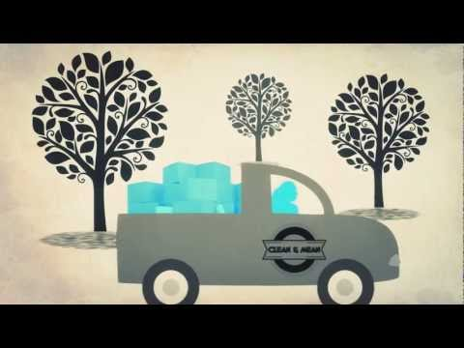
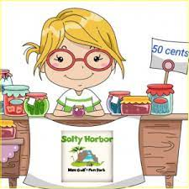
What does entrepreneur mean?
A person who starts a business
What does business mean?
A company that makes product or sells services
https://www.youtube.com/watch?v=q7K9RXqAK6s
Notes:
You will note some key vocabulary and definitions in the materials – entrepreneur, business.

Slide 15
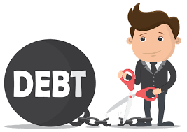
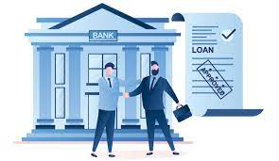
What does Debt mean?
Debt is anything owed by one person to another. It can be in a form of money, items, services, favors, or other things.
Is a Loan an example of Debt?
What does Loan mean?
A loan is a type of debt. It is an agreement of lending money with interest and a plan to repay it.
Notes:
Debt
Loan

Slide 16

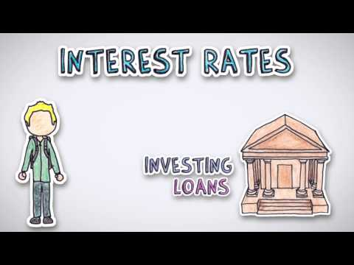
What does Interest mean?
Be an Entrepreneur
Lesson 1
Money paid to use someone else’s money
Notes:
Interest

Slide 17
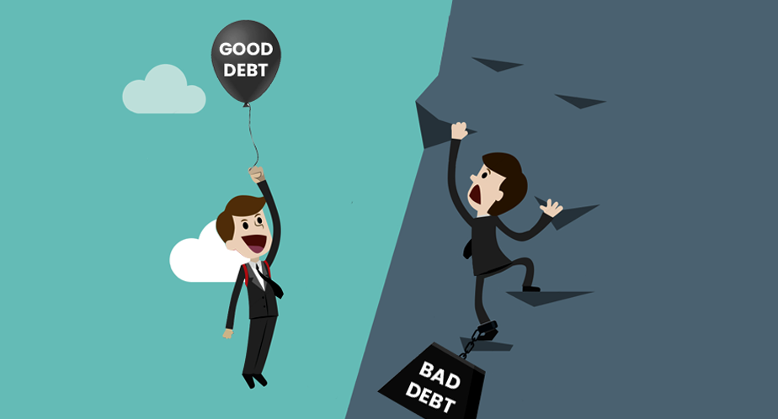
SCENARIOS
Notes:
We have provided some different debt scenarios that can lead to interesting discussions around debt – is it a good debt or a bad debt.

Slide 18

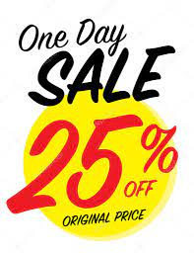
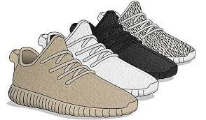
Donnie saw the shoes, he’d been wanting to buy for while, is on sale. Its original price is $300. But this time, it is discounted at 25%, so its price went down to $225. He doesn’t have cash and won’t get paid until the following month, but he has a credit card. Since he gets $500 every month from his part-time job, he decided to buy the shoes. He also has car insurance, gas and food to set aside for so it may take 3-5 months before he gets to pay off this shoes.
Notes:
Here are some examples that are also highlighted on your sample task sheet – an example about purchasing shoes on credit.

Slide 19

Naya and Kabir just got married and decided to buy a house. They have some money saved for the down payment. Because of the high prices of house and low-interest rates that promote longer repayment periods, they opt for a 25-year repayment term.
Notes:
Or a house through a mortgage – helping students to understand the total cost – short term and long benefits/risks.
There are many online resources for both credit card and mortgage calculators as tools for math instruction.

Slide 20

Let’s talk about Start-up Capital
Startup capital is what entrepreneurs use to pay for any or all of the required expenses involved in creating a new business.
Be an Entrepreneur
Lesson 1
Examples of required expenses:
employees
obtaining business space
raw material for your products
equipment and/or tools for your services
research and market tests
Permits
Licenses
product manufacturing
marketing
other operational expense
Notes:
Through the Business of our Own program students also learn more about the expenses required when running a business.

Slide 21

Where can we get Start-up Capital???
Be an Entrepreneur
Lesson 1
Your own savings
Family and Friends
Govt Grants/Programs
Bank Loan
Crowdfunding
Investors
Notes:
They learn about accessing funds through loans and credit cards as one way to get money but they also learn that businesses might access funds in other ways including investors, grants, crowdfunding or other sources that emerge.

Slide 22
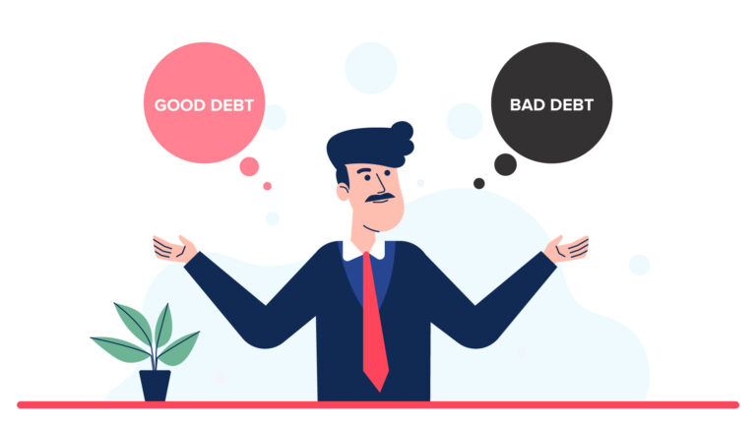
GOOD DEBT vs BAD DEBT
https://www.youtube.com/watch?v=ZzdKI3ZY-Yw
Notes:
Here is a video that might be useful to help students understand the difference between a bad debt and a good debt or investment.
Please know that this is a Prager University video – Junior Achievement is in the process of developing their own Canadian materials for some of the key concepts.
https://www.youtube.com/watch?v=ZzdKI3ZY-Yw (video length 5:37)

Slide 23
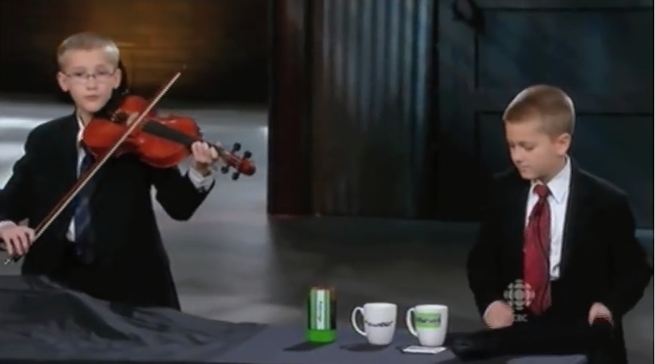
Would you support this business idea?
http://bit.ly/2v6pzGT
Notes:
We have provided some resources, too, to help students understand the decisions that lenders might make. Here are two Kelowna students featured on Dragons Den as they pitch their idea for Liquid Hot Chocolate. (video length 7:41)
Link to video here: http://bit.ly/2v6pzGT

Slide 24

Notes:
In the past, the JA Dollars with Sense program was primarily accessed by junior high teachers – because investing is included in the grade six learning outcome for the new curriculum, we’ve identified some sample information from this program.

Slide 25

Lesson 4: Make Your Money Work for You
Notes:
The information is from Lesson 4 in the Dollars with Sense Program: Make Your Money Work For You Inspiration Guide: pg. 27
Lesson Goal: Students will learn about a variety of investment vehicles. They will also learn the advantages and disadvantages of various investments.

Slide 26

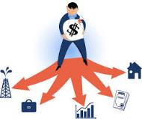

Dollars With Sense
Lesson 3: Core Activity 1
Become Investment Wise
An investment is putting away money to create an income or profit.
An investment vehicle is a way to invest your money. Which investment vehicles have you heard of?
*Interest is the cost of using somebody else’s money. When you borrow money, you pay interest. When you lend money, you can earn interest.
Do all investment vehicles have the same interest rate?
Notes:
Again key vocabulary is highlighted – investment, investment vehicle, interest

Slide 27

Become Investment Wise
Rank these investments (GIC, Mutual Funds, Stock) from 1 (least risky) to 3 (most risky).
What other investments might be added to this list? Ie real estate, digital currencies, bonds…
Notes:
Tools such as the investment vehicle fact sheet can be used to help students identify types of investments and their associated risks. You will also see this on your sample task sheet. Students often engage in further discussion as they wonder about investments not on the list – real estate, digital currencies, crowdfunding, bonds…

Slide 28
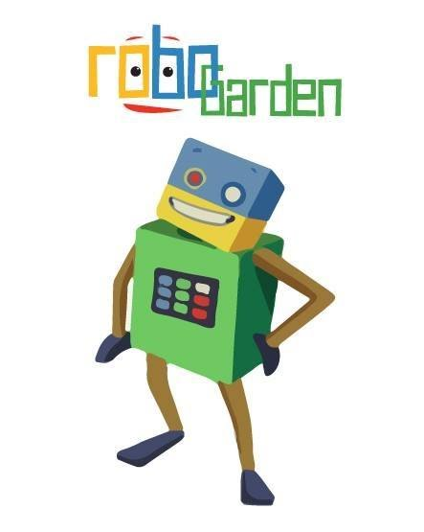
RoboGarden
Gamified
Self Directed
Flexible levels
Computational Thinking
Notes:
While our focus today is on financial literacy, we also wanted to highlight a new program for JA. Because computer science, too, is identified as a practical skill in the new Alberta curriculum, Junior Achievement has partnered with the Calgary developers of RoboGarden to offer this platform to our Calgary and Area teachers/students. Grades K to 6 teachers can apply through our JA website to also access this program for next year.
The focus of RoboGarden is on computational thinking including decomposing, pattern recognition, abstraction, algorithms. It is engaging, gamified and self directed platform that offers students access to different levels depending on their understanding. Much like your other online learning shells, it includes a section for teachers to track learning.
“From basic financial literacy to computer coding to understanding consent in relationships, students will learn a range of practical skills for real world success. The new curriculum will teach computer science and problem solving that includes coding and algorithms.” Alberta Education

Slide 29

Because of you…
Photo by Kindred Hues Photography
Notes:
Through our program registration, you may be able to access volunteers for single sessions - I would encourage you to continue to access financial experts, either through JA or through your own community. As an educator, I am always reminded, though, that it is your knowledge and expertise that brings “learning to life” in our Alberta classrooms - your ability to link learning such as with the previous tasks where students calculated credit or mortgage payments.
Please do continue to access our materials, though, as you make decisions around the complex work that you do. Please use the links on the program page to contact us.
Much can be accomplished when we are able to work together. (Video 49 sec)
https://vimeo.com/245772036

Slide 30
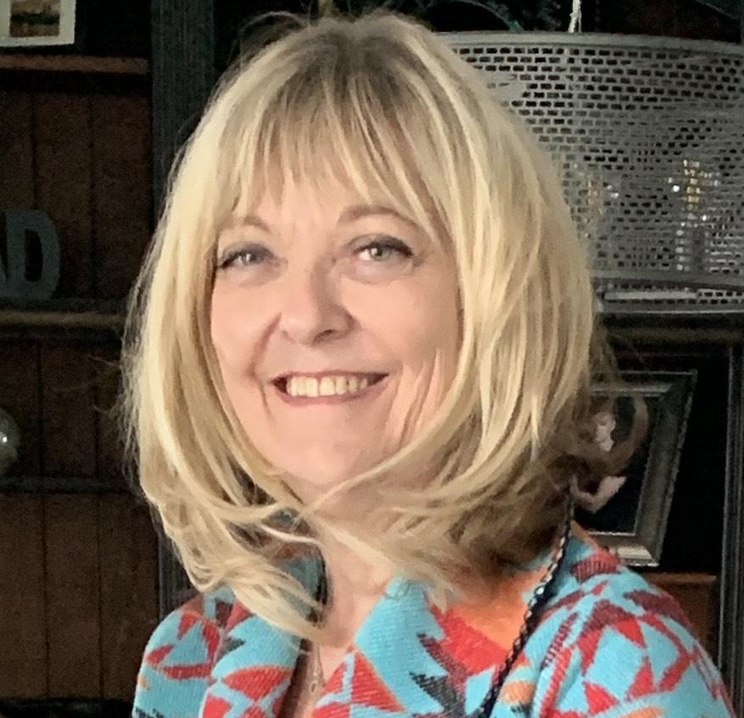
Chris Meaden,
Director of Teacher Development
Junior Achievement of Southern Alberta
cmeaden@jasouthalberta.org
Notes:
Again, thank you so much for choosing to spend time with me today. Please do reach out should you have questions, feedback or ideas for our organization or our services.

