Slide 1
Money Talks – Grade 5 Financial Literacy
JULY ‘22 CHANGE NOTICE: We’ve added a one-line style for titles to give you more space on each slide when you have short titles.
Junior Achievement of Southern Alberta
Notes:
Welcome to our Money Talks session today. My name is Chris Meaden. I am proud to be a long time educator, especially with the Calgary Board of Education, and now representing Junior Achievement of Southern Alberta as their Director of Teacher Development. My goal is to share a little bit of information about our organization and our programs especially those in financial literacy. I look forward as well to your feedback about how we can support your work in accomplishing the related outcomes in the new curriculum.
As we begin“I would like to take this opportunity to acknowledge the traditional territories of the peoples of the Treaty 7 region in Southern Alberta, which includes the Blackfoot First Nation tribes of Siksika, the Piikuni, the Kainai, the Stoney Nakoda First Nations tribes of Chiniki, Bearspaw, and Wesley and the Tsuut’ina First Nation. The city of Calgary is also homeland to the historic Northwest Métis and to Métis Nation of Alberta, Region 3.

Slide 2

About JA
As a member of the world’s largest and most-impactful youth-serving NGOs Junior Achievement, JA Southern Alberta delivers hands-on, immersive learning in entrepreneurship, financial health, work readiness, sustainability, STEM, economics, citizenship, ethics, and more.
Reaching more than 12 million young people globally each year through nearly half a million teachers and business volunteers, JA Worldwide is one of few organizations with the scale, experience, and passion to build a brighter future for the next generation of innovators, entrepreneurs, and leaders.
Notes:
Junior Achievement Southern Alberta is proud to be part of JA Worldwide - a global Non-Governmental Organization that has been in existence for over 100 years and that includes over 120 local chapters.

Slide 3



Skills we focus on
Entrepreneurship training
Financial literacy
Career readiness
Notes:
As an organization, JA continues to build and grow opportunities to help our students build their skills in three key areas - financial literacy, career readiness and entrepreneurship training. Through the opportunities provided, it has been exciting to see evidence of student growth, not only in terms of their financial literacy but also their financial capability and even financial capacity. You will see the term financial capacity more and more in literature – that motivation and knowledge that individuals have to engage with and use financial information to make sound decisions. Some of our volunteers and professionals have even found the information useful in their own financial planning – linking to what the literature also calls financial health.
I am interested in our audience today. Please feel free to turn on your microphones or identify in the chat if you have worked with Junior Achievement in the past – as a student, a teacher, a parent or a volunteer!

Slide 4
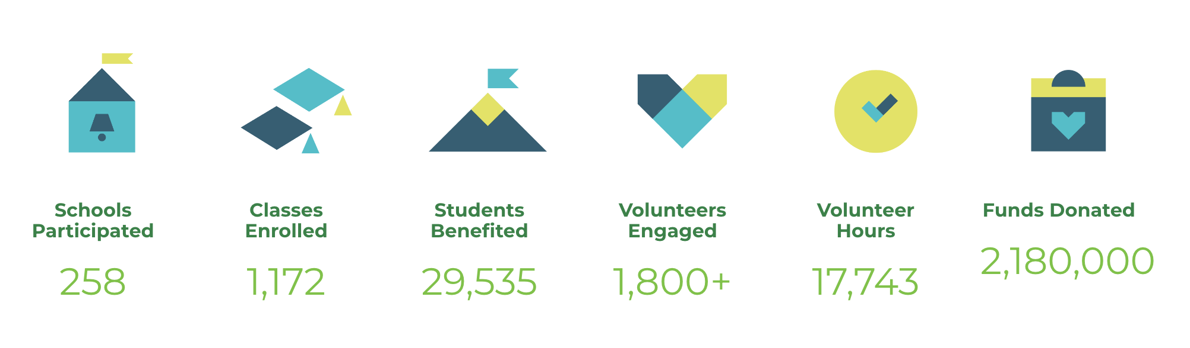
JA Southern Alberta - Our reach
Notes:
JA Southern Alberta is a regional office and one of the largest in Canada. We work with other regions including Junior Achievement of Northern Alberta and NWT to consider our provincial needs and develop new materials based on what is happening locally – in this case, our new provincial curricula.
Because of our reputation and our ability to respond, JA Southern Alberta is proud to report a substantial increase in our reach – as of December this year, almost 30, 000 students accessed our programs in Alberta.

Slide 5

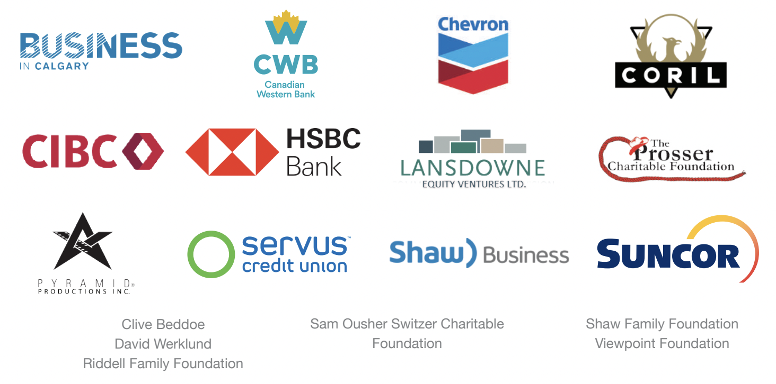
Recognizing our supporters
Notes:
Throughout the world, JA has huge support from the community. We appreciate our volunteers and the funds to provide our programs free of charge.
Here are some of our local funders.

Slide 6
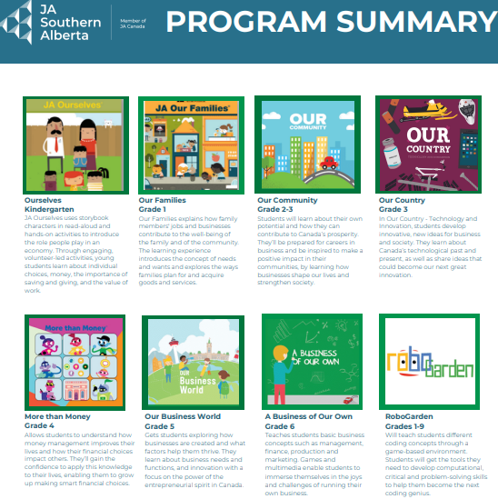
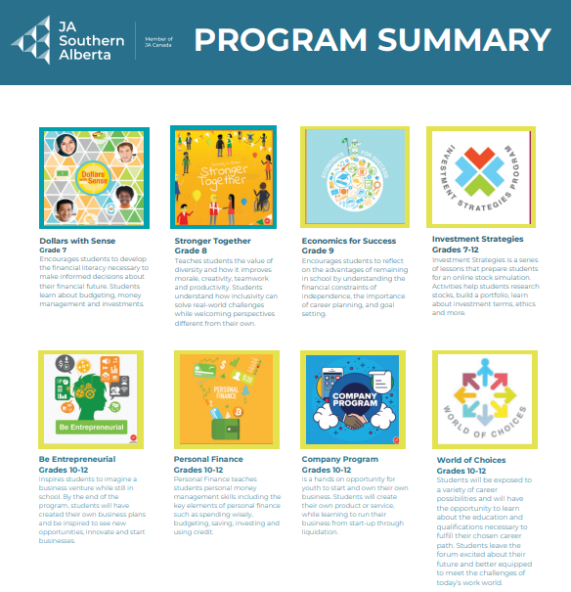
Our Program Summary Link
Notes:
You can find information about our many JA programs on our website and/or through the link/ QR code provided. You will note that the programs are currently attached to these K through 12 programs. You will note that most of the programs include both a student workbook as well as a program guide for facilitators. There are online options if you prefer less paper.
Today, as we adapt to the outcomes from the new curriculum though, we will highlight information from different across programs as it links to the new curricula.

Slide 7
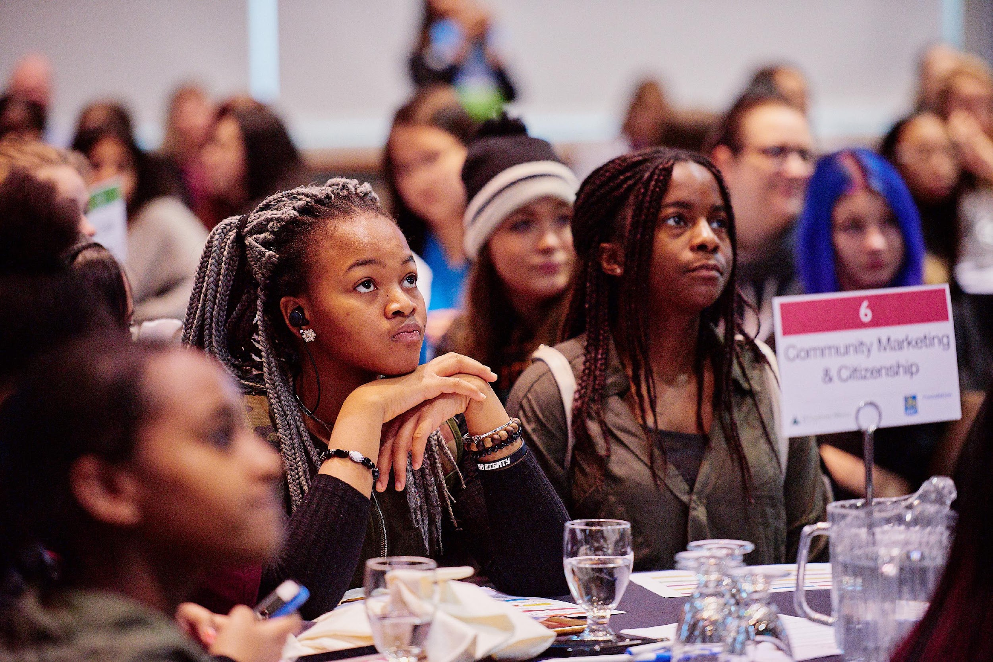
Sharing the Work – JA can help!
Notes:
Our goal is to help you as you consider your work related to financial literacy. We know that you make important decisions every day about the resources you choose as you consider the learning profiles of the students in your class, your lesson pacing,your assessment… and the list goes on!
We’ve provided a visual journal template or graphic organizer to help you as you reflect today. As educators, we recognize journaling as an important tool for both us and our students. Like many of our learning processes, it has been adopted by others. Bullet journals or BuJos (developed by Ryder Carroll) are also used by many entrepreneurs as a combination to do list, goal tracker, diary of questions, observations, both job-related and personal – the design of each is unique to the individual and may include things to read, write, edit, watch, blog, quote, hear…

Slide 8
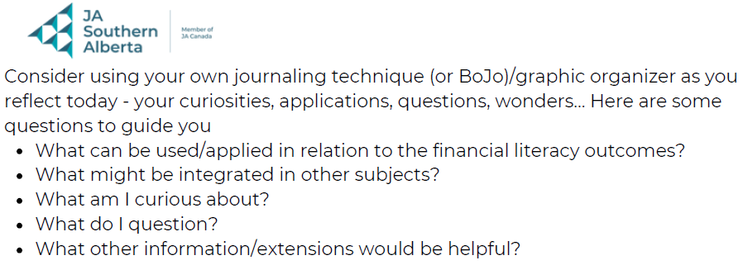
Visual Journal Link
Notes:
Consider using this journal/ learning tool as place to document today – what is interesting, important to take note of – imagine, wonder, question or be curious about. We’ll also appreciate your feedback as we continue to evolve our current programs and develop new ones.

Slide 9
Alberta’s K – 6 Curriculum and Financial Literacy
Physical Education and Wellness
Scope and sequence of Financial Literacy K to 6
Curriculum Integration - math
Practical Skills
Financial Literacy is identified as one of the practical skills.
Notes:
In terms of the Alberta Education’s new K to 6 curricula , a scope and sequence of financial literacy outcomes are now identified in our physical education and wellness curriculum. Students will learn in age- appropriate ways that money has value and allows them to purchase the things that they need and want.
Students will continue to work with money concepts in mathematics to support the financial literacy skills learned in physical education and wellness.
Alberta Education has specifically identified financial literacy as one of the practical skills alongside computer science, public speaking and consent.

Slide 10

Organizing Idea for Financial Literacy K to 6 (PE/Wellness)
Informed financial decision making contributes to the well being of individuals, groups and communities.
Notes:
Alberta Education has identified learning outcomes for financial literacy K to 6 under this broad organizing idea that spans all seven of the K - 6 curricula.

Slide 11

Grade 5 Learning Outcome
Students demonstrate how planning can support financial goals.
Notes:
The grade five learning outcome –
linked to the previous big organizing idea
and to be reported on and assessed in grade 5
is highlighted here – Students demonstrate how planning can support financial goals.

Slide 12
Grade 5 KUSPS
Knowledge
Definitions – budget, assets, income, expenses,
needs, wants, goals, consumer
Understanding
Budgeting is important to financial decision-making
and to achieving short and long term goals.
Consumers have choices when purchasing
goods and services.
Skills and Procedures
Develop a budget with a savings plan.
Examine factors that influence choices.
Notes:
While not specifically reported on, these KUSPS will help to provide a context for the learning outcome. In grade 5, students gain knowledge about their own financial planning in terms of budgeting and making consumer choices - by understanding how to create a budget and using their skills to examine the factors that influence their choices as a consumer – linking financial decision making to their own well being.

Slide 13
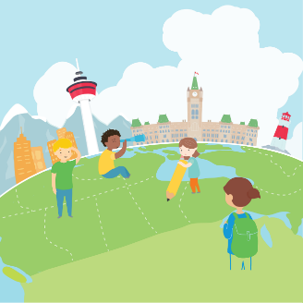
Our Business World
Notes:
The first of our tasks related to the new grade 5 learning outcome comes from the JA “Our Business World” program. In this program, often accessed by grades 4 to 6 teachers, students explore how businesses are created. Using games and multimedia students learn about innovation, startups and self-employment.
You will note that most of our programs have student “workbooks” as well as both program/inspiration guides for teachers and volunteer facilitators.

Slide 14
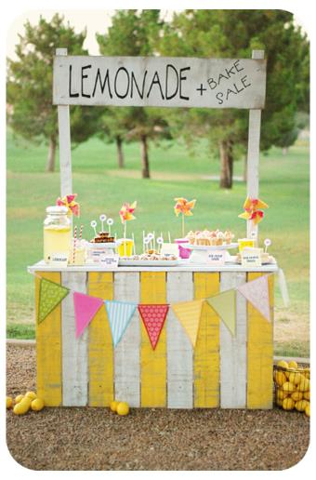

Lemonade Stand
Notes:
One common business idea for young students is to create a lemonade stand. This is a great way to understand concepts around budgeting, income/expenses and consumer choice.

Slide 15
Profit = Income – Expenses
Did the Lemonade Stand make a profit?
Sales Ledger
Monday | $30.00
Tuesday | $23.00
Wednesday | $44.00
Thursday | $1.00
Friday | $18.00
Total tips | $5.00
Total Income
Purchase Receipt
Disposable Glasses | $19.00
Hair Nets | $9.00
Advertising Flyers | $32.00
Lemons | $15.00
Sugar | $11.00
Lemon Press | $14.00
Total Expenses
$121.00
$100.00
Profit =
$21.00
Preparation Portfolio page 3
Notes:
This is from the teachers’ program/inspiration guide - In the student workbook, students calculate profit.

Slide 16
What will you do with your profits?
Imagine that every week your lemonade stand makes $21
Creating a budget helps manage your money
When making a budget, keep track of how much money you earn, spend, and save
For example, your budget could look like:
 | Income (money earned) | Expenses (money spent) | Balance (money left over)
1 | +$21 | -$10 | =$11
2 | +$21 | -$5 | =$27
Show your work!
1 - $21 - $10 = $11
2 - $11 + $21 =$32
$32 - $5 = $27
Notes:
The guide also helps students make decisions about what they want to do with the profit they have made using a budget.
Questions to ask include:
What is a budget?
Why do we need a budget?
What do we budget for?

Slide 17
Choose an item from the table below to save up for
Each week has a different scenario that challenges you to spend or save. Keep an eye on how much money you have
Item | Cost | Item | Cost
Headphones | $80 | Camping Supplies | $70
Video Game | $70 | A New Bike | $80
Art Supplies | $60 | Book Series | $75
Sports Equipment | $75 | Musical Instrument | $50
New Shoes | $60 | A gift | $60
Hoodie | $70 | Amusement Park | $55
Notes:
Students may brainstorm what they wish to purchase with their proceeds and have a discussion about how personal values impact consumer choice.

Slide 18

Week 1 +$21
Your friends decide to go for lunch after school. They give you 3 options:
Picnic at the park - $5
Share a pizza - $10
Full meal at fast food restaurant - $15
How much money do you have left?
Notes:
Even though students have decided on their personal priorities other questions emerge.
Post-Covid – are these costs realistic?

Slide 19

Week 2 +$21
It’s your turn to bring in snacks for the class? What will you choose?
Make cookies - $5
Buy cookies - $10
Buy a cake - $15
How much money do you have left?
Notes:
How do the scenarios impact their initial budget and consumer decisions.

Slide 20
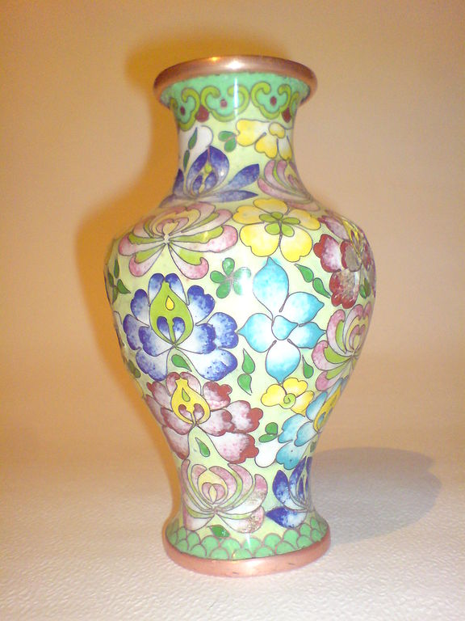
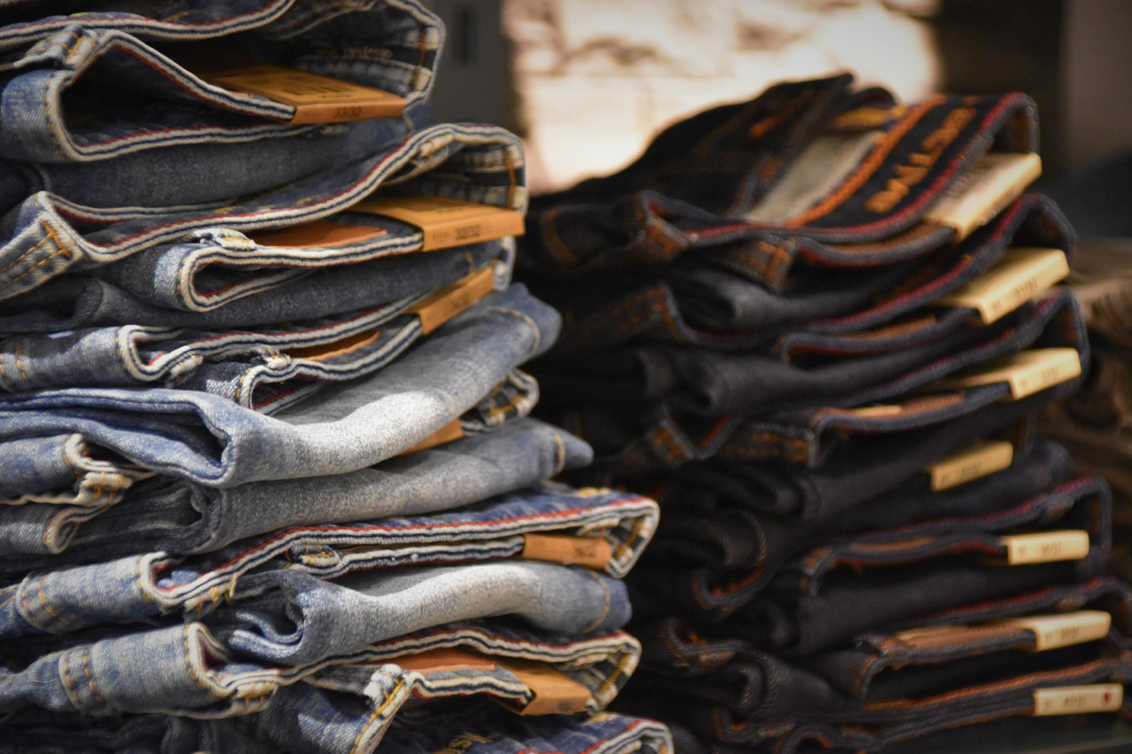
Week 3 +$21
Oh no! You ripped your pants! What will you do?
Fix them yourself - $2
Get a friend to fix them - $5
Buy new pants - $10
How much money do you have left?
You were playing with a friend but accidentally broke your Mom’s favourite vase. To buy her a replacement will cost you $10.
This Photo by Unknown Author is licensed under CC BY-SA

Slide 21
Week 4 +$21
There’s a sale at the store!
How much money do you have left?
Item | Cost | Item | Cost
Pen | $2 | A craft | $4
Notebook | $4 | Glowsticks | $2
Bookmark | $1 | Ice Cream | $3
Hat | $5 | Keychain | $3
Bracelet | $5 | Stickers | $2
Socks | $4 | Pencil | $1
Candy | $2 | Water Bottle | $5
Notes:
There’s a sale at the store – how do your decisions to buy sale items impact next decisions and budget?

Slide 22

Week 5 +$21
It’s time to buy the item you saved up for!
Have you saved up enough?
If you do not have enough money, what can you do?
How much money do you have left?
This Photo by Unknown Author is licensed under CC BY-NC
Notes:
What other scenarios might emerge that will impact your budget?

Slide 23
Look at your budget again
Do you still want to save up for the same item as before, or would you like to change your end goal?
Item | Cost | Item | Cost
Headphones | $80 | Camping Supplies | $70
Video Game | $70 | A New Bike | $80
Art Supplies | $60 | Book Series | $75
Sports Equipment | $75 | Musical Instrument | $50
New Shoes | $60 | A gift | $60
Hoodie | $70 | Amusement Park | $55
Notes:
How and why is budgeting an ongoing process?

Slide 24

Notes:
These next set of tasks come from Dollars with Sense, a program often used in Grade 7. Through the Dollars with Sense program, students get the tools they need to make smart financial decisions, reduce their debt and make investments

Slide 25

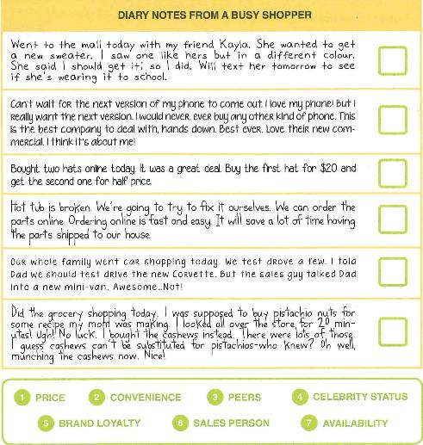
Dollars With Sense
Lesson 2: Core Activity 1
Why do we buy the things we buy?
3
5
What was your last purchase?
What influenced your decision to buy?
1
2
6
7
Student workbook pg. 12
Notes:
In the previous examples, we have talked about things that may impact initial decisions about spending – some are related to consumer choice and others may be emergent or unavoidable.
These next tasks help to lead the discussion about why we buy the things we buy - what influences us when we shop? – Program/Inspiration Guide: pg. 15

Slide 26




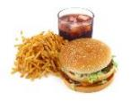



Dollars With Sense
Lesson 3: Core Activity 2
How are needs and wants alike and different?
NEEDS
WANTS
GOALS
What are some of your goals?
Complete the Needs, Wants, and Goals activity on pg. 16
Notes:
The discussion can also lead to an opportunity to revisit needs/wants/goals as a consumer – a concept related to the big idea around informed financial decision making that is revisited throughout K-6.
Core Activity 2 – Needs, Wants, and Goals, Program/Inspiration Guide pg. 24-25 // Preparation Portfolio Pg. 16
Go over the differences between Needs, Wants and Goals, using the questions found at the bottom of pg. 24 in the Inspiration Guide
Have students turn to page 16 in the preparation portfolio and record 1 need, 1 want, and 1 goal they have. They will fill out the rest of that page to determine how they can save money for those needs, wants, and goals

Slide 27

Dollars With Sense
Lesson 3: Core Activity 2
What must you do to be able to afford your needs, wants, and goals?
MAKE A BUDGET
Notes:
A reminder again that budgets are revisited and revised as situations change.

Slide 28

Are You a SMART Consumer?
Stop & Think
Make A Plan
Ask Questions
Review Information
Take Action
Student workbook pg. 13
Notes:
And constantly includes making smart consumer choices.
Core Activity 2 – Are you a SMART consumer? – Program/Inspiration Guide: pg. 16
Ask students what it means to be a SMART shopper
Go over the SMART steps with the class using an example. (Process of purchasing a car, buying an expensive electronic, etc.) Use a personal story if you can

Slide 29
Extensions for Learning
You want a new backpack for school. A favorite store
has one for $35 which will take all of the money you have
saved. A friend tells you, they have a similar backpack,
slightly used, in another color that they will sell for $20.
What do you do?
You want to download a song. Your friends
say you should but your mom says the lyrics are
offensive and not age-appropriate. You need her credit
card to pay. The song only costs $1.29 and you have the
money. What do you do?
What scenario would you add?
Notes:
Again, today’s sample tasks came from JA’s Our Business World and Dollars with Sense. In both programs, there are opportunities to support and extend learning. Many of the worksheet tasks, for example, are more directed and offer less choice and more guidance.
Our Business World offers extension through the creation of a startup company – , budgeting, marketing, sales
Here are some examples of scenarios about consumer choices from Dollars with Sense.

Slide 30

RoboGarden
Gamified
Self Directed
Flexible levels
Computational Thinking
Notes:
While our focus today is on financial literacy, we also wanted to highlight a new program for JA. Because computer science, too, is identified as a practical skill in the new Alberta curriculum, Junior Achievement has partnered with the Calgary developers of RoboGarden to offer this platform to our Calgary and Area teachers/students. Grades K to 6 teachers can apply through our JA website to also access this program for next year.
The focus of RoboGarden is on computational thinking including decomposing, pattern recognition, abstraction, algorithms. It is engaging, gamified and self directed platform that offers students access to different levels depending on their understanding. Much like your other online learning shells, it includes a section for teachers to track learning.
“From basic financial literacy to computer coding to understanding consent in relationships, students will learn a range of practical skills for real world success. The new curriculum will teach computer science and problem solving that includes coding and algorithms.” Alberta Education

Slide 31
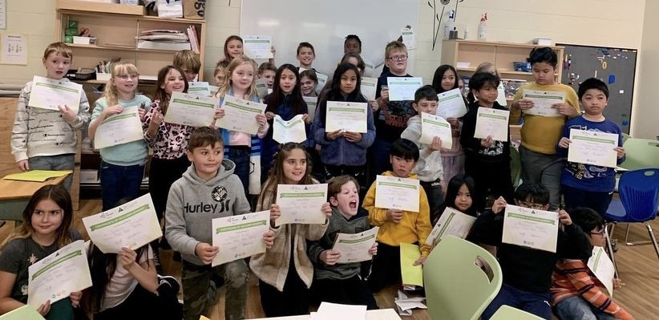
What’s next for JA????
Notes:
Supporting you as teachers including –
Clear alignment with new curriculum
Evolving our online/less paper approach
Advancing the Learning Management System for teachers
Capitalizing on our visibility and reach within the business community

Slide 32
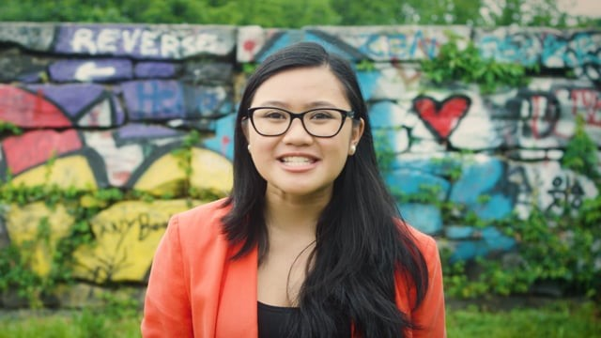
Because of you…
Photo by Kindred Hues Photography
Notes:
Through our program registration, you may be able to access volunteers for single sessions - I would encourage you to continue to access financial experts, either through JA or through your own community. As an educator, I am always reminded, though, that it is your knowledge and expertise that brings “learning to life” in our Alberta classrooms - your ability to link learning such as with the previous tasks where students calculated credit or mortgage payments.
Please do continue to access our materials, though, as you make decisions around the complex work that you do. Please use the links on the program page to contact us.
Much can be accomplished when we are able to work together. (Video 49 sec)
https://vimeo.com/245772036

Slide 33
Our Program Summary Link
Notes:
You can find information about our many JA programs on our website and/or through the link/ QR code provided. You will note that the programs are currently attached to these K through 12 programs. You will note that most of the programs include both a student workbook as well as a program guide for facilitators. There are online options if you prefer less paper.
I will give you the opportunity to sign off if you like but I have pulled the program slide up again – take a look at the link or the QR codes on the link and I will stay online in case you have questions.

Slide 34
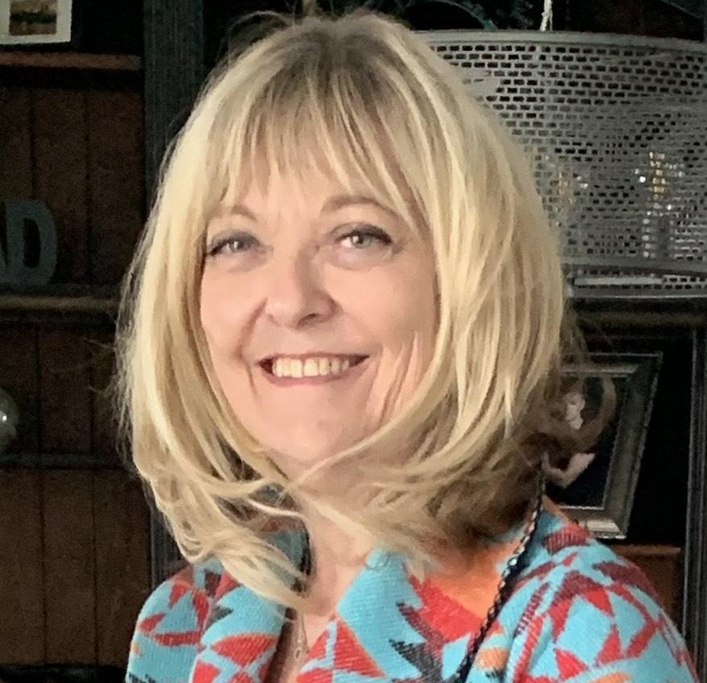
Chris Meaden,
Director of Teacher Development
Junior Achievement of Southern Alberta
cmeaden@jasouthalberta.org
Notes:
Again, thank you so much for choosing to spend time with me today. Please do reach out should you have questions, feedback or ideas for our organization or our services.

