Slide 1


Oral Language Resource:
Show and Tell
In support of LearnAlberta English Language Arts and Literature curriculum

Slide 2

ORGANIZING IDEA Oral Language: Listening and speaking form the foundation for literacy development and improve communication, collaboration, and respectful mutual understanding.
Learning Outcomes: K - Children explore listening and speaking skills through a variety of literacy experiences. 1 - Students develop listening and speaking skills through sharing stories and information. 2 - Students examine and adjust listening and speaking to communicate effectively. 3 - Students examine and apply listening and speaking skills, processes, or strategies in a variety of formal and informal interactions. 4 - Students examine and demonstrate how listening and speaking support connections and clarify understandings. 5 - Students investigate how oral language can be designed to communicate ideas and information. 6 - Students connect the quality and efficacy of oral communication to oral language skills.
To view the complete curriculum visit curriculum.learnalberta.ca For more information, or help with teaching this subject area, please contact your local consortia office.

Slide 3
Lesson Plan for Show and Tell
Materials: Each student who is sharing brings one personal object to show and describe.
Procedure: Schedule Show and Tell so that every student will participate once in each reporting term, but only 2-3 students per day will present. The teacher should model the desired Show and Tell behaviour, both as a presenter and as an audience member. When introducing Show and Tell, you may want to have students simply bring an object of significance to them, but later in the year or in upper grades a theme or purpose for Show and Tell will be helpful in keeping a curricular focus.
The presenter will show an object of importance and explain what it is. They will tell the story around the object and its significance. Students will be allowed to ask follow-up questions.

Slide 4
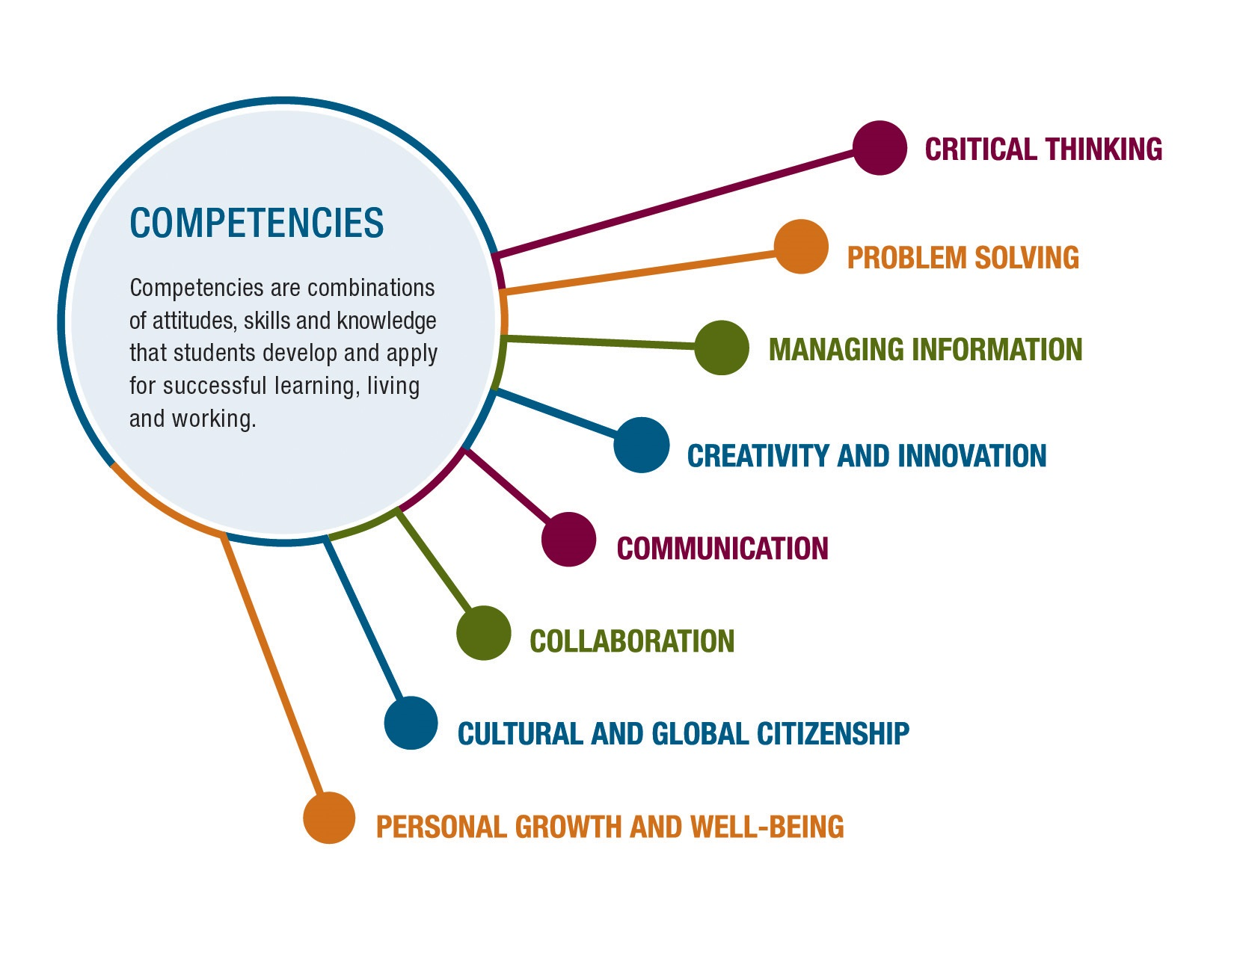
The main competency for “Show and Tell” is Communication.
Communication involves sharing ideas through oral, written, or non-verbal media.

Slide 5
Guide to Success
Task Requirements What do I need to do? | Criteria for Proficiency What do I need to do to do it well? | Self-Reflection What’s going well? What’s my next best step? | Teacher Guidance What’s going well? What revisions need to be considered?
Describe the object you have Stay on topic Use appropriate body language Focus on the speaker | Use interesting language to describe your object Explain your personal connection to the object Project your voice Ask clarifying questions Make eye contact with the speaker | Going well Needs work Next Steps | Going well Needs work Next Steps

Slide 6
Continuum for Increasing Complexity
K | 1 | 2 | 3 | 4 | 5 | 6
Show and Share an object of personal significance. | Show and Share an object and its personal significance. | Show and Share an object and its significance to a classroom topic. | Present an object with details to support its significance. | Present about a picture or object’s relevance to a classroom topic. | Present about a picture or object’s relevance to a classroom topic. | Present about a picture or object’s relevance to a classroom topic.
Share personal experiences and stories through listening and speaking with others. | Share experiences, ideas, and information with appropriate volume, tone, and pace. | Enhance clarity of oral communication through word emphasis and enunciation. | Combine verbal and non-verbal language to enhance communication. | Adjust verbal and non-verbal language to enhance clarity or create effects when communicating. | Plan ideas and details in a logical manner, including introductions and conclusions. | Apply elements of public speaking for planning and delivering a speech.
Express ideas and information | Collect ideas that are inspired by a variety of experiences. | Collect ideas that are inspired by a variety of experiences. | Organize, categorize, or sequence information | Demonstrate how information can be ethically shared using a variety of methods or tools. | Develop a main idea or topic supported by facts, details, examples, and explanations. | Support the topic with relevant facts, details, examples, and explanations from multiple sources.

Slide 7
Video of Show and Tell Coming Soon

Slide 8
Resources and References
ARPDC New Curriculum Resources
The Critical Thinking Consortium
Bright Hub Education

