Slide 1


Oral Language Resource:
Coffee Time Conversation
In support of LearnAlberta English Language Arts and Literature curriculum

Slide 2

Organizing Idea: Oral Language: Listening and speaking form the foundation for literacy development and improve communication, collaboration, and respectful mutual understanding.
Learning Outcome: K - Children explore listening and speaking skills through a variety of literacy experiences. 1 - Students develop listening and speaking skills through sharing stories and information. 2 - Students examine and adjust listening and speaking to communicate effectively. 3 - Students examine and apply listening and speaking skills, processes, or strategies in a variety of formal and informal interactions. 4 - Students examine and demonstrate how listening and speaking support connections and clarify understandings. 5 - Students investigate how oral language can be designed to communicate ideas and information. 6 - Students connect the quality and efficacy of oral communication to oral language skills.
To view the complete curriculum visit curriculum.learnalberta.ca For more information, or help with teaching this subject area, please contact your local consortia office.

Slide 3
Lesson Plan for Coffee Time Conversation
Materials: One object for the group to describe. For our example, we used a pumpkin.
Procedure: Fill your cup with coffee, tea, juice or water and join the discussion on what it is you see. What is one word you think about to describe the pumpkin? Move around the room and have participants give one thought or descriptor word. Keep a visible record of the words and phrases you gather. Participants may choose to add to the ideas of others, or they may be inspired by those responses. The words and phrases you collect can support future writing activities.

Slide 4
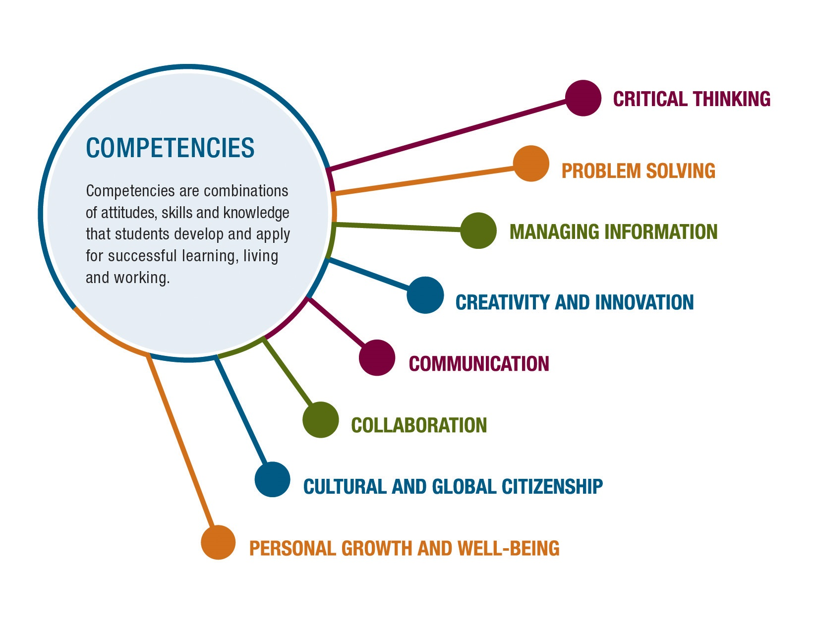
The main competency for “Coffeetime Conversation” is Communication.
Communication involves sharing ideas through oral, written, or non-verbal media.

Slide 5
Guide to Success
Task Requirements What do I need to do? | Criteria for Proficiency What do I need to do to do it well? | Self-Reflection What’s going well? What’s my next best step? | Teacher Guidance What’s going well? What revisions need to be considered?
Focus on the speaker Speak at the appropriate time Stay on topic Use appropriate body language | Offer an original answer Elaborate on your own answer Ask clarifying questions Add to the answers of others Make eye contact with the speaker | Going well Needs work Next Steps | Going well Needs work Next Steps

Slide 6
Continuum for Increasing Complexity
K | 1 | 2 | 3 | 4 | 5 | 6
Participate in group discussions. | Share experiences, ideas, and information with appropriate volume, tone, and pace. | Contribute to a variety of listening and speaking activities to build confidence in oral language skills. | Engage in dialogue to express and understand messages. | Contribute respectfully to a variety of interactions that involve listening and speaking. | Ensure messages are heard clearly by using breath, body, and energy to project voice. | Ensure messages are heard clearly by using breath, body, and energy to project voice.
Express an idea or share information through the use of body language or voice. | Adjust verbal or non-verbal language according to a variety of situations. | Adjust verbal or non-verbal language according to purpose and audience. | Adjust voice quality, audibility, articulation, or clarity to communicate effectively. | Adjust verbal and non-verbal language to enhance clarity or create effects when communicating. | Engage in collaborative dialogue when sharing ideas, solving problems, or making decisions. | Offer relevant information and logical reasoning to enhance collaborative dialogue.

Slide 7
Video of Coffee Time Conversation Coming Soon

Slide 8
Resources and References
ARPDC New Curriculum Resources
The Critical Thinking Consortium

