Slide 1



WRITING
English
Language Arts
& Literature

Slide 2
Lana Lane
Charlie Kraig
Learning
Network
Educational
Services
You can connect with me at:
lana2lane@gmail.com
You can connect with me at:
teacherkraig@gmail.com
charlie.kraig@arpdc.ab.ca

Slide 3
Using this Slide Deck
You will find resources to support this area of literacy instruction linked in the slides and in the speaker notes.
It is the teacher’s responsibility to align resources with their students’ needs and curriculum expectations.
If you have questions, please contact your local consortia office.
This is not a comprehensive list of resources; rather, it is a place to get you started for quality instructional practices.

Slide 4
Organizing Idea | K | 1 | 2 | 3 | 4 | 5 | 6
Text Forms & Structures
Oral Language
Vocabulary
Phonological Awareness
Phonics
Fluency
Comprehension
Writing
Conventions
Notes:
Organizing ideas throughout the grades.

Slide 5
Organizing Idea (from Curriculum) | Pillars of Reading
Text Forms & Structures | Writing/ Comprehension
Oral Language | Fluency/ Vocabulary
Vocabulary | Vocabulary
Phonological Awareness | Phonological Awareness
Phonics | Phonics
Fluency | Fluency
Comprehension | Comprehension
Writing | Writing
Conventions | Writing/ Fluency

Slide 6
WRITING is an unconstrained literacy skill used to accomplish a variety of outcomes within the school setting and beyond. It is a multimodal process we can use to tell stories, create imagined worlds, explore who we are, combat loneliness, and chronicle our learning and experiences. Writing is an indispensable tool for learning and communicating. We use it to gather, preserve and transmit ideas and information. The permanence of writing makes ideas we are studying readily available for review and evaluation, its explicitness encourages establishing connection between these ideas, and its active nature fosters the exploration of unexamined assumptions (Graham & Harris, 2019). Writing is a way to make our thinking visible, deepen comprehension, and perhaps, make misconceptions observable. Its recursive nature allows writers to reflect, revise, and improve their thinking in critical and collaborative ways.
From
Calgary Board of Education
K-12 Literacy Framework - cbe.ab.ca
Notes:
Literacy Framework https://cbe.ab.ca/about-us/policies-and-regulations/Documents/Literacy-Framework.pdf

Slide 7
WRITING
Mentor Texts
(identifying writer’s craft)
DAILY Mini
Lessons
Shared & interactive writing activities
Reciprocal Reading-Writing connections
Response Journals
Ideas
Organization
Voice
Word Choice
Sentence Fluency
Conventions
Presentation
Loose parts
Graphic organizers
Multi-modal
Notes:
Angela Stockman’s Website https://angelastockman.com/ (Sign up for her newsletter)
Mentor Texts https://movingwriters.org/
Share Writing in Elementary Classroom https://www.readwritethink.org/professional-development/strategy-guides/shared-writing

Slide 8
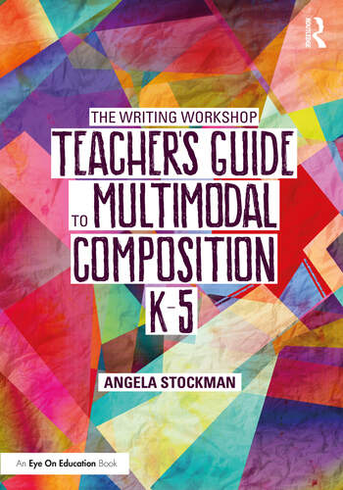
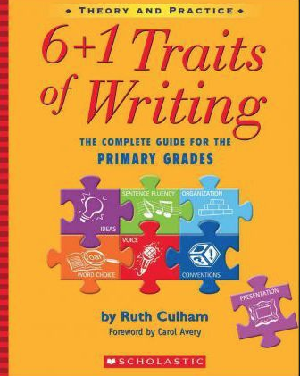
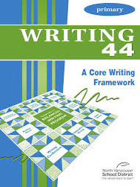

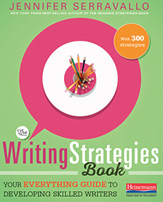
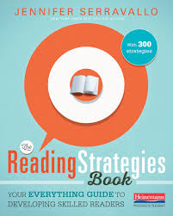
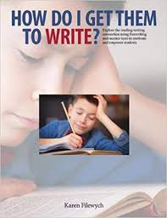

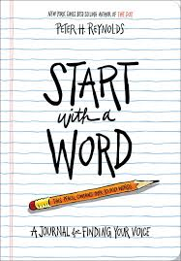
Notes:
Only a few of the resources you may wish to have on your shelf.

