Slide 1



VOCABULARY
English
Language Arts
& Literature

Slide 2
Lana Lane
Charlie Kraig
Learning
Network
Educational
Services
You can connect with me at:
lana2lane@gmail.com
You can connect with me at:
teacherkraig@gmail.com
charlie.kraig@arpdc.ab.ca

Slide 3
Using this Slide Deck
You will find resources to support this area of literacy instruction linked in the slides and in the speaker notes.
It is the teacher’s responsibility to align resources with their students’ needs and curriculum expectations.
If you have questions, please contact your local consortia office.
This is not a comprehensive list of resources; rather, it is a place to get you started for quality instructional practices.

Slide 4
Organizing Idea | K | 1 | 2 | 3 | 4 | 5 | 6
Text Forms & Structures
Oral Language
Vocabulary
Phonological Awareness
Phonics
Fluency
Comprehension
Writing
Conventions
Notes:
Organizing ideas throughout the grades.

Slide 5
Organizing Idea (from Curriculum) | Pillars of Reading
Text Forms & Structures | Writing/ Comprehension
Oral Language | Fluency/ Vocabulary
Vocabulary | Vocabulary
Phonological Awareness | Phonological Awareness
Phonics | Phonics
Fluency | Fluency
Comprehension | Comprehension
Writing | Writing
Conventions | Writing/ Fluency

Slide 6
VOCABULARY is the knowledge of words and word meanings. As a learner begins to read, vocabulary from the text is mapped onto the oral vocabulary that a student brings from his/her background knowledge. Having a deep understanding of the letter-sound correspondences supports learning new written vocabulary, especially when the words are already, or become, part of one’s oral vocabulary. Oral vocabulary is KEY to weaving together spoken and written forms; reading vocabulary is crucial to the comprehension of a skilled reader (National Reading Panel, 2000).
From
Calgary Board of Education
K-12 Literacy Framework - cbe.ab.ca
Notes:
Literacy Framework https://cbe.ab.ca/about-us/policies-and-regulations/Documents/Literacy-Framework.pdf

Slide 7

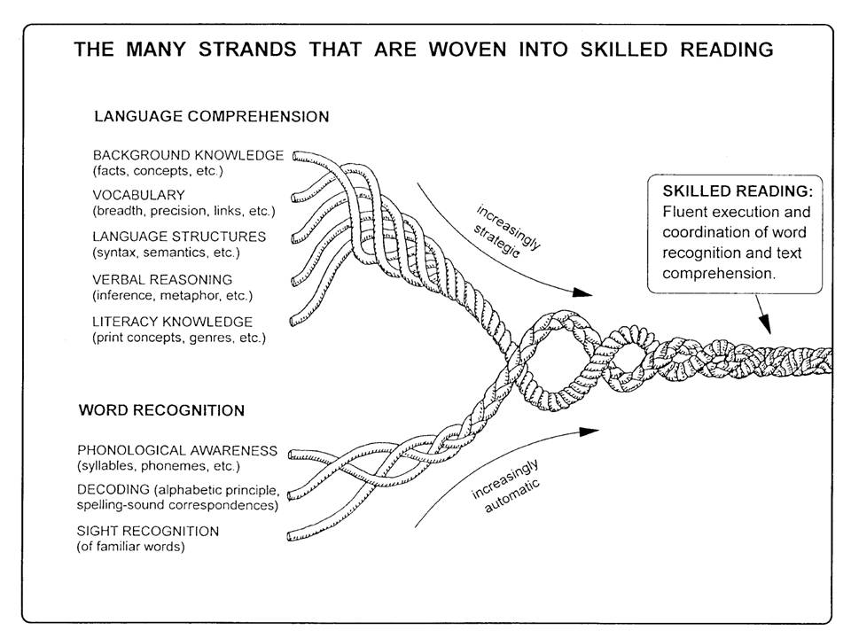

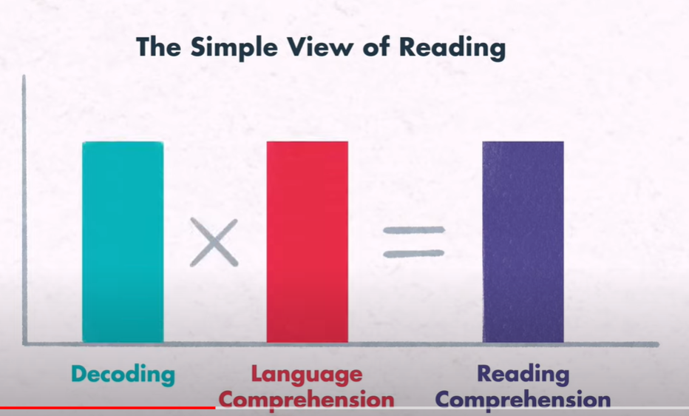
Scarborough's Reading Rope
Simple View of Reading
Notes:
https://www.youtube.com/watch?v=JR7GbAHntQ4
Scarborough’s Reading Rope - leading researcher of Early Language development- Hollis Scarborough- 2001
https://www.youtube.com/watch?v=QtDEMHMRd8E
Gough and Tunmer’s model explains that reading comprehension is a product of decoding and language comprehension, both of which are necessary.- 1996

Slide 8
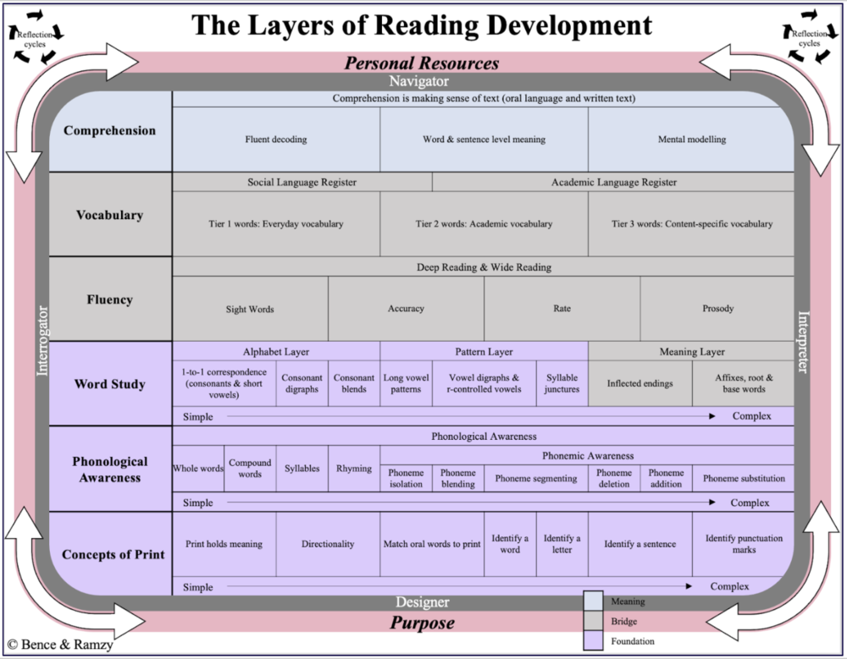

Upcoming Learning Opportunity
Aligning the Layers of Reading with the New Curriculum

Slide 9
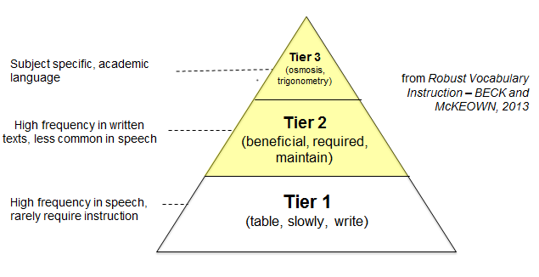
VOCABULARY
Routine Word Play Activities
Word Walls, Sound Walls & Anchor Charts
Mentor Texts
Morphology
Explicit Instruction
Notes:
Explicit instruction (Vocabulary Activities Fancy Nancy) https://drive.google.com/file/d/16OOYsYHVTj77vjyamflKxSr-zJMks2hx/view?usp=sharing
Books with Big Words (Mentor Texts Pinterest List) https://www.pinterest.ca/anitakeppinger/vocabulary-books-with-big-words/
Transitioning from Word Walls to Sound Walls https://www.readingrockets.org/article/transitioning-word-walls-sound-walls
What Morphology Instruction Should Look Like https://www.readingrockets.org/blogs/shanahan-literacy/what-should-morphology-instruction-look

