Slide 1



PHONOLOGICAL
AWARENESS
English
Language Arts
& Literature

Slide 2
Lana Lane
Charlie Kraig
Learning
Network
Educational
Services
You can connect with me at:
lana2lane@gmail.com
You can connect with me at:
teacherkraig@gmail.com
charlie.kraig@arpdc.ab.ca

Slide 3
Using this Slide Deck
You will find resources to support this area of literacy instruction linked in the slides and in the speaker notes.
It is the teacher’s responsibility to align resources with their students’ needs and curriculum expectations.
If you have questions, please contact your local consortia office.
This is not a comprehensive list of resources; rather, it is a place to get you started for quality instructional practices.

Slide 4
Organizing Idea | K | 1 | 2 | 3 | 4 | 5 | 6
Text Forms & Structures
Oral Language
Vocabulary
Phonological Awareness
Phonics
Fluency
Comprehension
Writing
Conventions
Notes:
Organizing ideas throughout the grades.

Slide 5
Organizing Idea (from Curriculum) | Pillars of Reading
Text Forms & Structures | Writing/ Comprehension
Oral Language | Fluency/ Vocabulary
Vocabulary | Vocabulary
Phonological Awareness | Phonological Awareness
Phonics | Phonics
Fluency | Fluency
Comprehension | Comprehension
Writing | Writing
Conventions | Writing/ Fluency

Slide 6
PHONOLOGICAL AWARENESS is the umbrella term that includes everything from rhyming and sentence segmentation to phonemic awareness- the sounds
of ORAL LANGUAGE.
It does not include PHONICS but phonics builds upon phonemic awareness.
Notes:
Phonological Awareness Lessons and Continuum https://sites.google.com/arpdc.ab.ca/supporting-intervention-instru/literacy-support/teacher-led-interventions?authuser=0

Slide 7
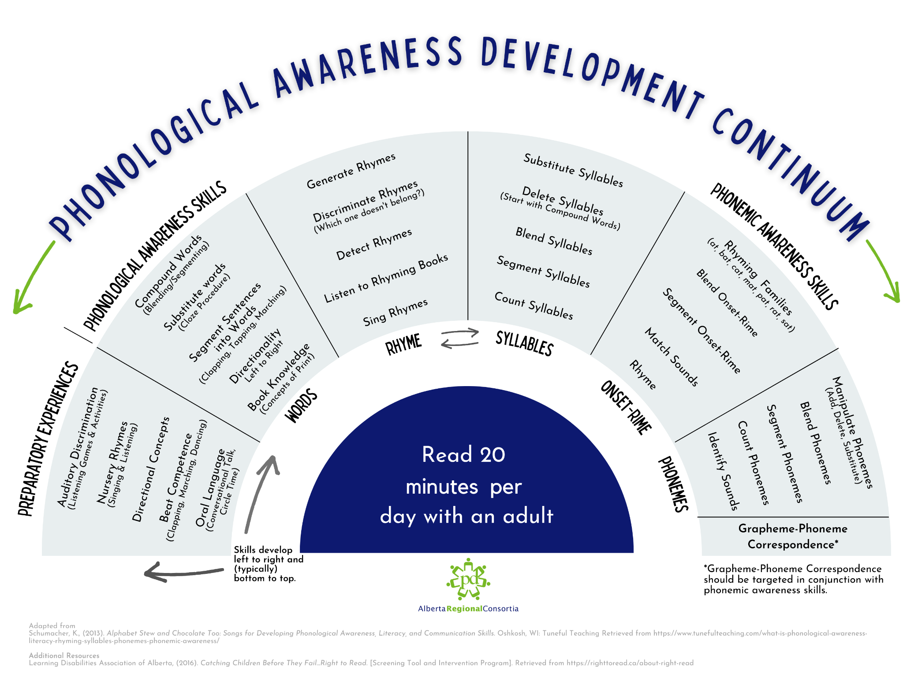
Notes:
PDF of continuum https://drive.google.com/file/d/1j6kOKWJ6oAp1masji5LZY3NHhb6nfQb1/view

Slide 8
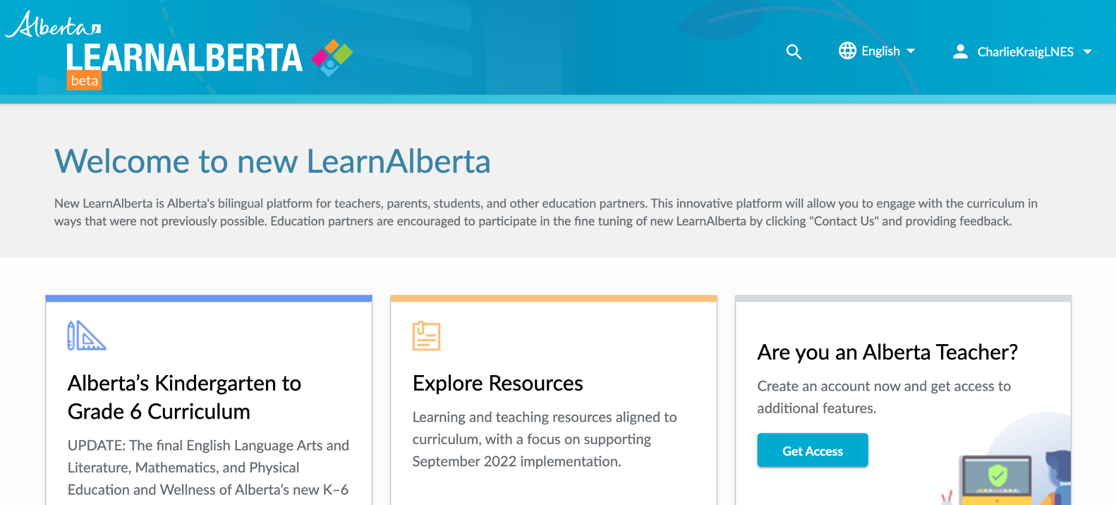
Can you identify learning outcomes with a
Phonological Awareness focus?
What skills & abilities (KUSPs) support the outcomes?
Aug. 2022- Curriculum- Phonological Awareness Skills & Abilities

Slide 9
Key Assessments for the support of Phonological Awareness.
Phonological Awareness Resources

Slide 10

Phonological Awareness Classroom Practices
READ
ALOUDS
2 or 3 per day
NURSERY RHYMES
daily structure
ELKONIN
Sound Boxes
PHONOLOGICAL AWARENESS
15 mins.
DAILY
SYL*LA*BI*CA*TION*

